Slide 1
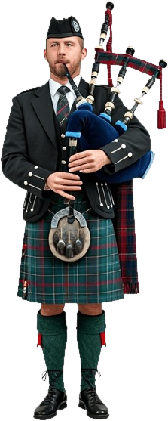

Slide 3


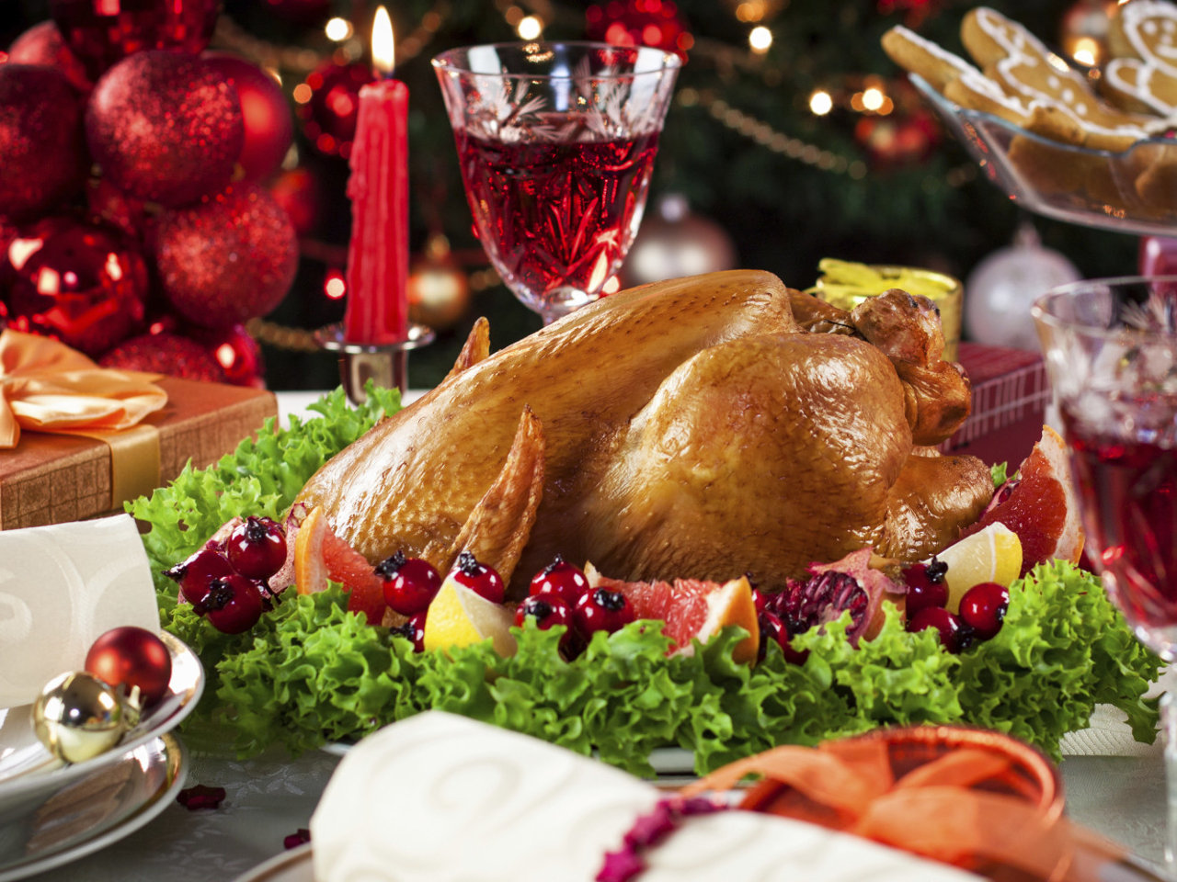


Slide 4
?

Slide 5
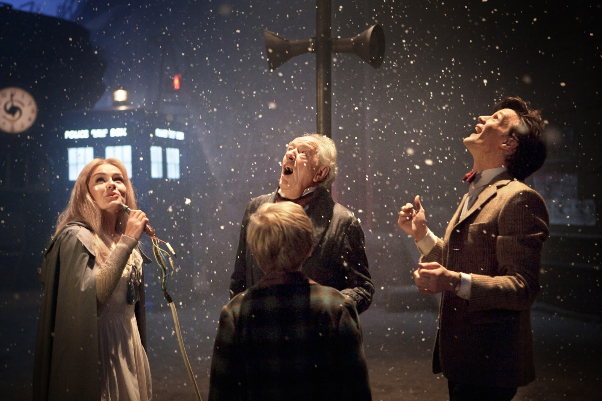
Doctor Who: A Christmas Carol
XXX Doctor Who A Christmas Carol

Slide 6
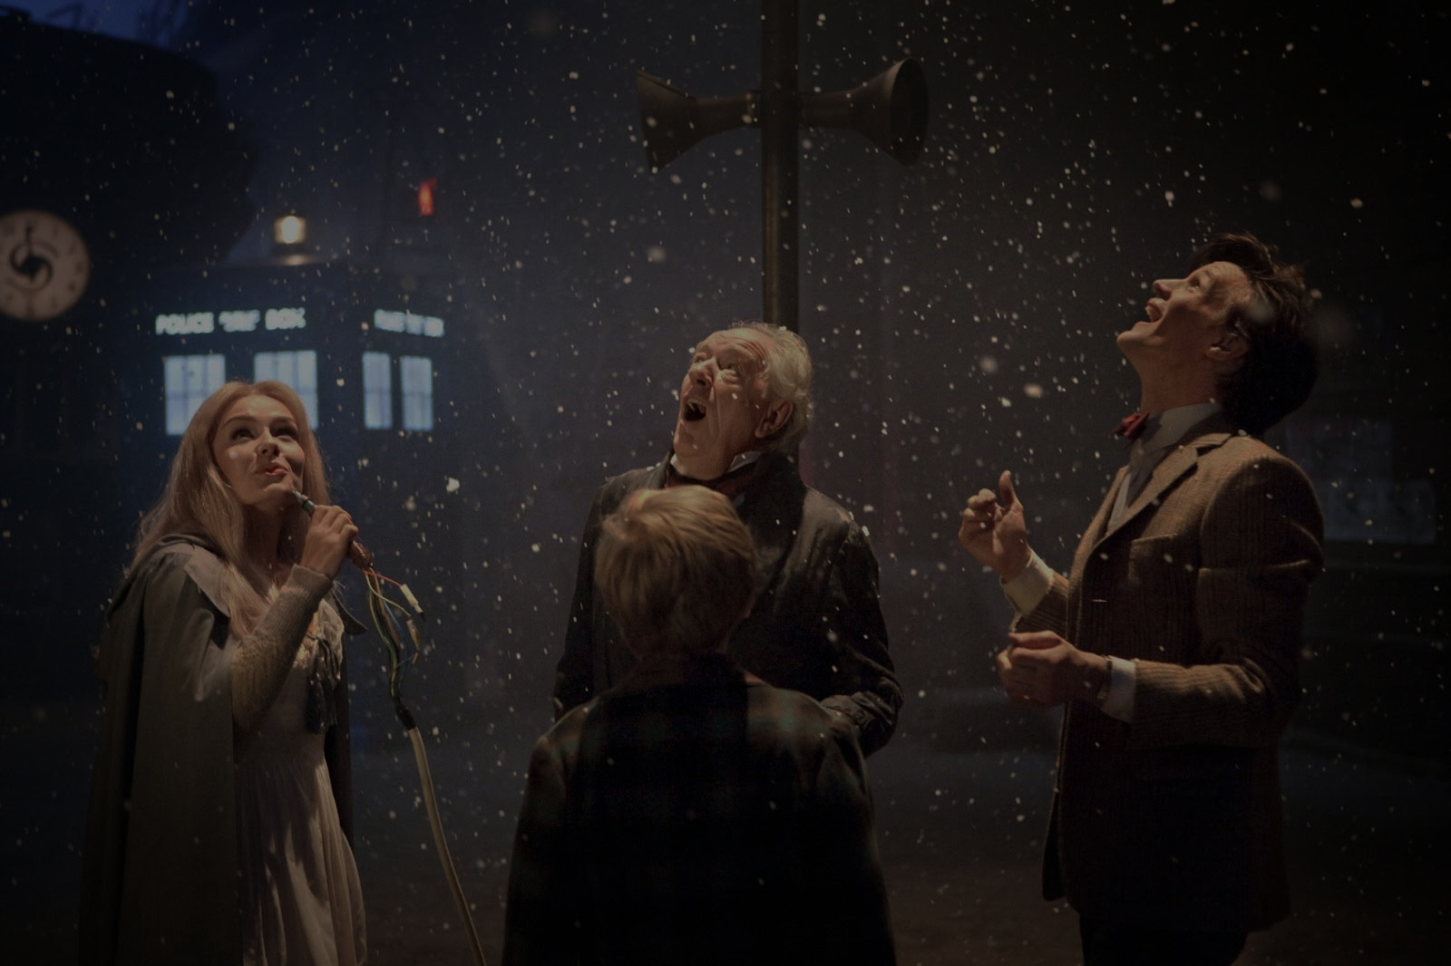
“On every world, wherever people are, in the deepest
part of the winter, at the exact mid-point, everybody
stops and turns and hugs, as if to say, well done. Well
done, everyone. We’re halfway out of the dark.
Back on Earth, we called this Christmas.”
XXX Doctor Who A Christmas Carol

Slide 7
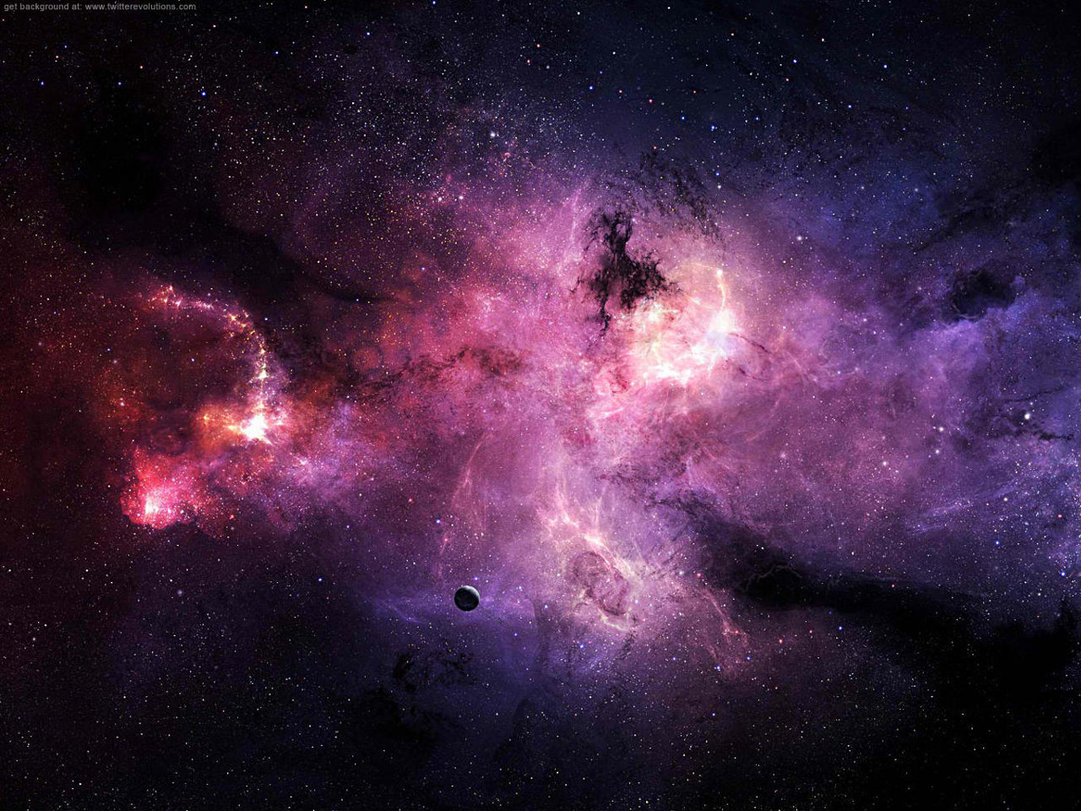

Slide 8
Lift up your eyes and look to the heavens:
Who created all these?
He who brings out the starry host one by one
and calls forth each of them by name.
— Isaiah 40:26.

Slide 9
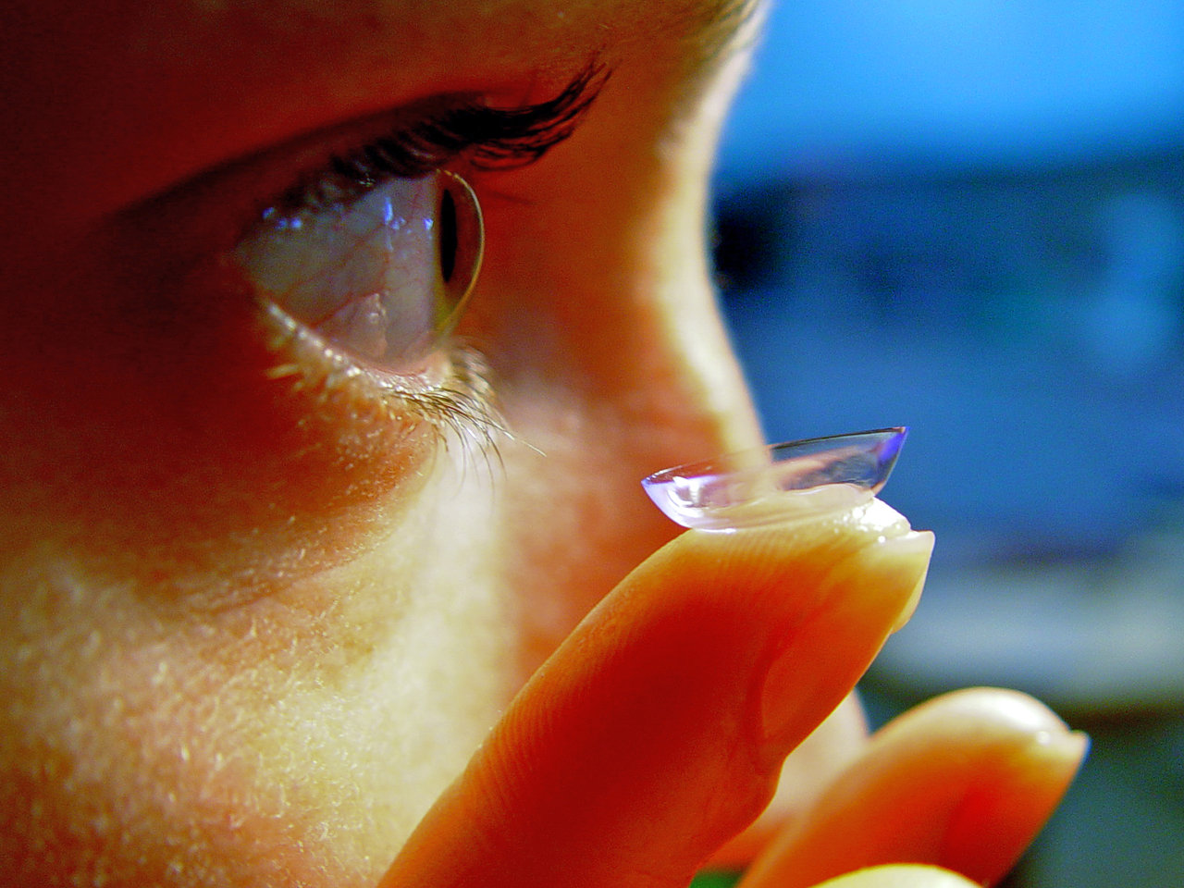

Slide 10
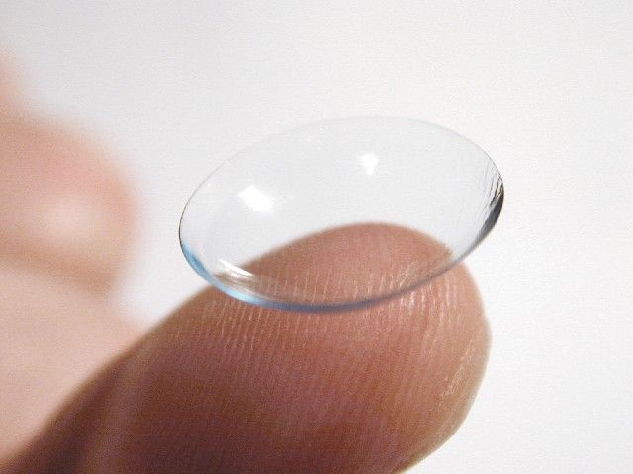

Slide 11
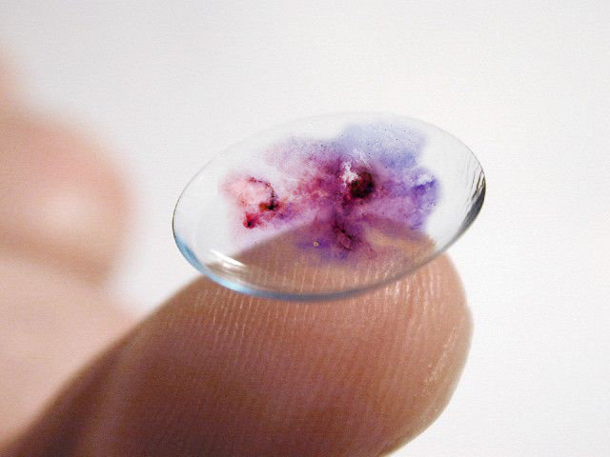

Slide 12
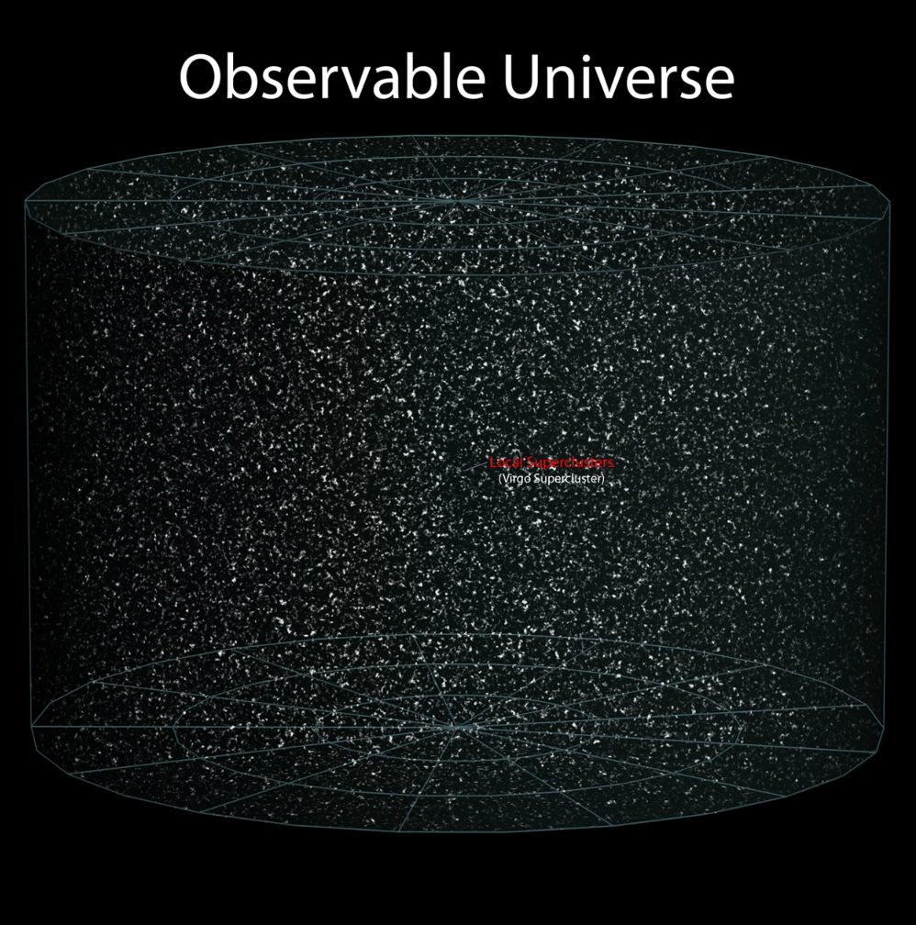
http://chonkix.tumblr.com/you_are_here

Slide 13
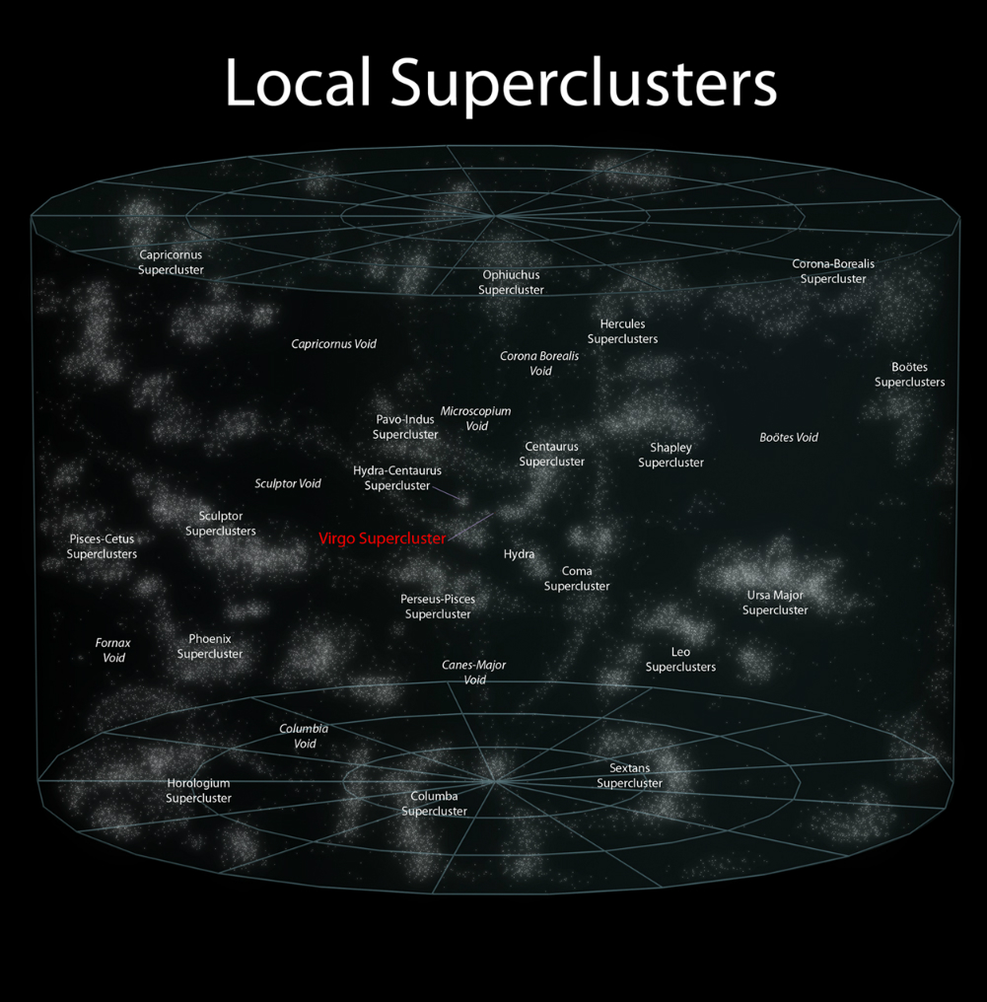

Slide 14
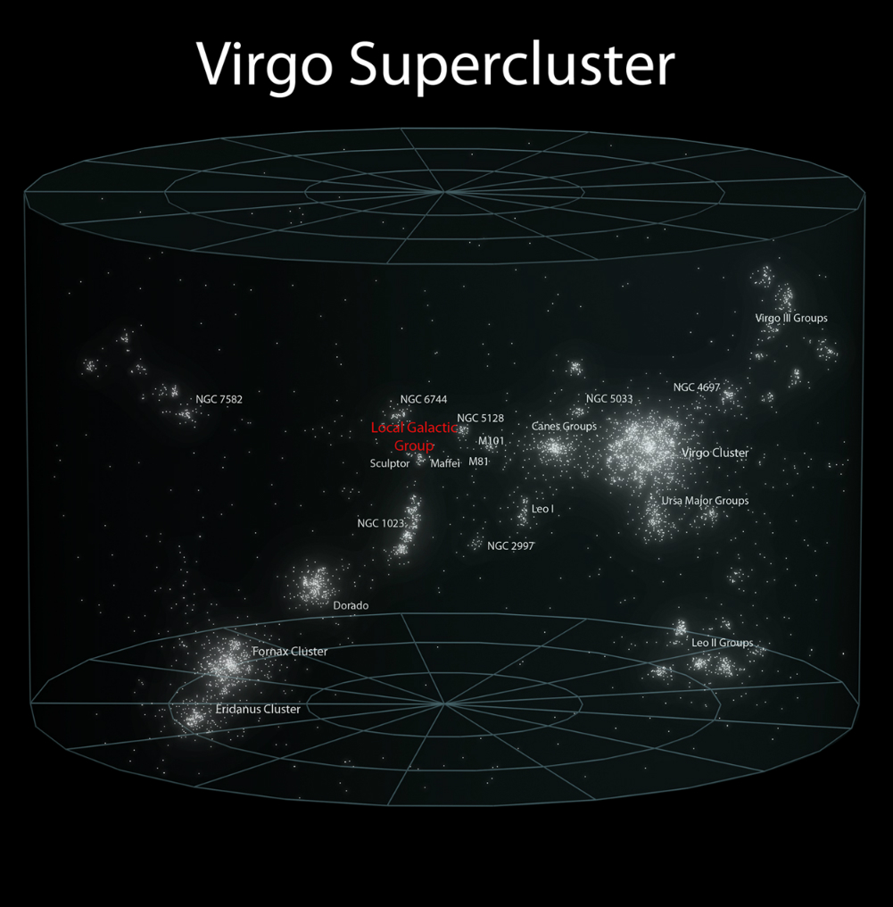

Slide 15
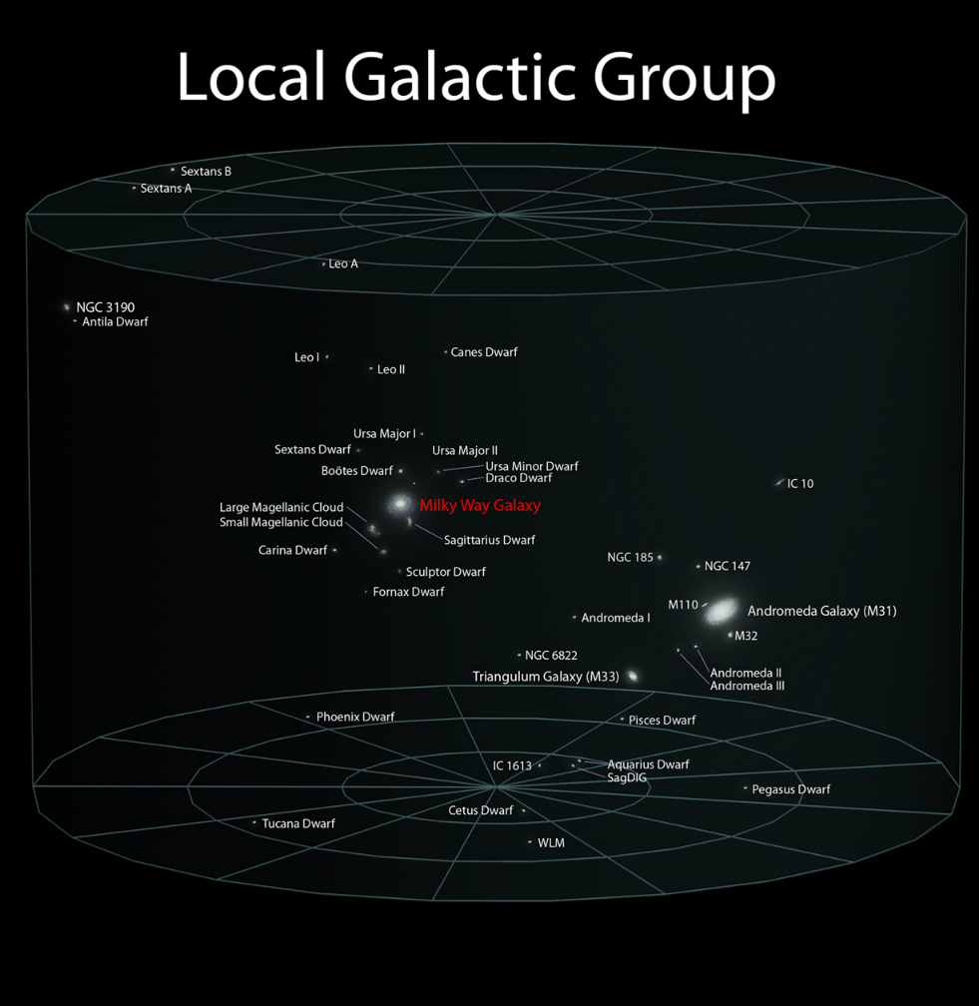

Slide 16
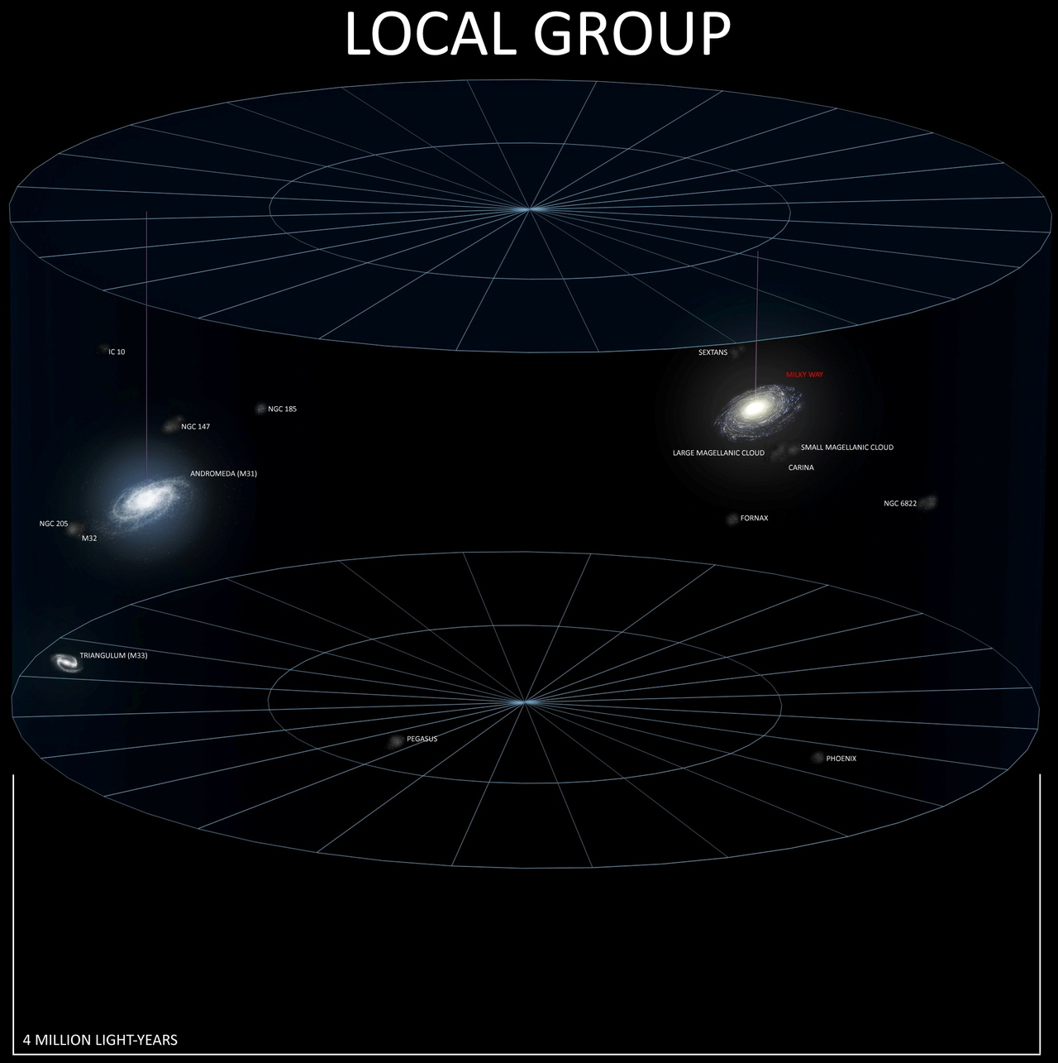

Slide 17
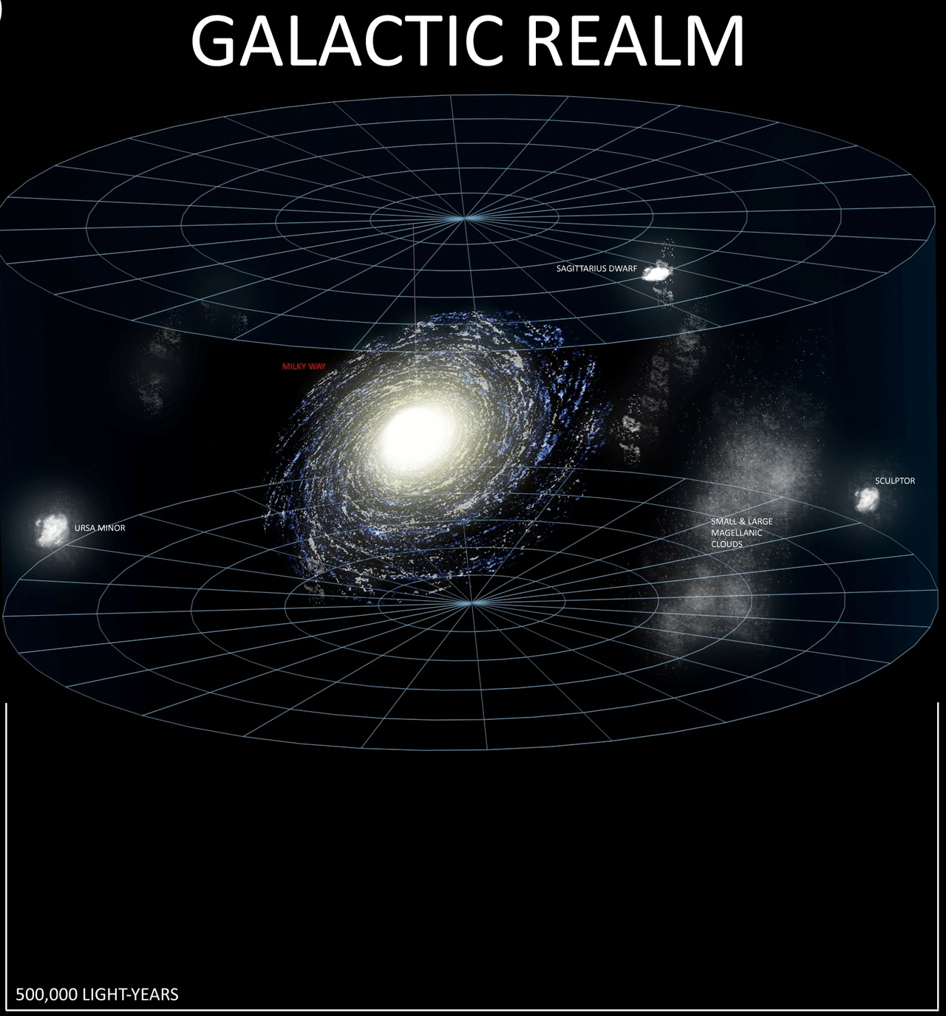

Slide 18
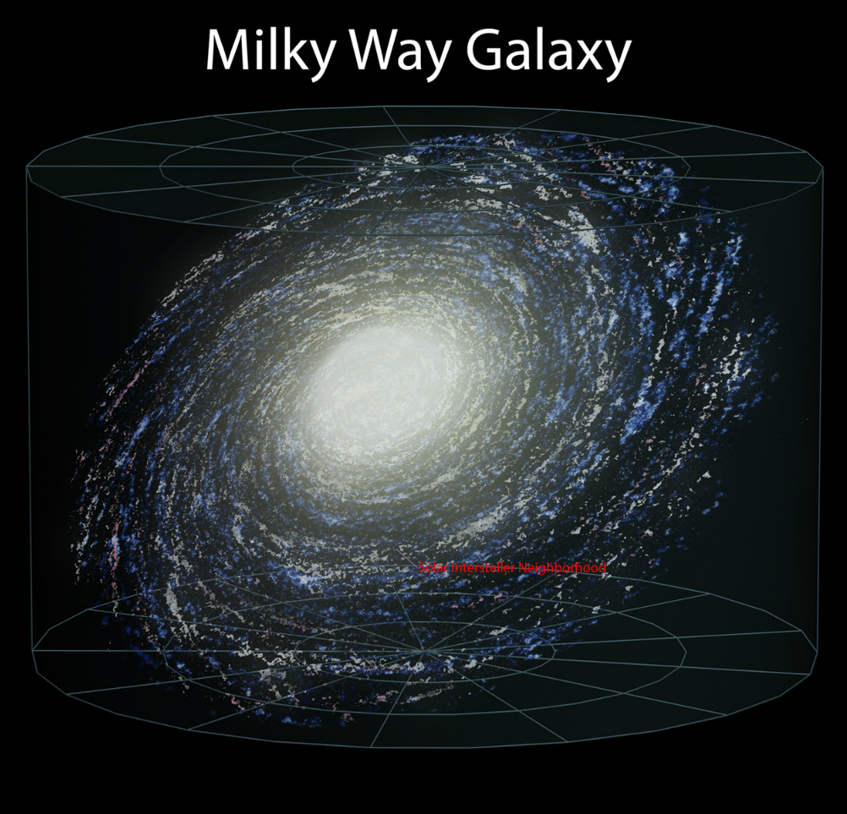

Slide 19
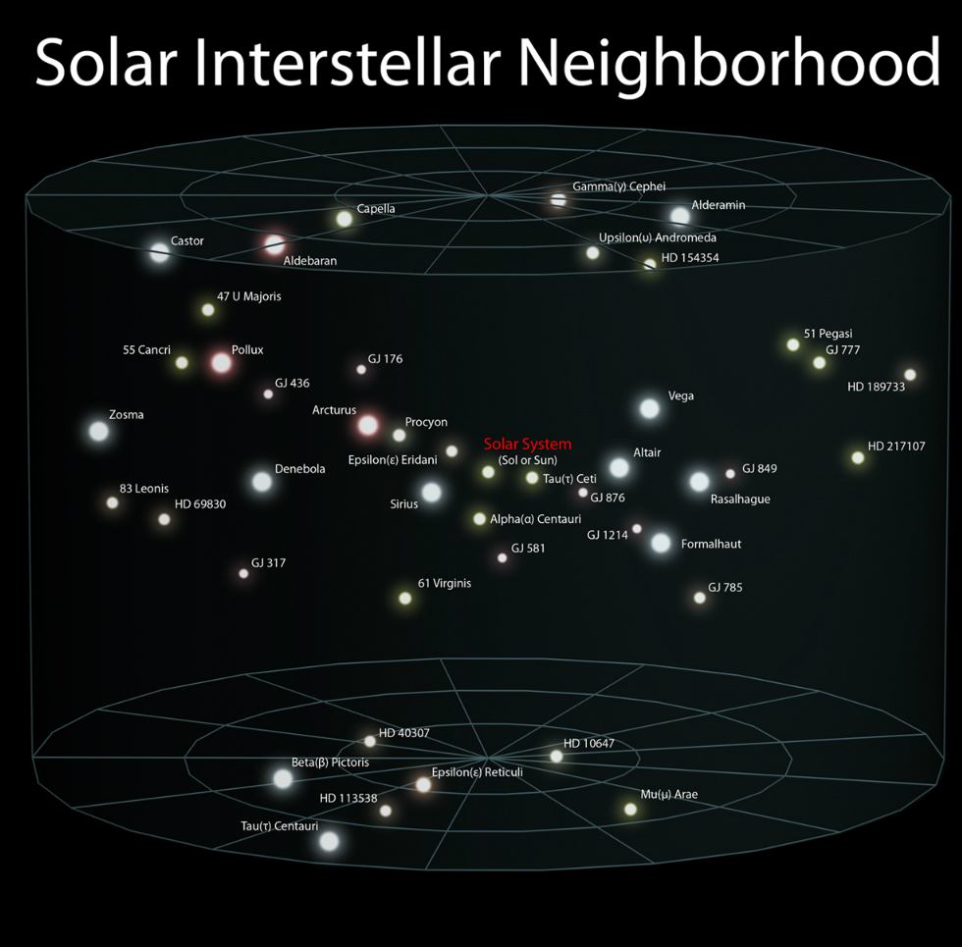

Slide 20
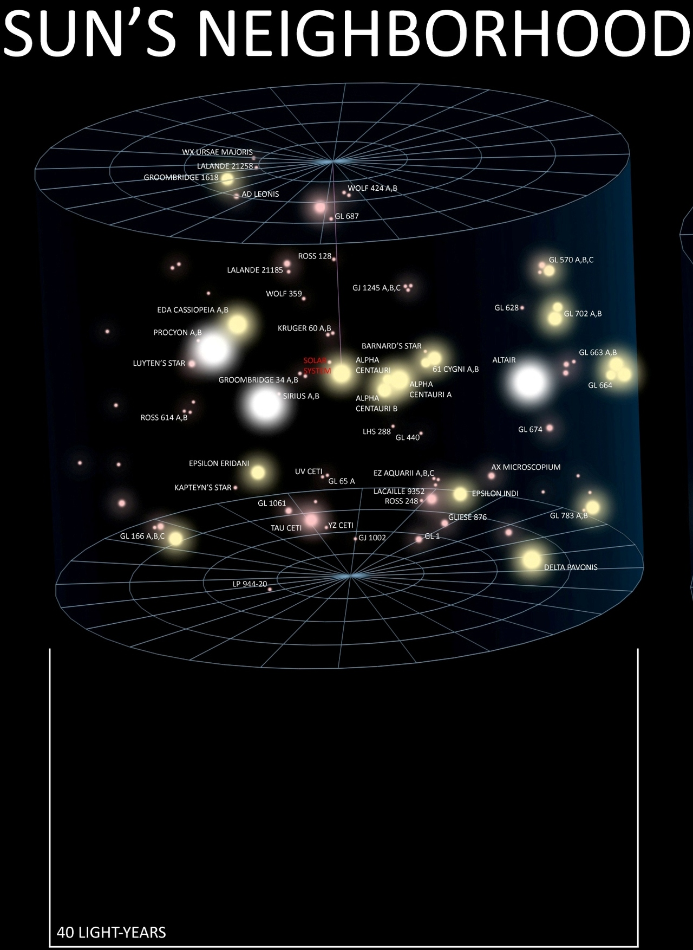

Slide 21
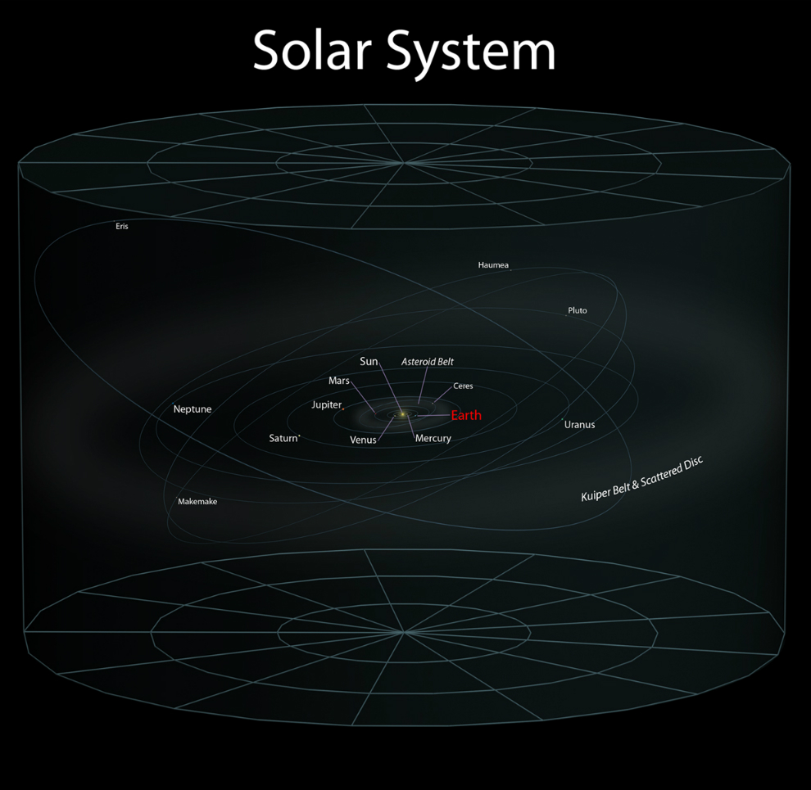

Slide 22
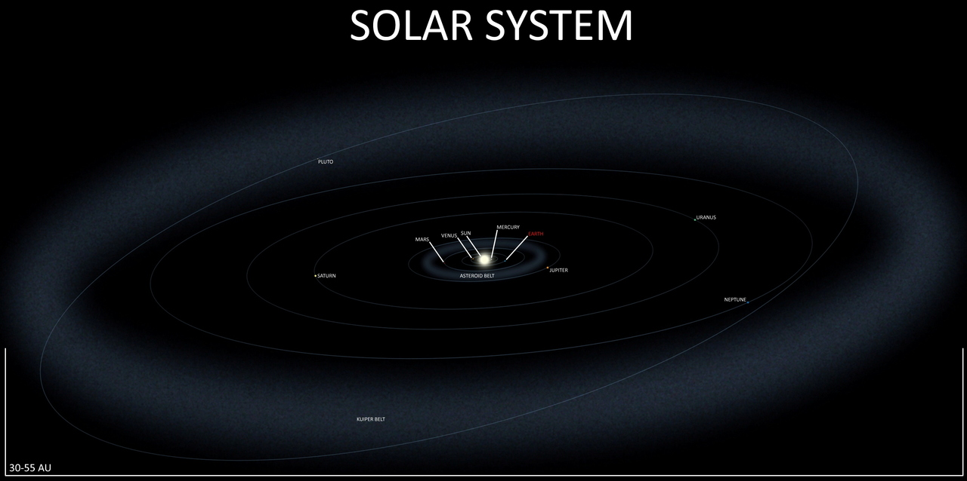

Slide 23
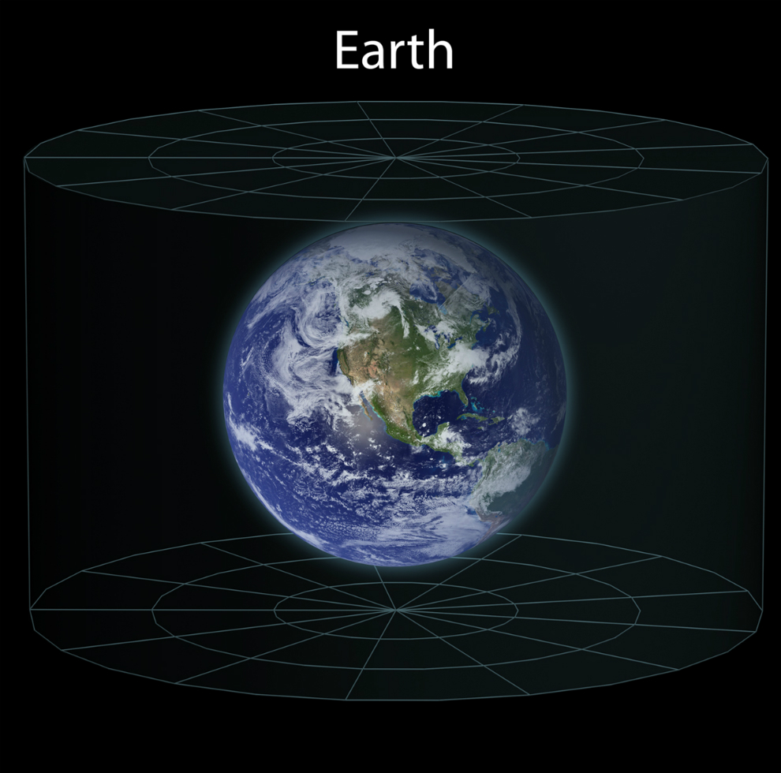

Slide 24
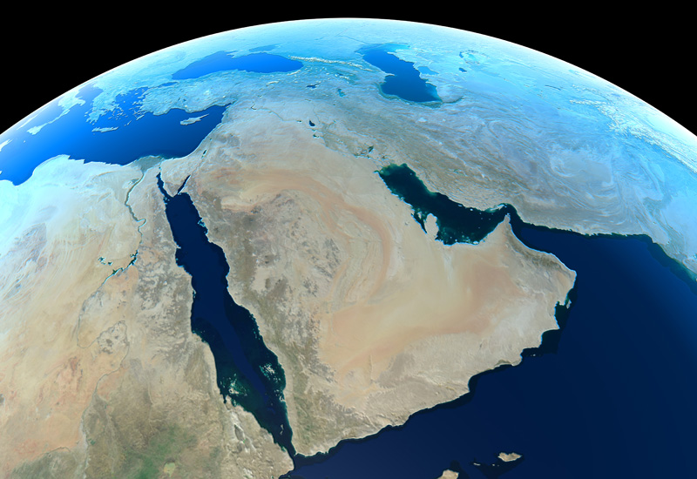

Slide 25
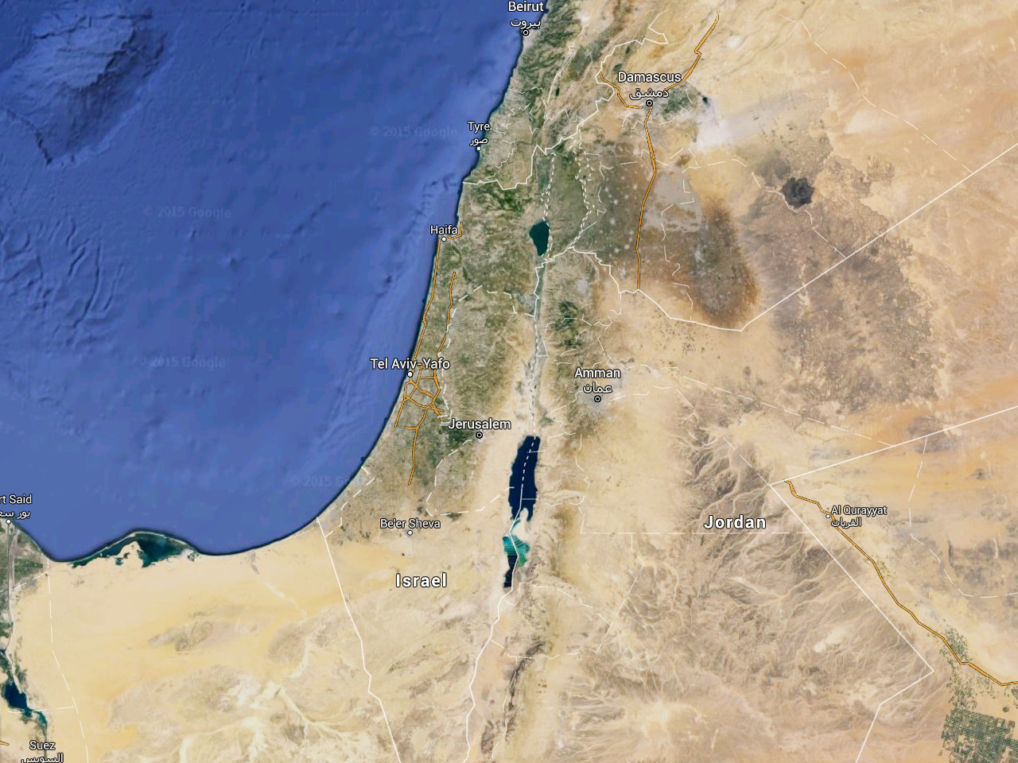

Slide 26
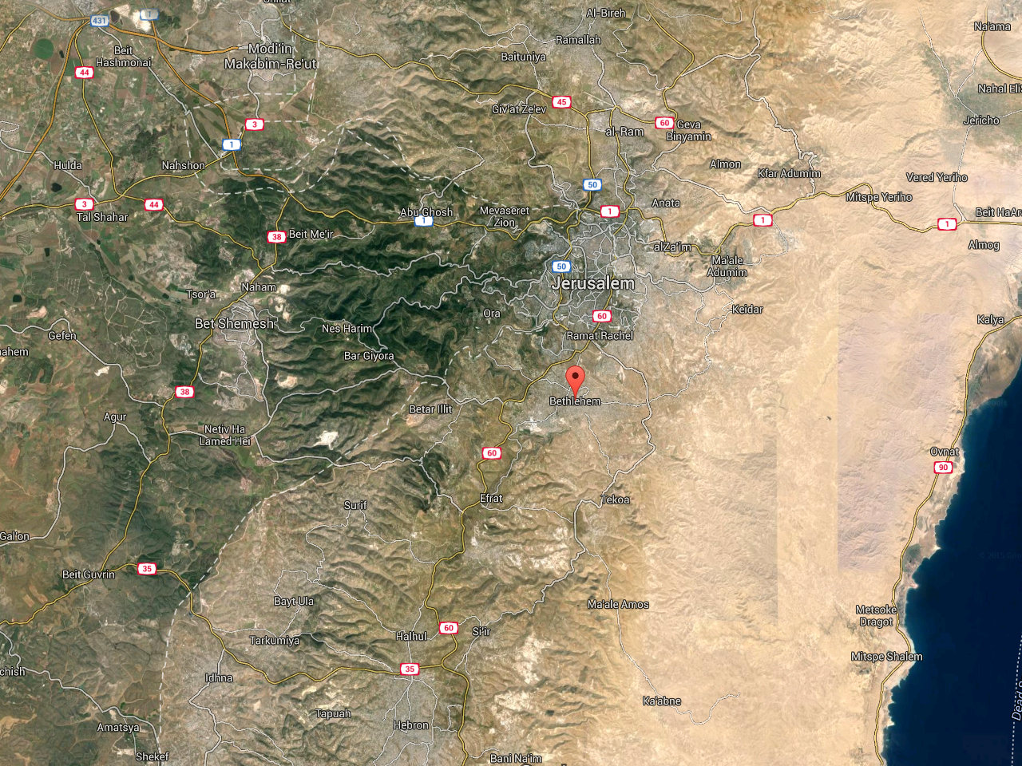

Slide 27
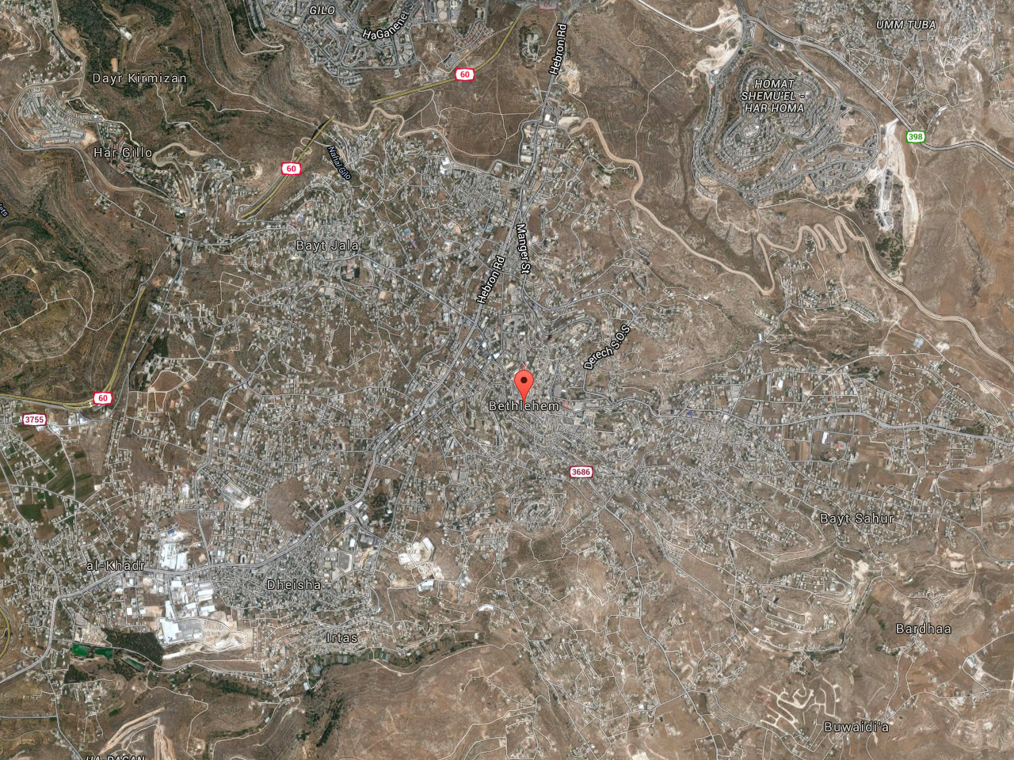

Slide 28
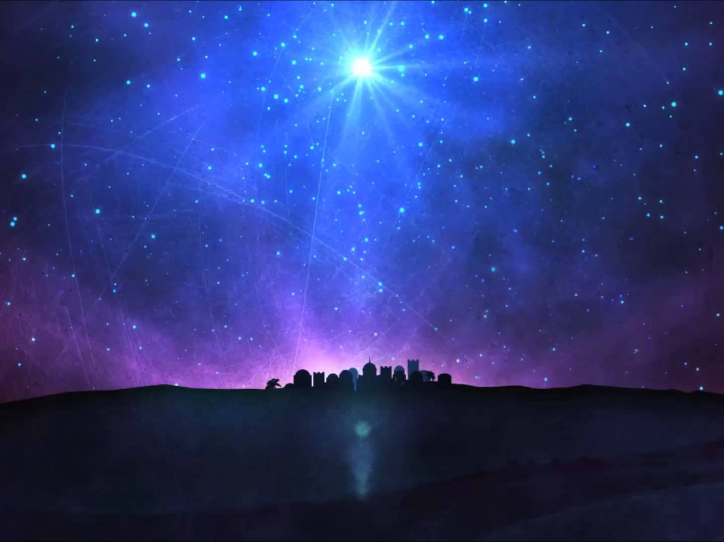

Slide 29
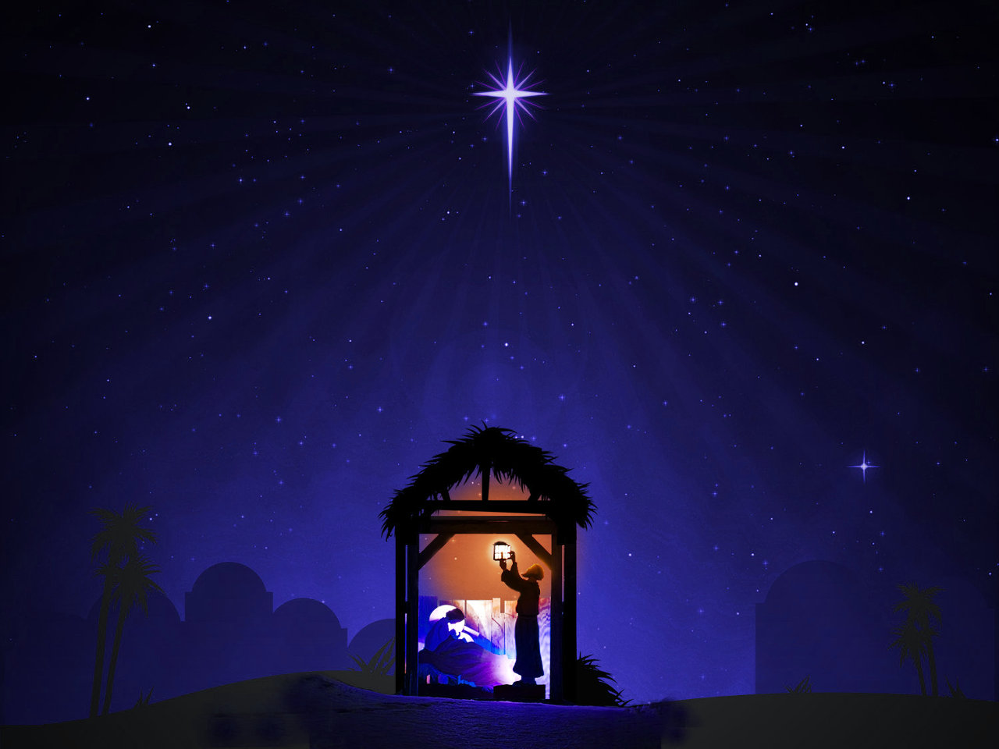

Slide 30
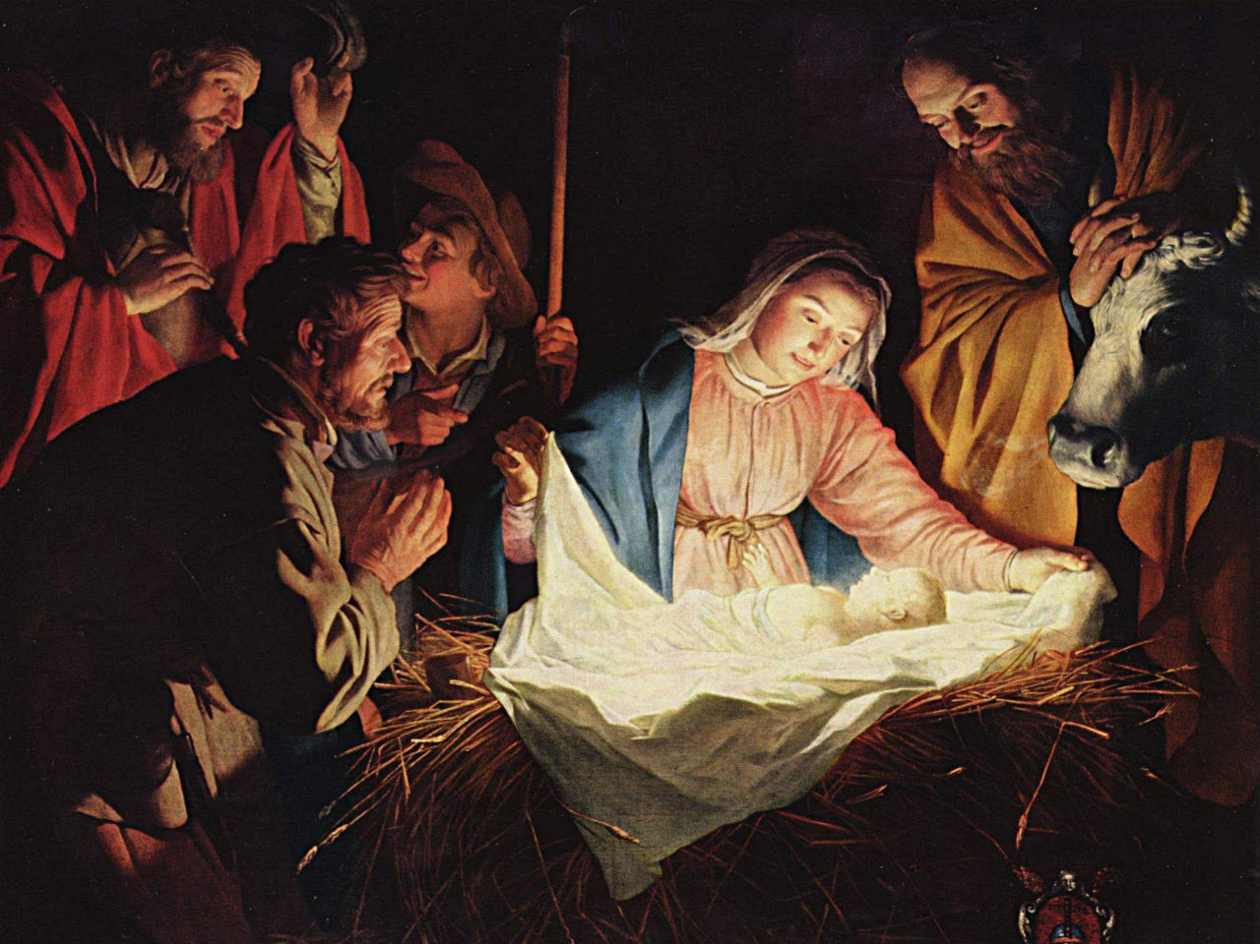

Slide 31
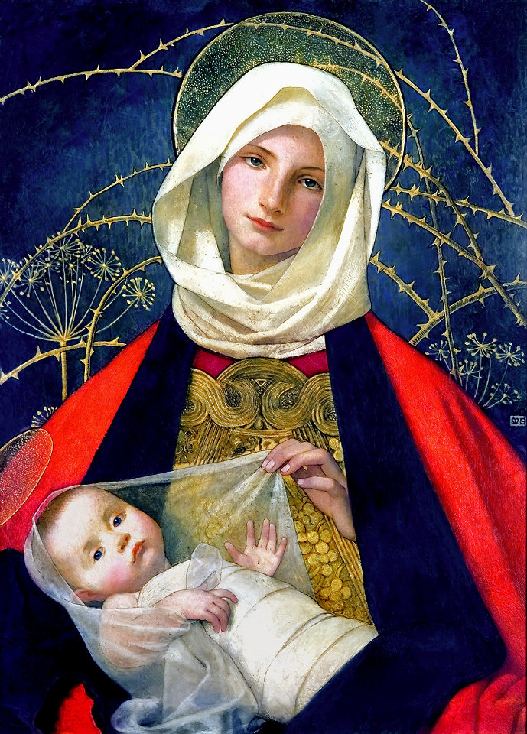

Slide 32
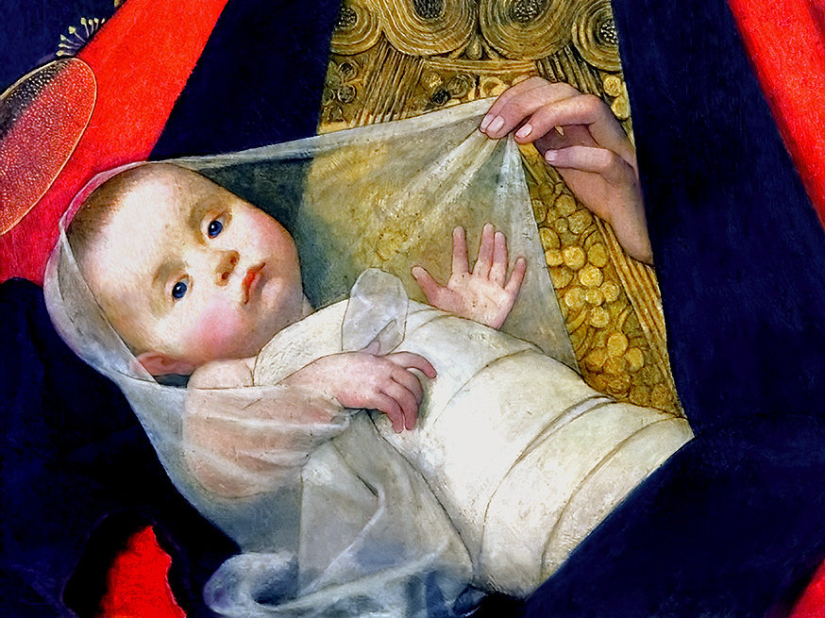

Slide 35
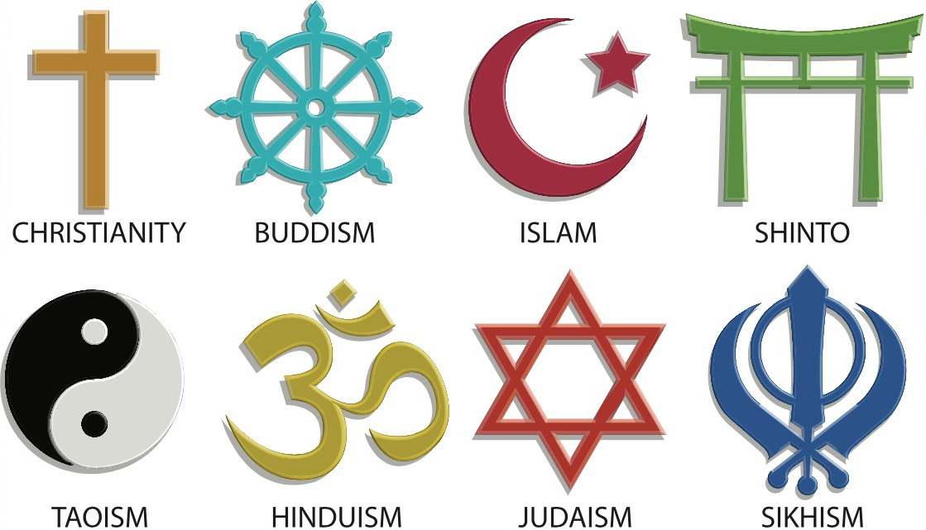

Slide 36
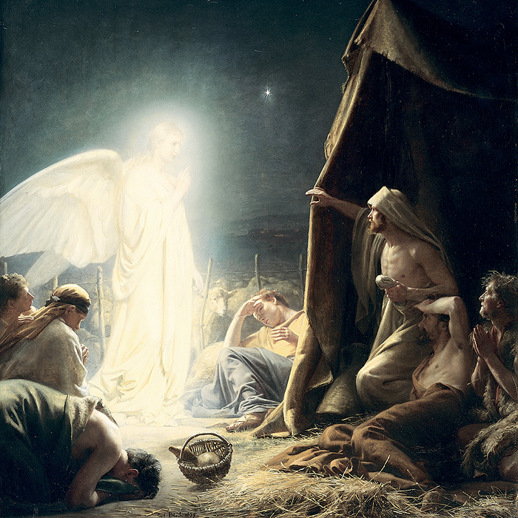
Even angels long to
look into these things.
— 1 Peter 1:12b

Slide 37
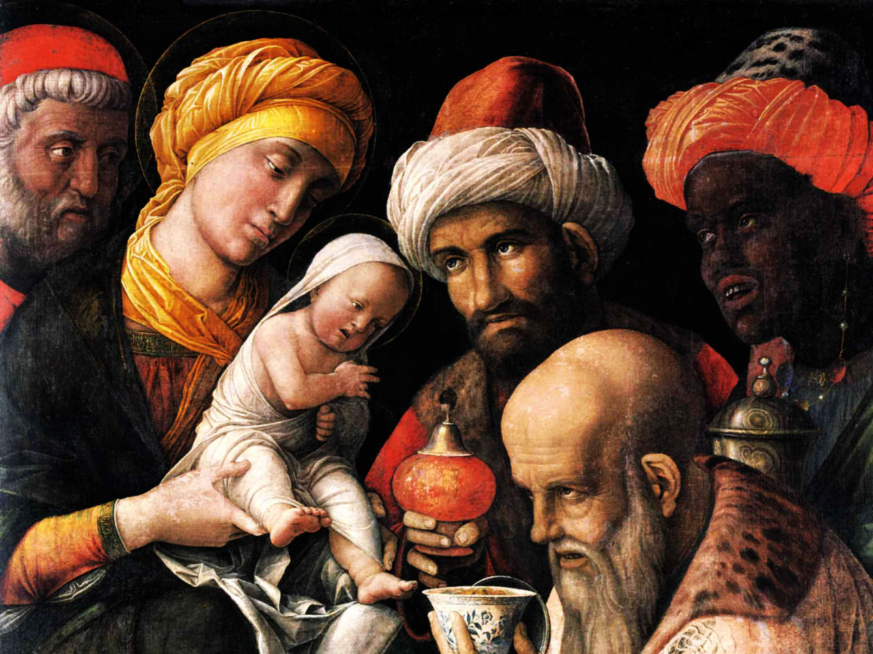

Slide 38
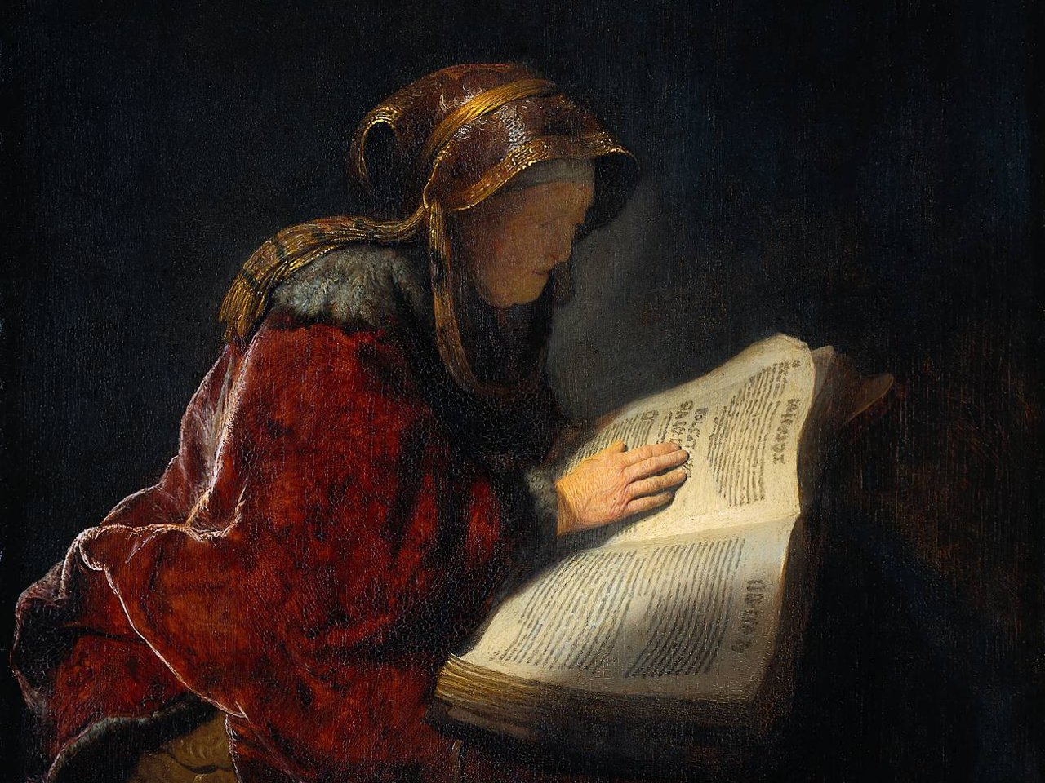
Concerning this salvation,
the prophets, who spoke
of the grace that was
to come to you,
searched intently
and with the
greatest care.
— 1 Peter 1:10

Slide 39
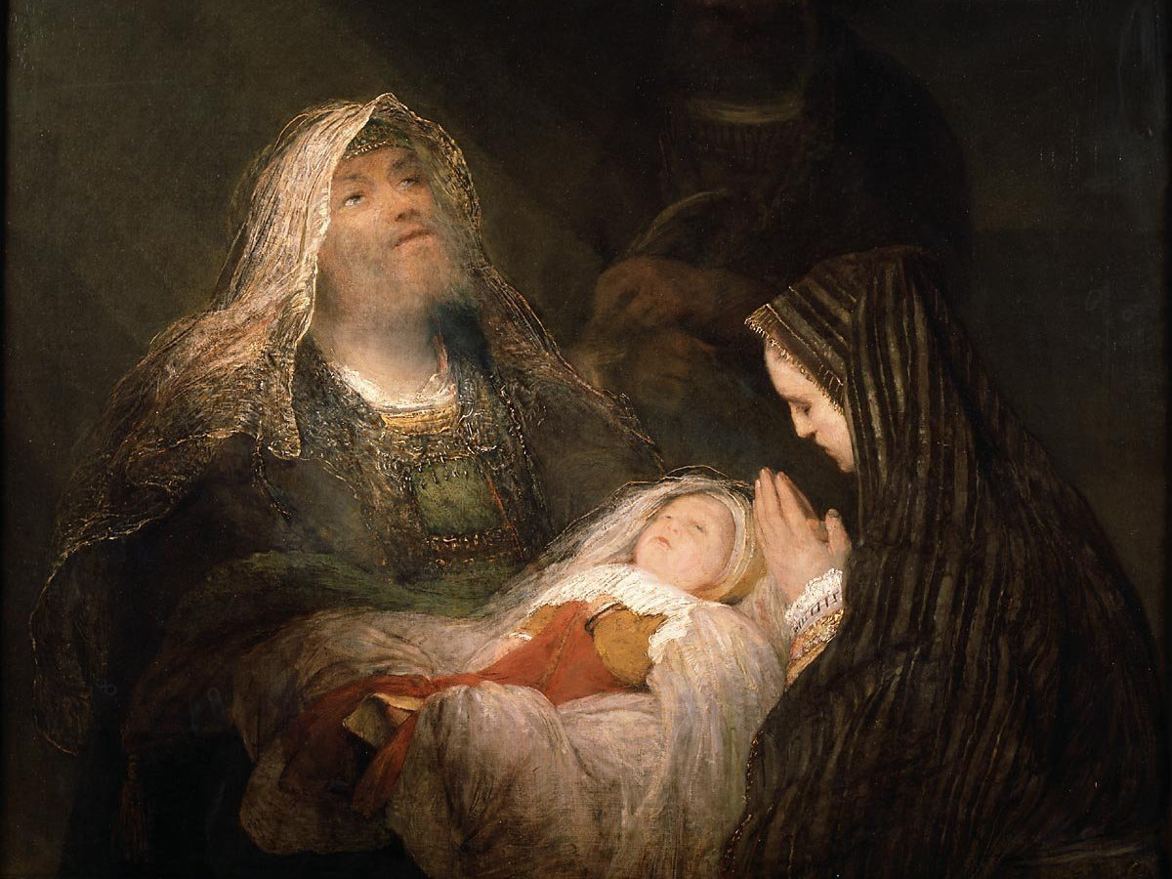
“Sovereign Lord, as you
have promised, now dismiss
your servant in peace.”
— Luke 2:29.

Slide 40
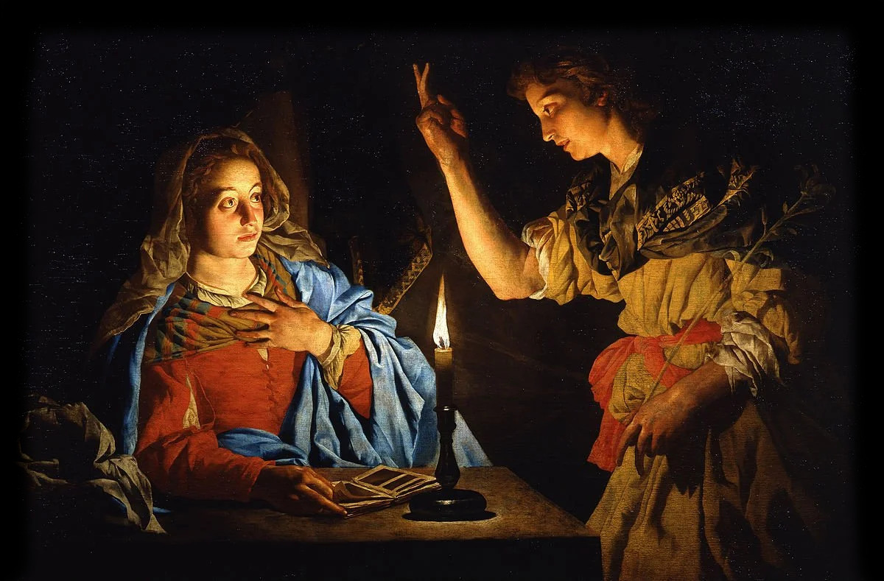
“You will conceive and give birth to a son, and you are
to call him Jesus. He will be great and will be called
the Son of the Most High.”
“How will this be, since I am a virgin?”
— Luke 1:31–34.

Slide 42
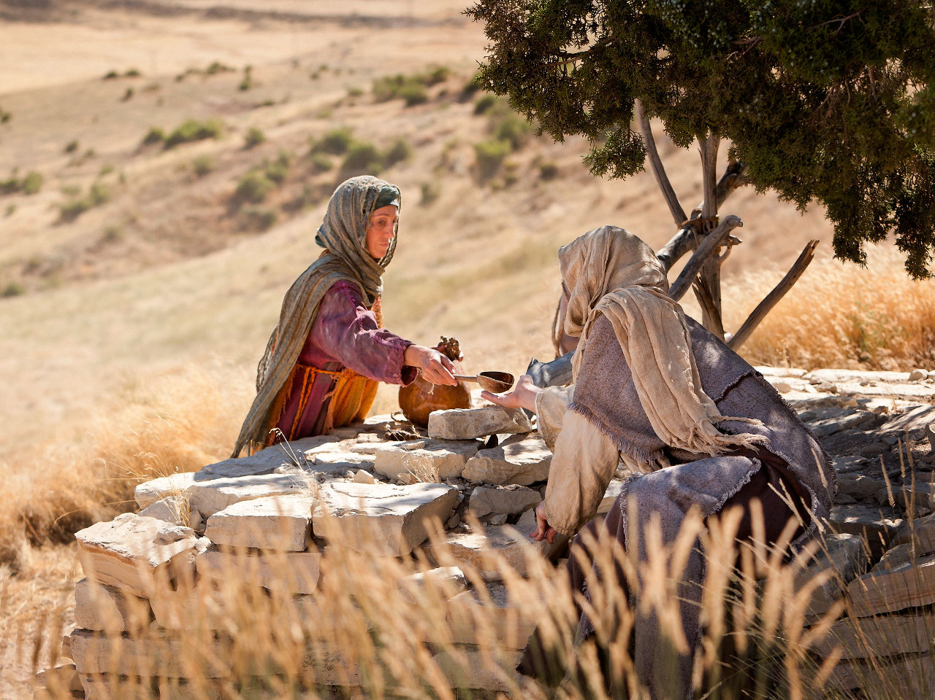
“Jesus said to her, “Will you give me a drink?”
— John 4:7

Slide 43
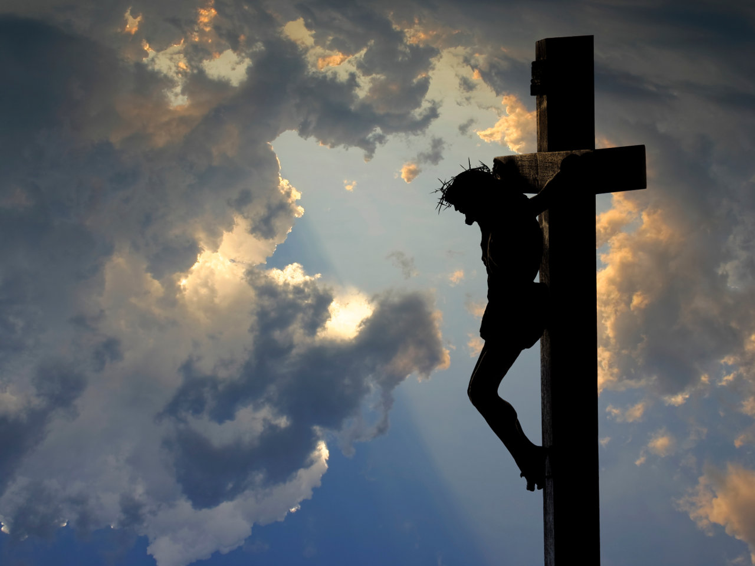

Slide 45
Our God contracted to a span,
Incomprehensibly made man.
[…]
In vain; ye angels, gaze no more,
But fall, and silently adore.
— Charles Wesley, Let Earth and Heaven Combine.

Slide 47
