Slide 1
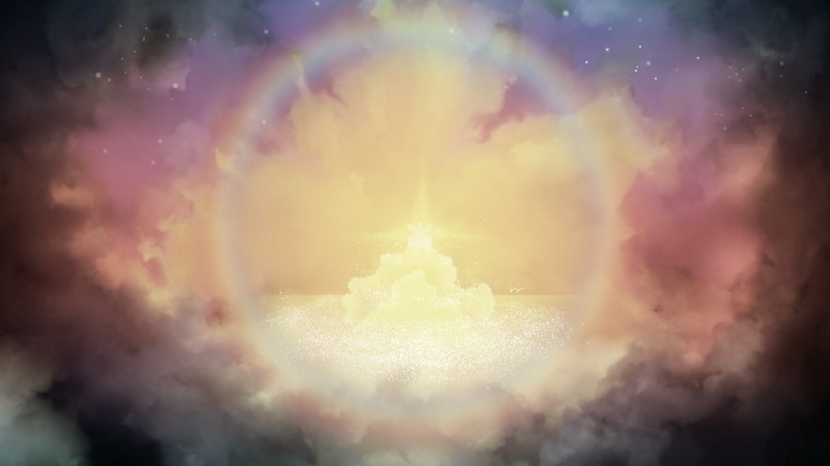
Holiness
1 Peter 1:14-16.

Slide 2
1 Peter 1:14-16.
As obedient children, do not conform to the evil desires you had when you lived in ignorance. But just as he who called you is holy, so be holy in all you do; for it is written: “Be holy, because I am holy”.

Slide 3
“Oh, no, not a talk on holiness!”
We're going to talk about two things:
1. God's holiness
2. The call for us to be holy

Slide 4
Things that we are not drawn to
When we think of what God is like:
Great
Good
Holy
We like his greatness and goodness!

Slide 5
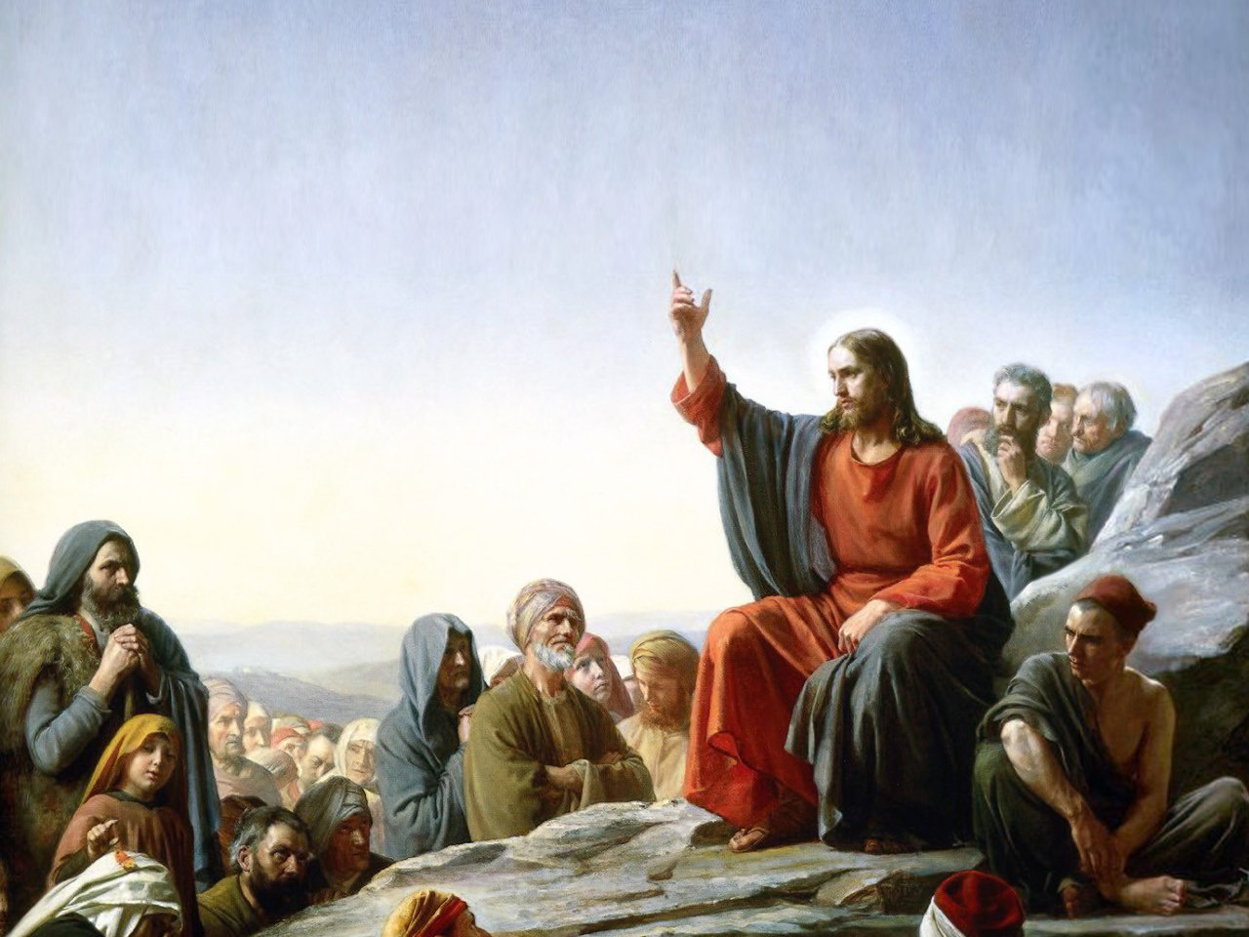
But God’s holiness is not optional
How did Jesus teach us to pray?

Slide 6
But God’s holiness is not optional
How did Jesus teach us to pray?
“Our Father,
In Heaven,
Your name is holy.”

Slide 7
But God’s holiness is not optional
How did Jesus teach us to pray?
“Our Father, God is good
In Heaven,
Your name is holy.”

Slide 8
But God’s holiness is not optional
How did Jesus teach us to pray?
“Our Father, God is good
In Heaven, God is great
Your name is holy.”

Slide 9
But God’s holiness is not optional
How did Jesus teach us to pray?
“Our Father, God is good
In Heaven, God is great
Your name is holy.” God is holy

Slide 10
Things that we are not drawn to
It might be because of our own immaturity.
Children don't like:
the spiciness of curry
the bitterness of beer
the texture of smoked salmon

Slide 11
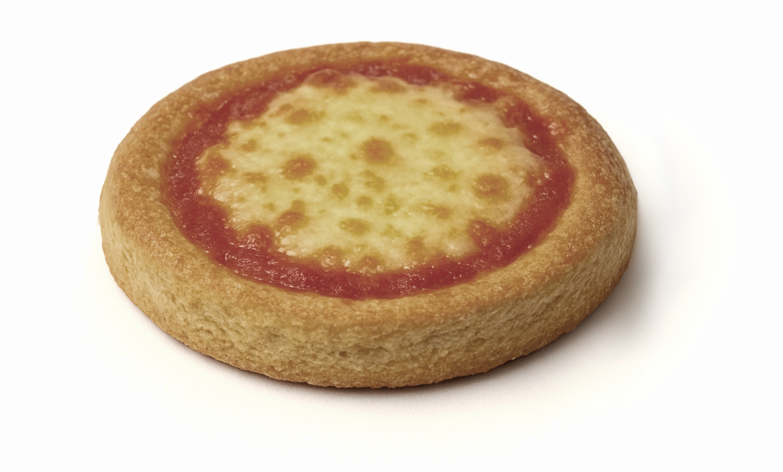
Things that we are not drawn to
It might be because we were shown a pale imitation.
My first pizza (school dinners)

Slide 12
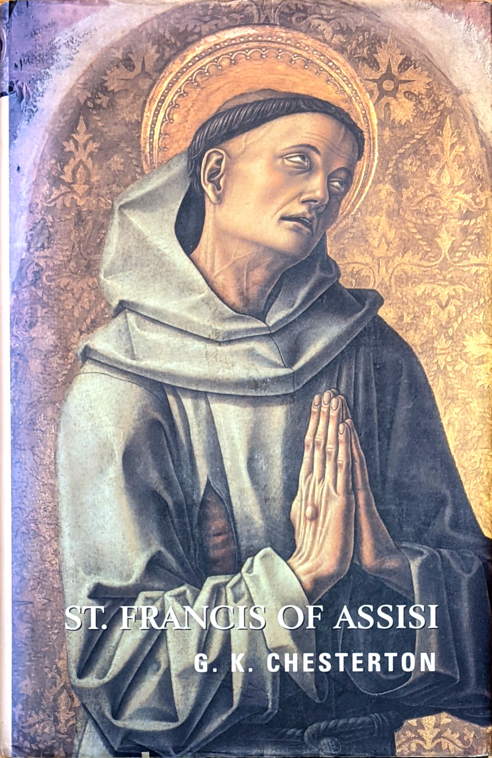
Things that
we are not
drawn to
No-one wants
to live the
self-denying life
of a monk or nun.

Slide 13
Growing to love these things

Slide 14
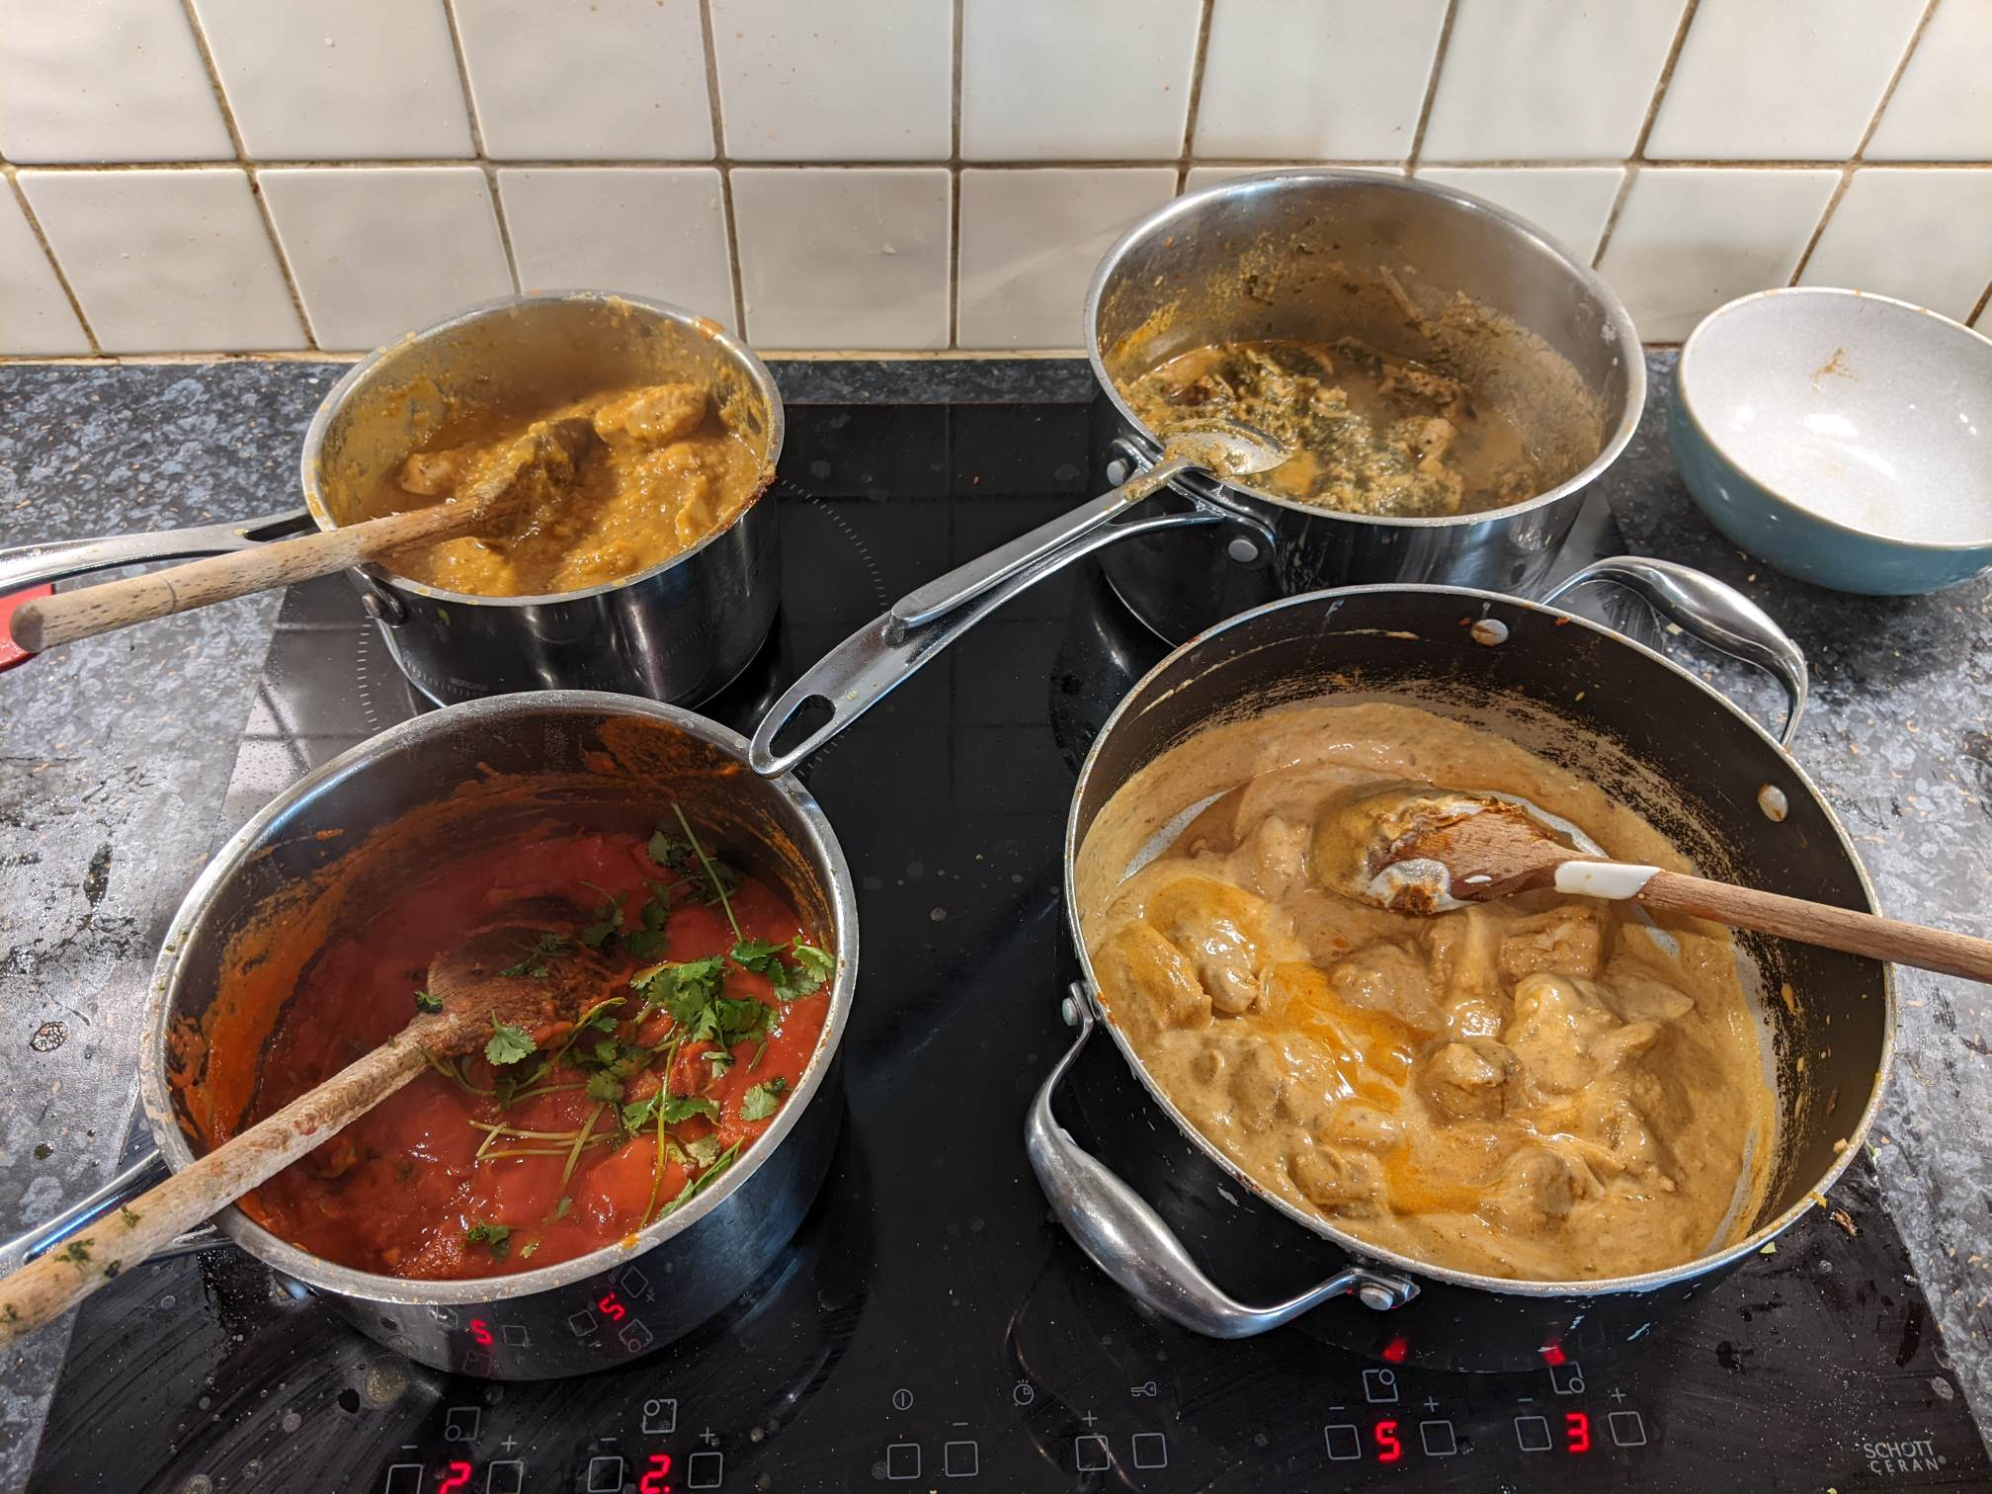
Growing to love these things
I didn't like curry because I was immature.
As I have grown up, I have come to love it.

Slide 15
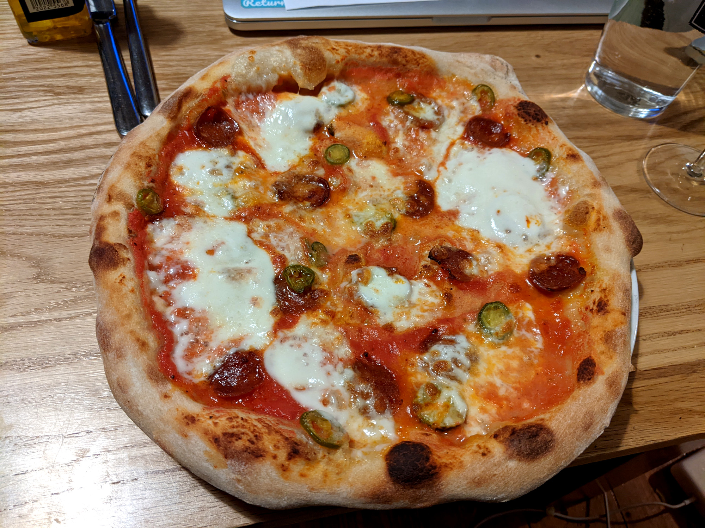
Growing to love these things
I didn't like pizza because
I'd never seen the real thing

Slide 16
Growing to love these things
Similarly, as we grow in Christian maturity:
We develop a mature taste

Slide 17
Growing to love these things
Similarly, as we grow in Christian maturity:
We see things in their proper form

Slide 18
Growing to love these things
Similarly, as we grow in Christian maturity:
We see things in their proper form

Slide 19
What holiness is not
We usually think of holiness as self denial:
Vows of poverty
Vows of chastity
Hair shirts
Lists of things we're
not allowed to do
Disapproving

Slide 20
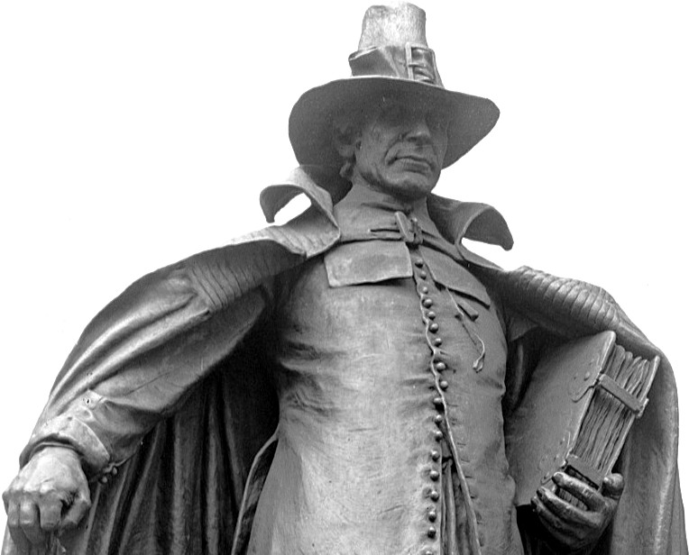
“Puritanism”

Slide 21
“Puritanism”
“Puritanism: The haunting fear that someone, somewhere, may be happy.”
— H. L. Mencken.

Slide 22
“Puritanism”
“Puritanism: The haunting fear that someone, somewhere, may be happy.”
— H. L. Mencken.
“At the bottom of Puritanism one
finds envy of the fellow who is
having a better time in the world,
and hence hatred of him.”
— Also H. L. Mencken.

Slide 23
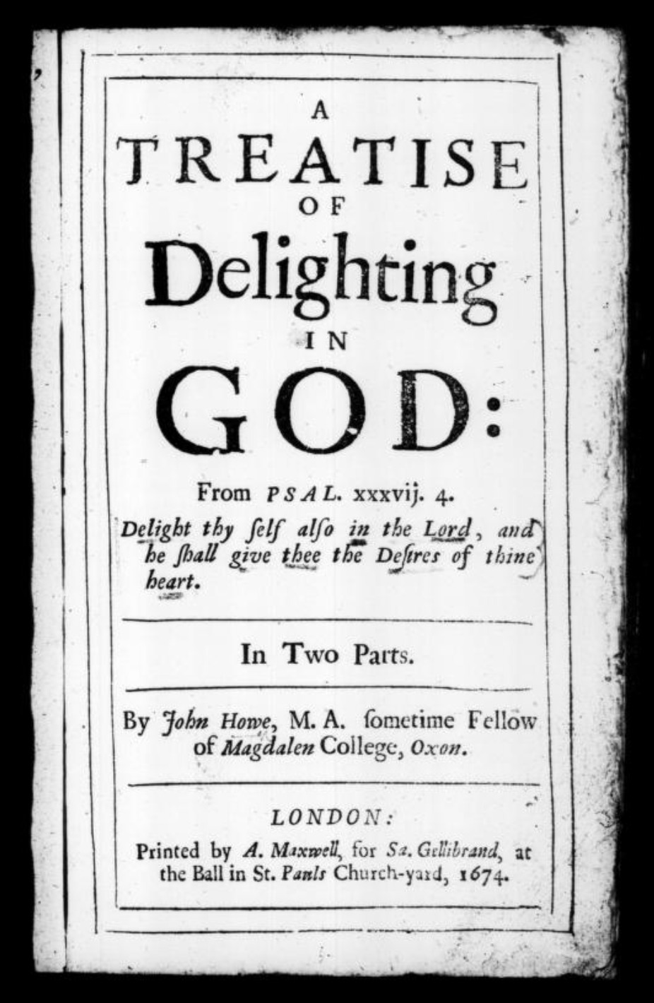
Actual Puritans
John Howe,
chaplain to
Oliver Cromwell.

Slide 24
Actual Puritans
“I consider everything a loss because of the surpassing worth of knowing Christ Jesus my Lord, for whose sake I have lost all things. I consider them garbage, that I may gain Christ.”
— Philippians 3:8.

Slide 25
Actual Puritans
“I consider everything a loss because of the surpassing worth of knowing Christ Jesus my Lord, for whose sake I have lost all things. I consider them garbage, that I may gain Christ.”
— Philippians 3:8.
The Puritans set themselves apart for God.

Slide 26
“Puritans”
In time, the Puritans came to be known for
the things they didn't care for,
instead of the one thing they did.

Slide 27
“Puritans”
In time, the Puritans came to be known for
the things they didn't care for,
instead of the one thing they did.
(No doubt some of them slid
into becoming exactly what
the caricature looks like.)

Slide 28
A dried-up parody of the real thing
“Do not handle! Do not taste! Do not touch!” […] Such regulations indeed have an appearance of wisdom, with their self-imposed worship, their false humility and their harsh treatment of the body, but they lack any value in restraining sensual indulgence.”
— Colossians 2:23.

Slide 29
A dried-up parody of the real thing
“Do not handle! Do not taste! Do not touch!” […] Such regulations indeed have an appearance of wisdom, with their self-imposed worship, their false humility and their harsh treatment of the body, but they lack any value in restraining sensual indulgence.”
— Colossians 2:23.
“Having a form of Godliness
but denying its power”
— 2 Timothy 3:5.

Slide 30
A dried-up parody of the real thing
“Having a form of pizza
but denying its power”
— 2 Timothy 3:5, more or less.

Slide 31
What holiness is

Slide 32

What holiness is
The Hebrew Old Testament word
And Greek New Testament word
translated "holy" both mean:
“set apart”

Slide 33
What holiness is
“Then God blessed the seventh day and made it holy, because on it he rested from all the work of creating that he had done.”
— Genesis 2:3.
He set one day apart from the others.

Slide 34
What holiness is
As obedient children, do not conform to the evil desires you had when you lived in ignorance. But just as he who called you is holy, so be holy in all you do; for it is written: “Be holy, because I am holy”.
— 1 Peter 1:14–16.

Slide 35
What holiness is
As obedient children, do not conform to the evil desires you had when you lived in ignorance. But just as he who called you is holy, so be holy in all you do; for it is written: “Be holy, because I am holy”.
— 1 Peter 1:14–16.
We start with God’s holiness.

Slide 36
What holiness is
“My thoughts are not your thoughts, neither are your ways my ways”, declares the Lord.
“As the heavens are higher than the earth, so are my ways higher than your ways and my thoughts than your thoughts.”
— Isaiah 55:8-9.
God is unimaginably above us.

Slide 37
What holiness is
“My thoughts are not your thoughts, neither are your ways my ways”, declares the Lord.
“As the heavens are higher than the earth, so are my ways higher than your ways and my thoughts than your thoughts.”
— Isaiah 55:8-9.
God is unimaginably above us.
(But at the same very close to us: see Psalm 119.)

Slide 38
What holiness is
What does this mean for our Holiness?
We are set apart when
we separate ourselves from lesser things
to be more dedicated to the God who loves us.

Slide 39
What holiness is
What does this mean for our Holiness?
We are set apart when
we separate ourselves from lesser things
to be more dedicated to the God who loves us.
(Like the real Puritans.)

Slide 40
What holiness is
“Both the one who makes people holy and those who are made holy are of the same family. So Jesus is not ashamed to call them brothers and sisters.”
— Hebrews 2:11.
God's holiness calls us to become holy as he is.

Slide 41
What holiness is
Becoming holy is
coming closer to God
at the expense of
our closeness to the world.

Slide 42
What holiness is
Becoming holy is
coming closer to God
at the expense of
our closeness to the world.
A joyful trade!

Slide 43
What holiness is
I’ve been cheating!

Slide 44
What holiness is
I’ve been cheating!

Slide 45
What holiness is
I’ve been cheating!
St. Francis was,
most of all, joyful.

Slide 46
What holiness is
“Do not let anyone judge you by what you eat or drink, or with regard to a religious festival, a New Moon celebration or a Sabbath day. These are a shadow of the things that were to come; the reality, however, is found in Christ.”
— Colossians 2:16-17.

Slide 47
Is holiness an obligation?

Slide 48
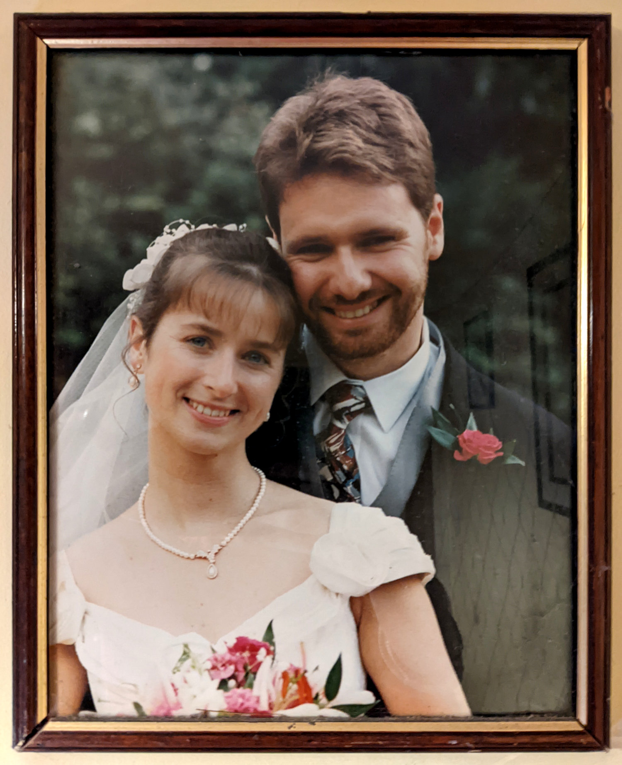
Is holiness an obligation?

Slide 49
Is holiness an obligation?
In our wedding vows, I was asked:
Mike, will you take Fiona
to be your wife?
Will you love her,
comfort her,
honour and protect her,
and, forsaking all others,
be faithful to her as long
as you both shall live?

Slide 50
Is holiness an obligation?
In our wedding vows, I was asked:
Mike, will you take Fiona
to be your wife?
Will you love her,
comfort her,
honour and protect her,
and, forsaking all others,
be faithful to her as long
as you both shall live?

Slide 51
Is holiness an obligation?
I set myself apart
for Fiona.
I made myself
holy to her.

Slide 52
Holiness is a privilege
Being set apart for Fiona
is a privilege,
not a burden.

Slide 53
Holiness is a privilege
When we love God,
being set apart for him
is a privilege,
not a burden.

Slide 54
Holiness is a privilege
The more clearly we see him,
The better we know him,
The more the love him,
The more we will want to be holy.

Slide 55
Three things that go together
How did Jesus teach us to pray?
“Our Father, God is good
In Heaven, God is great
Your name is holy.” God is holy

Slide 56
The holiness to come
“The spirit in us lives directly on God; but the mind, and still more the body, receives life from Him at a thousand removes — through our ancestors, through our food, through the elements.
[…]
What would it be to taste at the fountain-head that stream of which even these lower reaches prove so intoxicating? Yet that, I believe, is what lies before us. [We are] to drink joy from the fountain of joy.
— C. S. Lewis, The Weight of Glory.

Slide 57
Holiness
1 Peter 1:14-16.

