Slide 1
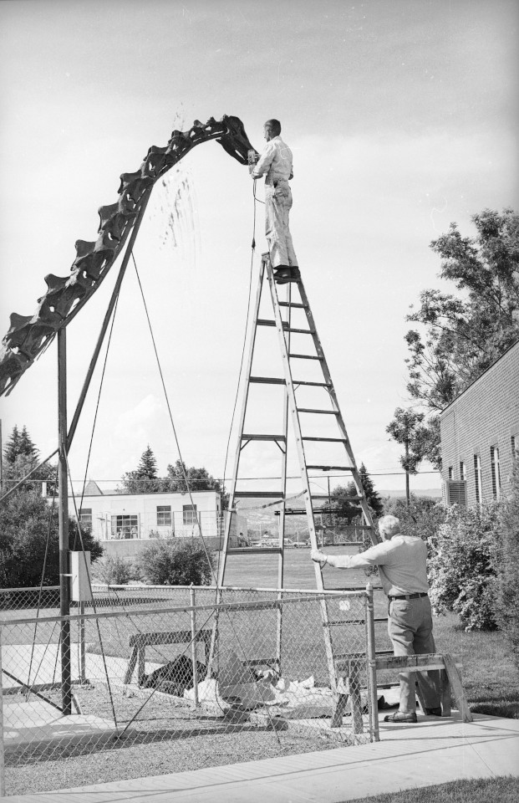
The Untold Story of
the Carnegie Diplodocus
Mike Taylor^{1,*}, Matt Lamanna², Ilja Nieuwland³, Amy Henrici², Linsly Church², Steve Sroka⁴ and Ken Carpenter⁵
1. University of Bristol, Bristol, UK
2. Carnegie Museum of Natural History, Pittsburgh, PA, USA
3. Royal Netherlands Academy of Arts and Sciences, Netherlands
4. Utah Field House of Natural History, Vernal, Utah, USA
5. University of Colorado Museum, Boulder, Colorado, USA

Slide 2
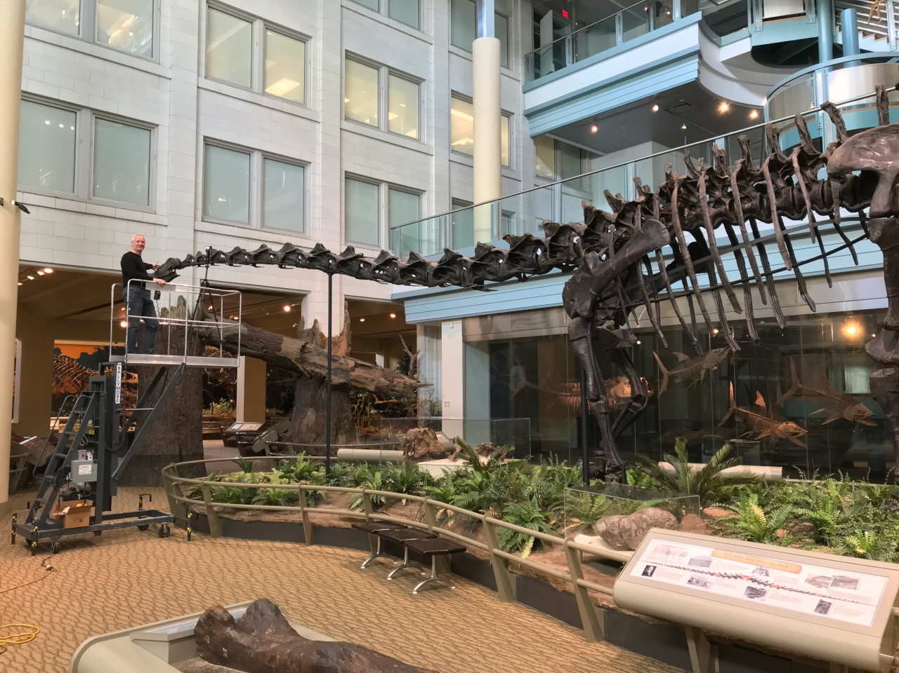
The sauropod
dinosaur
Diplodocus
Best known
from the
Carnegie
specimen
“CM 84”

Slide 3
The sauropod
dinosaur
Diplodocus
Best known
from the
Carnegie
specimen
“CM 84”
“Dippy” 🤮

Slide 4
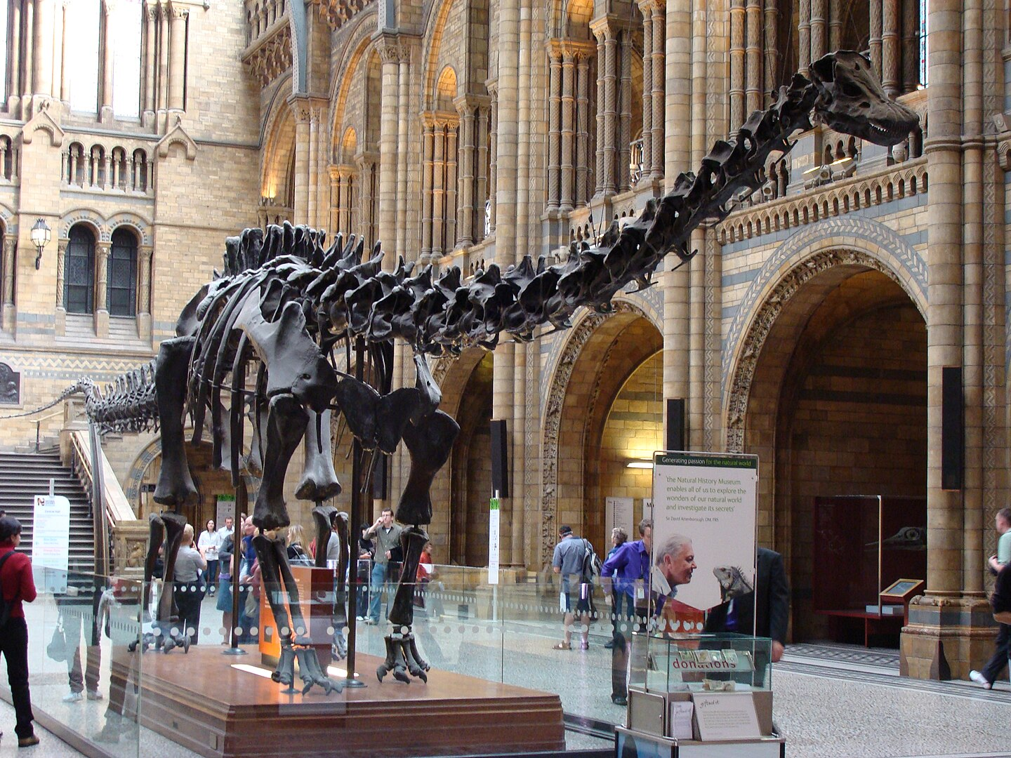
… And its
many casts
Photograph by
Fernando Losada Rodríguez
CC BY-SA 4.0

Slide 5
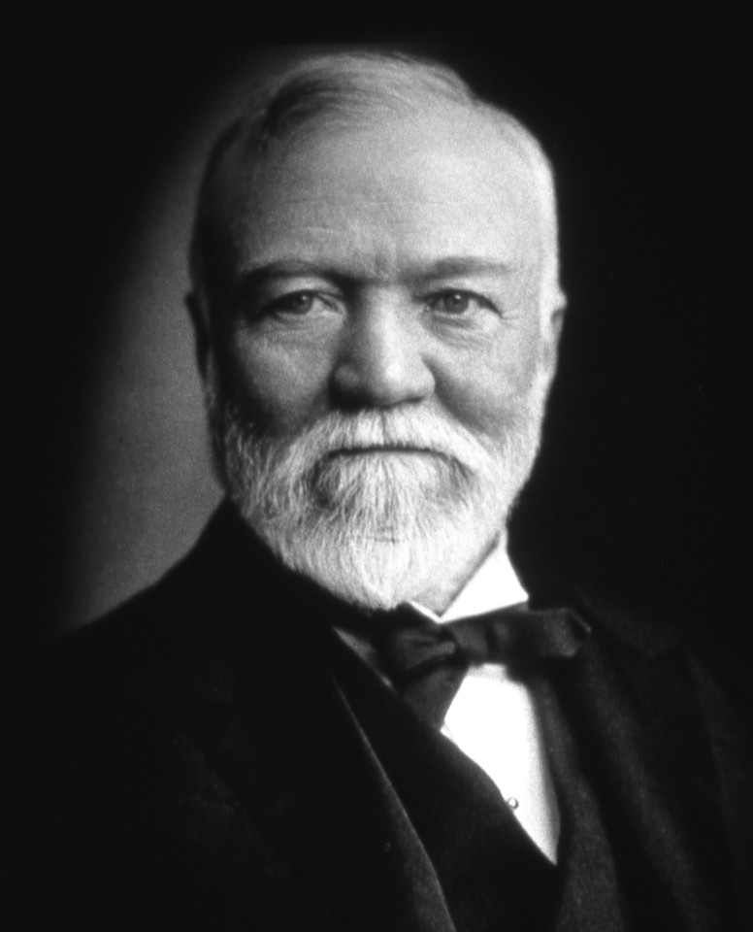
Funded by Andrew Carnegie
The Carnegie Museum.
Diplodocus carnegii:
Excavation
Mounting
Molding
Casts

Slide 6
Casts were sent around the world in the early 1900s.
Natural History Museum | London | England | 12 May 1905
Museum für Naturkunde Berlin | Berlin | Germany | 13 May 1908
Muséum National d’Histoire Naturelle | Paris | France | 15 June 1908
Kaiserliches und königliches naturhistorisches Hof-Museum | Vienna | Austria | 24 September 1909
Giovanni Capellini Museum for Paleontology and Geology | Bologna | Italy | 27 October 1909
The Imperial Museum | St. Petersburg | Russia | Early July 1910
Museo de La Plata | La Plata | Argentina | 1912
Museo Nacional de Ciencias Naturales | Madrid | Spain | 2 December 1913
Museo de Paleontología (UNAM) | Mexico City | Mexico | 1930
Staatssammlung für Paläontologie und Geologie | Munich | Germany | 1934 (never mounted)

Slide 7
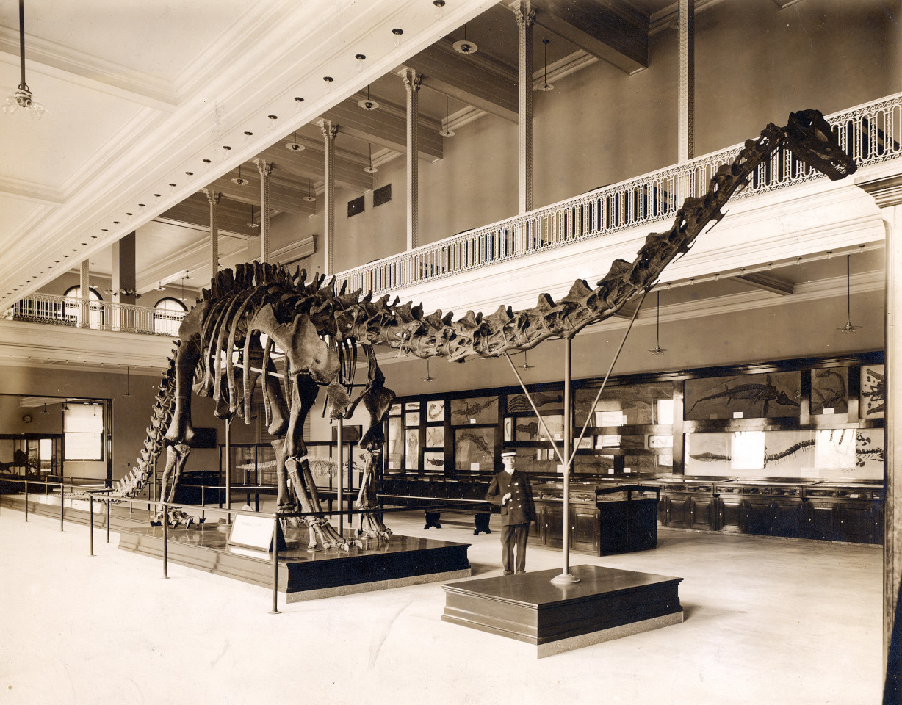
The original
skeleton was
mounted in
1907

Slide 8
The composition of the mounted “skeleton” was complex
Bones
CM 84: neck, torso, ribs, sacrum, 12 proximal caudals, left scapulocoracoid, sternal plates, right ilium, pubes, ischia, left femur

Slide 9
The composition of the mounted “skeleton” was complex
Bones
CM 84: neck, torso, ribs, sacrum, 12 proximal caudals, left scapulocoracoid, sternal plates, right ilium, pubes, ischia, left femur
CM 94: right scapulocoracoid, lower right hindlimb and much of the tail
CM 307: the rest of the tail
CM 33985: lower left hindlimb
CM 21775: left forelimb

Slide 10
The composition of the mounted “skeleton” was complex
Bones
CM 84: neck, torso, ribs, sacrum, 12 proximal caudals, left scapulocoracoid, sternal plates, right ilium, pubes, ischia, left femur
CM 94: right scapulocoracoid, lower right hindlimb and much of the tail
CM 307: the rest of the tail
CM 33985: lower left hindlimb
CM 21775: left forelimb
Sculptures
CM 662: sculpted right forelimb
AMNH 965: sculpted forefeet
CM 662: sculpted braincase
USNM 2673: sculpted remainder of skull
Pure sculpture: axis, left ilium, femur and tibia

Slide 11
The composition of the mounted “skeleton” was complex
Bones
CM 84: neck, torso, ribs, sacrum, 12 proximal caudals, left scapulocoracoid, sternal plates, right ilium, pubes, ischia, left femur
CM 94: right scapulocoracoid, lower right hindlimb and much of the tail
CM 307: the rest of the tail
CM 33985: lower left hindlimb
CM 21775: left forelimb
Sculptures
CM 662: sculpted right forelimb
AMNH 965: sculpted forefeet
CM 662: sculpted braincase
USNM 2673: sculpted remainder of skull
Pure sculpture: axis, left ilium, femur and tibia
Something
wrong here

Slide 12
The composition of the mounted “skeleton” was complex
Bones
CM 84: neck, torso, ribs, sacrum, 12 proximal caudals, left scapulocoracoid, sternal plates, right ilium, pubes, ischia, left femur
CM 94: right scapulocoracoid, lower right hindlimb and much of the tail
CM 307: the rest of the tail
CM 33985: lower left hindlimb
CM 21775: left forelimb
Sculptures
CM 662: sculpted right forelimb
AMNH 965: sculpted forefeet
CM 662: sculpted braincase
USNM 2673: sculpted remainder of skull
Pure sculpture: axis, left ilium, femur and tibia
Missing: clavicles, interclavicle, sternal ribs, gastralia

Slide 13
The composition of the mounted “skeleton” was complex
CM 84: neck, torso, ribs, sacrum, 12 proximal caudals, left scapulocoracoid, sternal plates, right ilium, pubes, ischia, left femur
CM 94: right scapulocoracoid, lower right hindlimb and much of the tail
CM 307: the rest of the tail
CM 33985: lower left hindlimb
CM 21775: left forelimb
Sculptures
CM 662: sculpted right forelimb
AMNH 965: sculpted forefeet
CM 662: sculpted braincase
USNM 2673: sculpted remainder of skull
Based on skeletal reconstruction by Scott Hartman
Used by permission

Slide 14
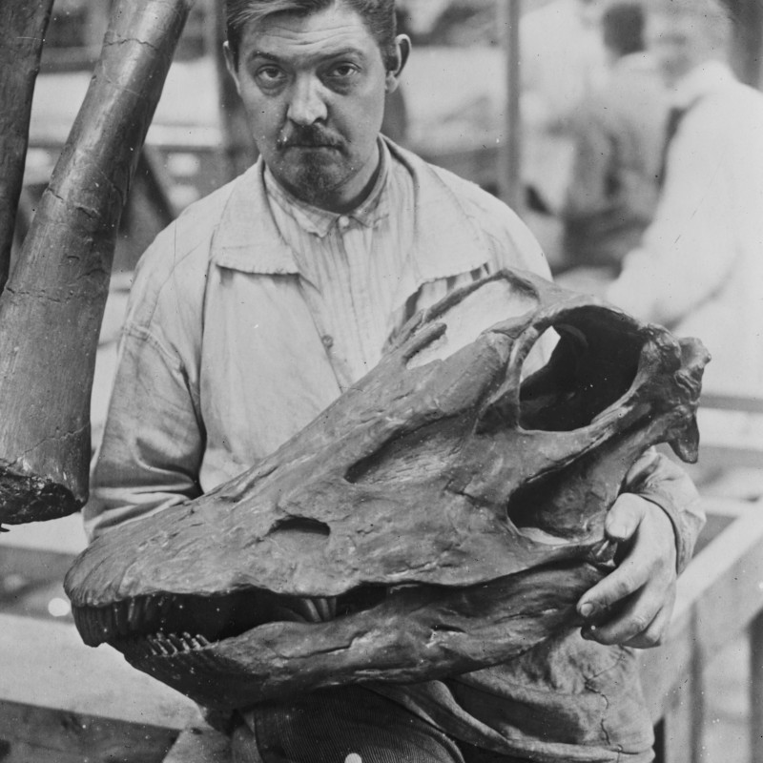
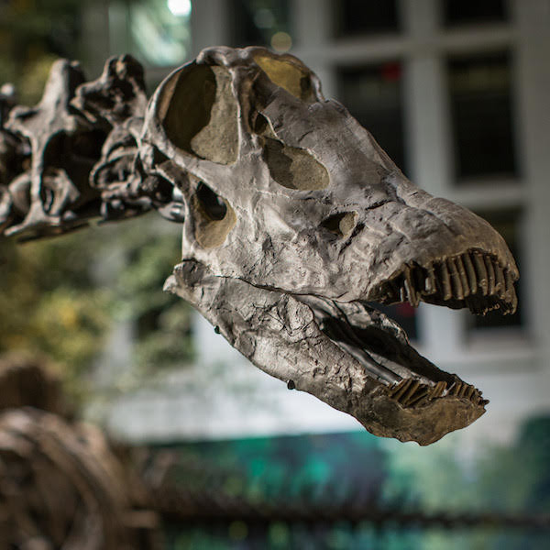
Skull replacement (between 1924 and 1971)
CM 662 braincase +
USNM 2673 remainder of skull
→
CM 11161 skull

Slide 15
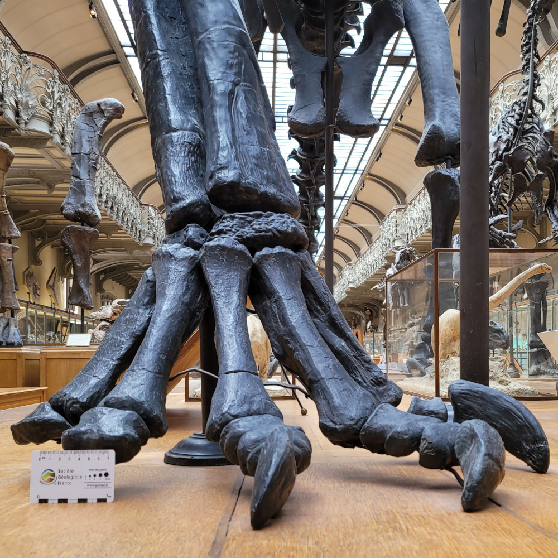
Forefoot epic part 1.
Original Paris mount
AMNH 965 camarasaurid

Slide 16
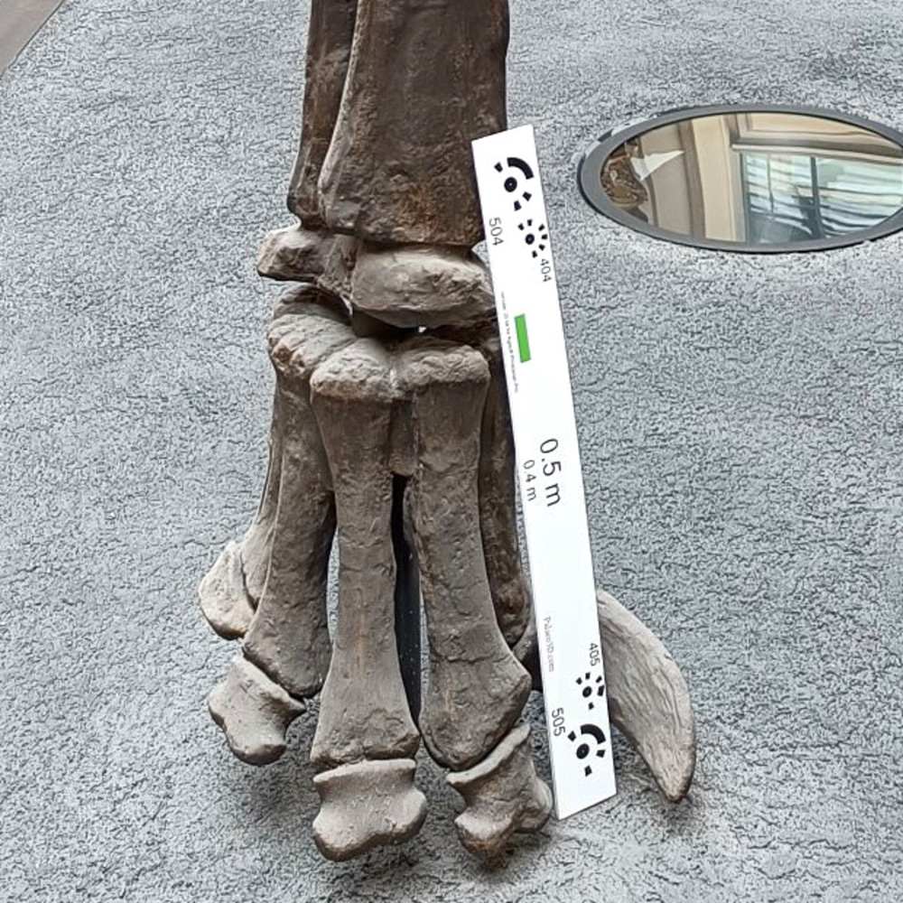
Forefoot epic part 2.
2007 re-pose at HMN
AMNH 965 camarasaurid

Slide 17
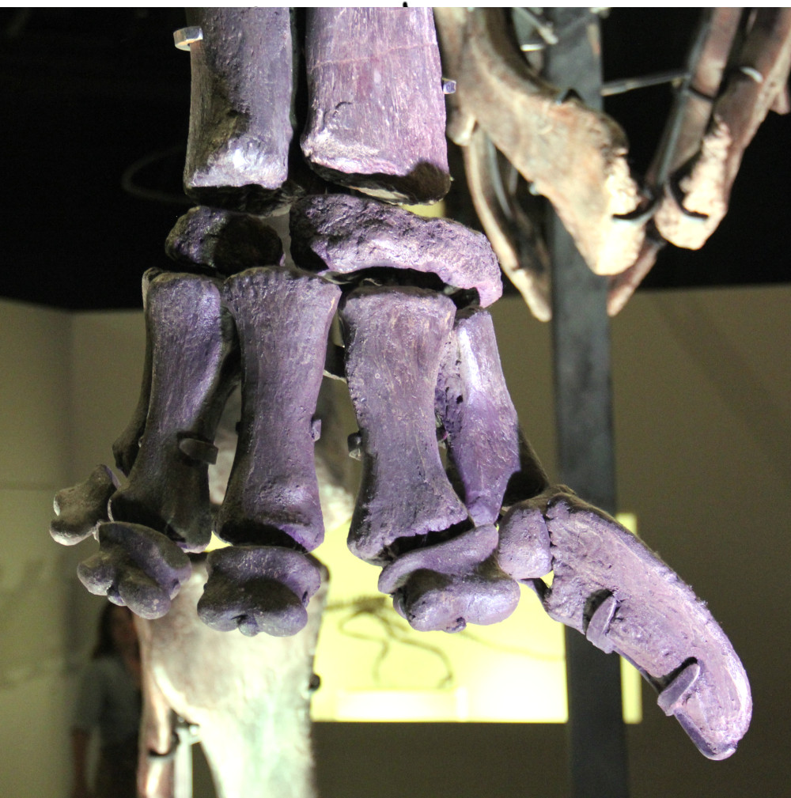
Forefoot epic part 3.
1999 forefoot update
CM 662 “Diplodocus” hayi
(= Galeamopus hayi)

Slide 18
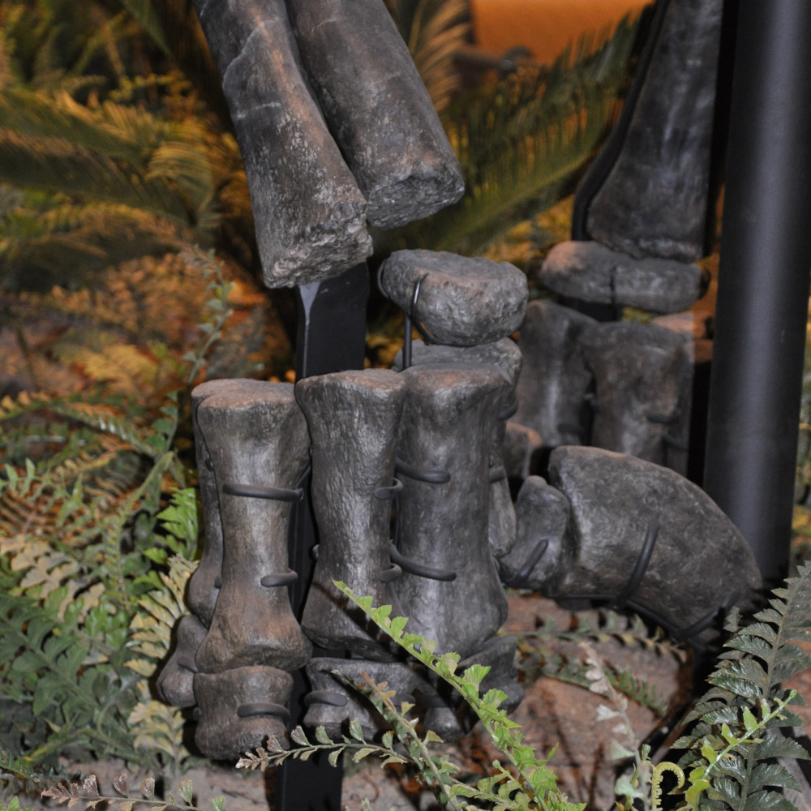
Forefoot epic part 4.
2007 remount
WDC-FS001A
Referred to D. carnegii
but probably not Diplodocus.

Slide 19
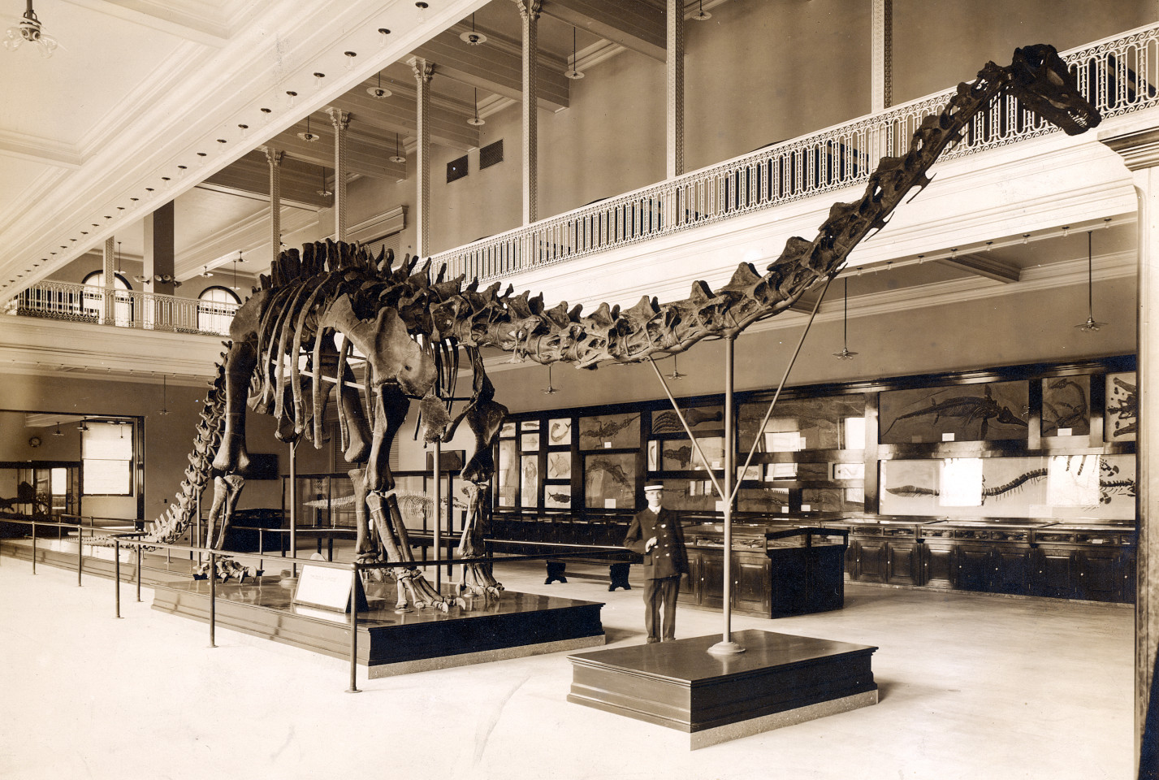
Forelimb problems

Slide 20
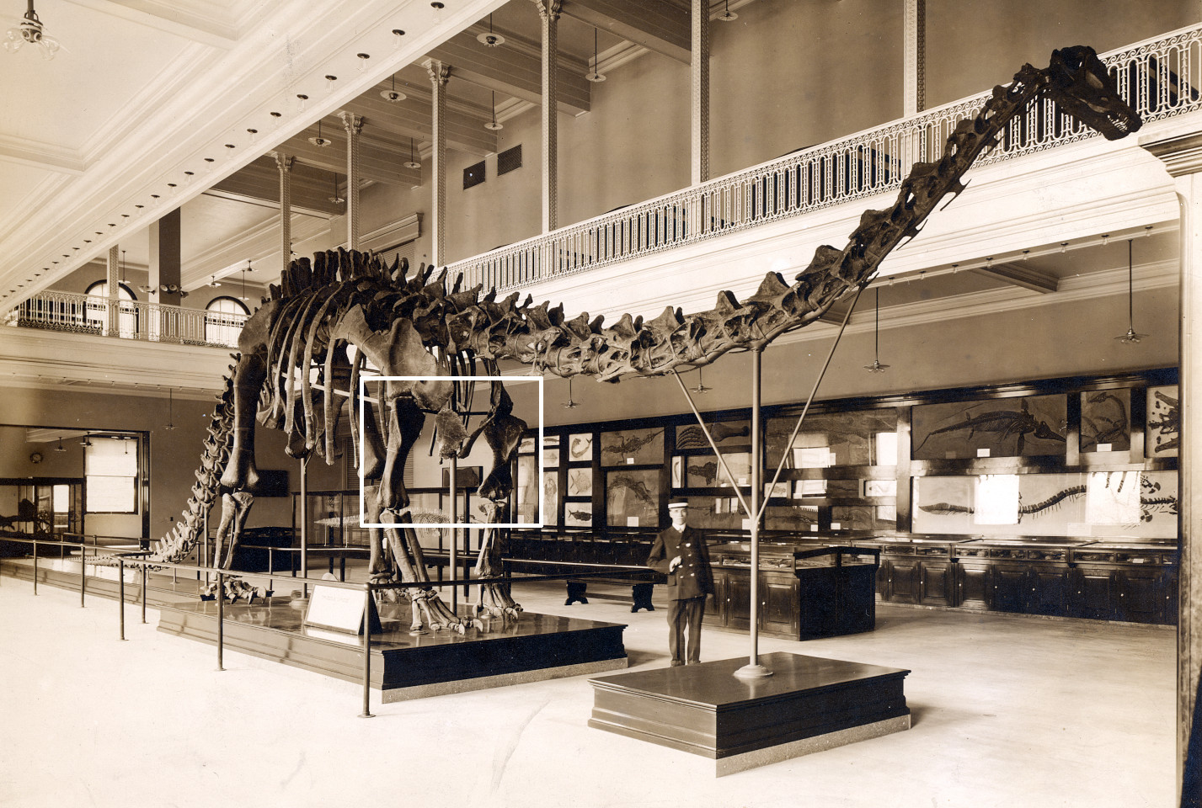
Forelimb problems

Slide 21
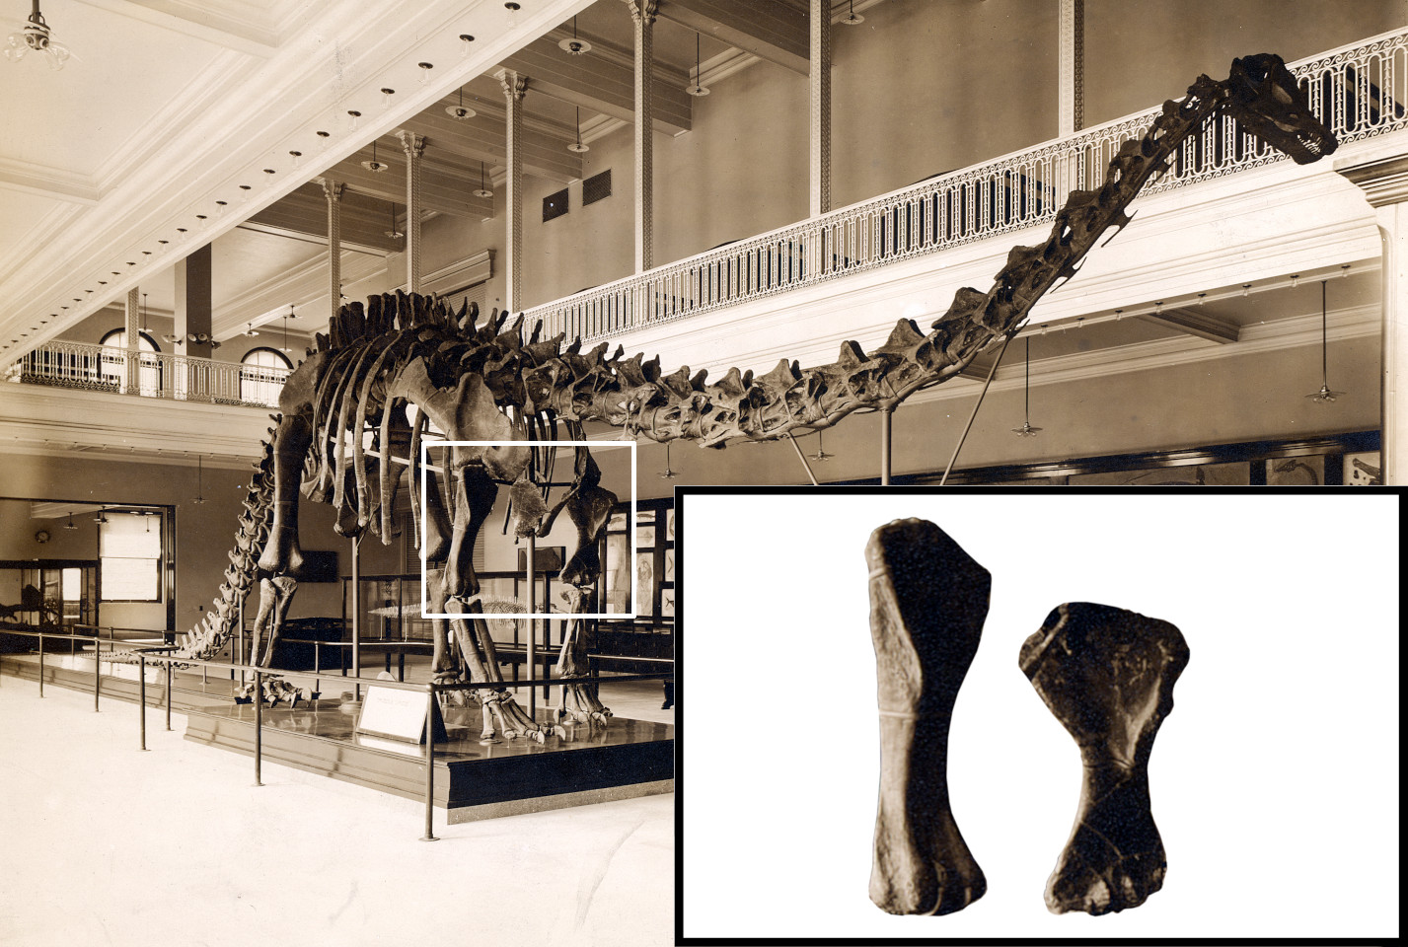
Forelimb problems

Slide 22
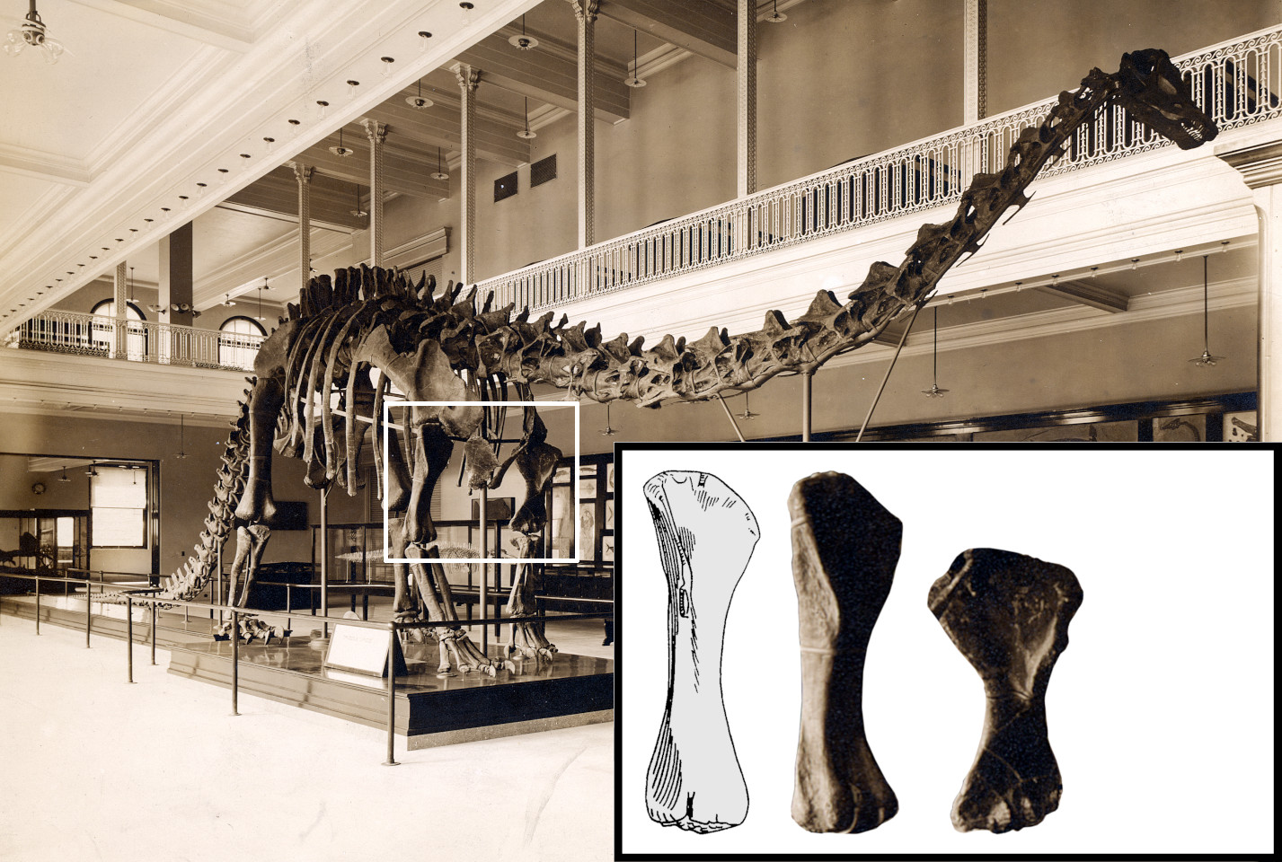
Diplodocus sp. AMNH 5855 left humerus, anterior view (reversed)
(Mook 1917:figure 2A)

Slide 23
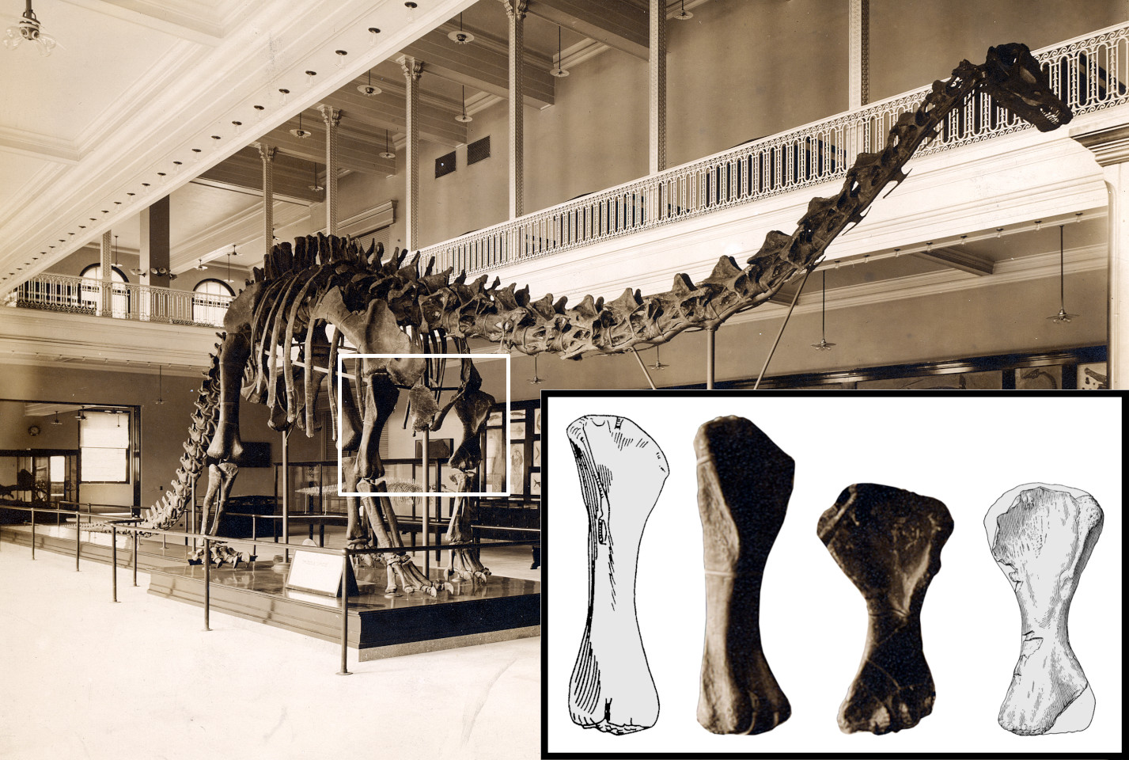
Camarasaurus supremus AMNH 5761/H.2
left humerus, anterior view
(Osborn and Mook 1921:figure 84B)

Slide 24
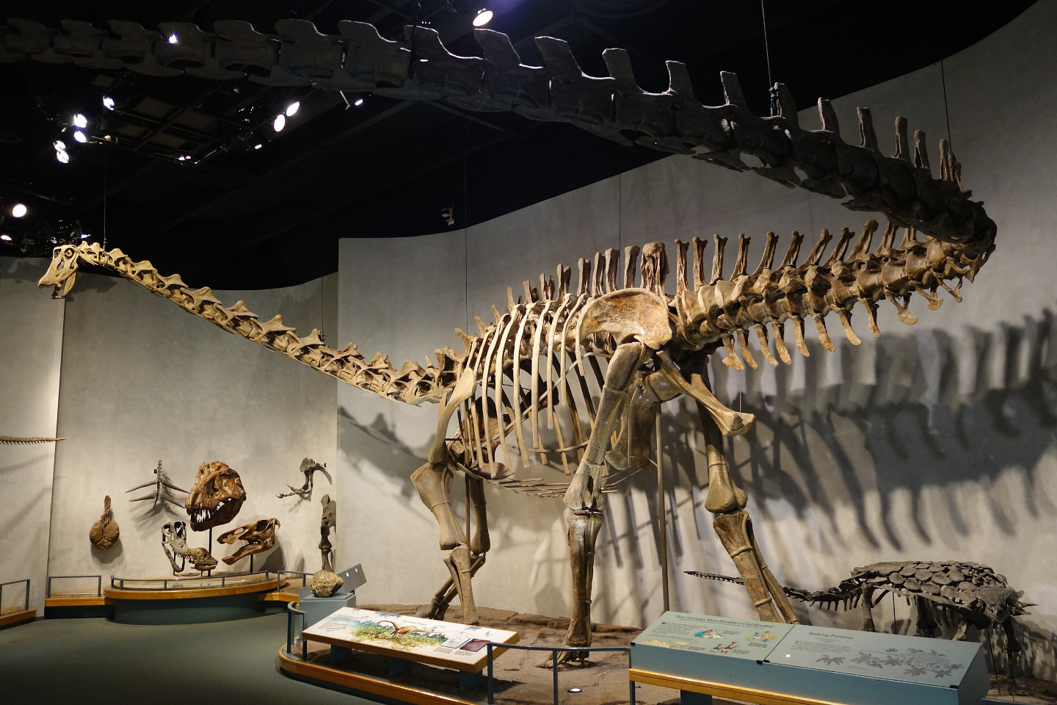
Forelimb replacement from DMNS 1494?

Slide 25
Forelimb replacement from DMNS 1494?
But its forelimbs were
casts from the original
Carnegie mount!

Slide 26
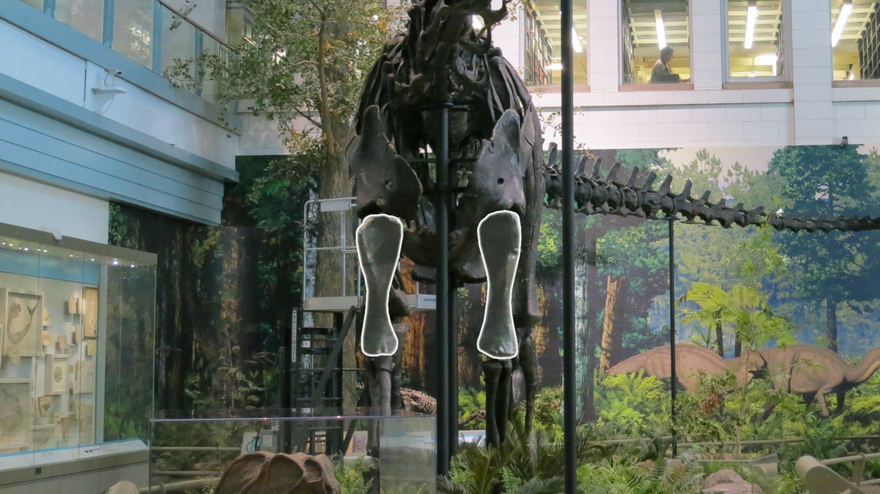
Forelimb replacement
2007
BYU 681 scaled sculptures

Slide 27
Casts were sent around the world in the early 1900s.
Natural History Museum | London | England | 12 May 1905
Museum für Naturkunde Berlin | Berlin | Germany | 13 May 1908
Muséum National d’Histoire Naturelle | Paris | France | 15 June 1908
Kaiserliches und königliches naturhistorisches Hof-Museum | Vienna | Austria | 24 September 1909
Giovanni Capellini Museum for Paleontology and Geology | Bologna | Italy | 27 October 1909
The Imperial Museum | St. Petersburg | Russia | Early July 1910
Museo de La Plata | La Plata | Argentina | 1912
Museo Nacional de Ciencias Naturales | Madrid | Spain | 2 December 1913
Museo de Paleontología (UNAM) | Mexico City | Mexico | 1930
Staatssammlung für Paläontologie und Geologie | Munich | Germany | 1934 (never mounted)
Molds unused since
1930 or even 1910.

Slide 28
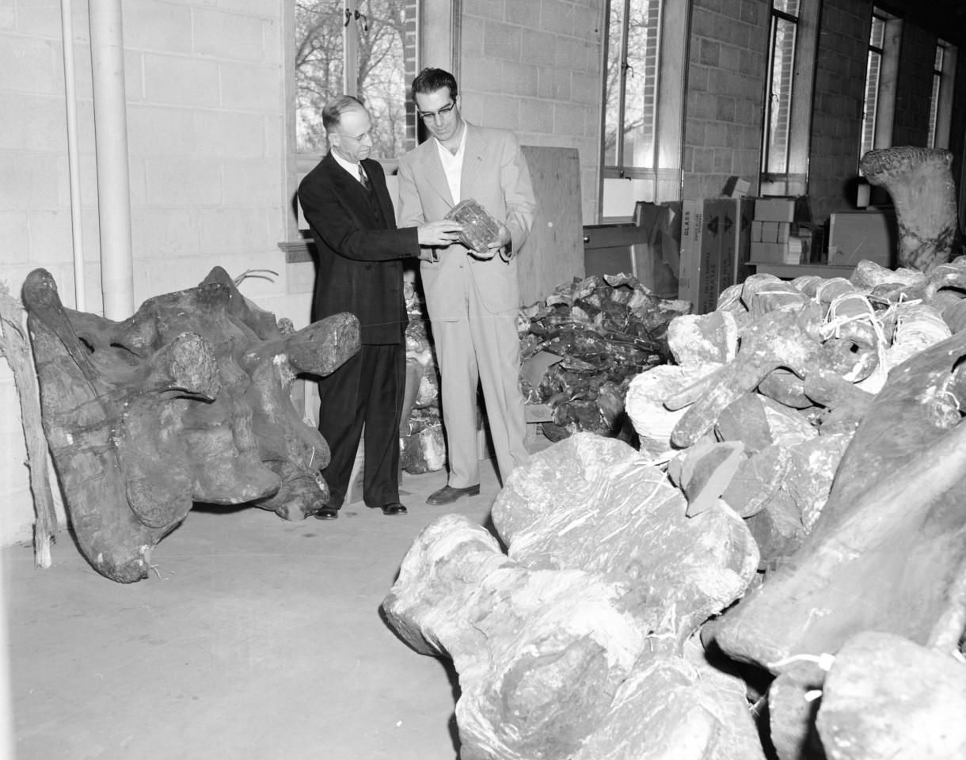
Episode IV: A New Hope
In 1952, Carnegie curator
LeRoy “Pop” Kay
donated the molds to the Field House in Vernal.

Slide 29
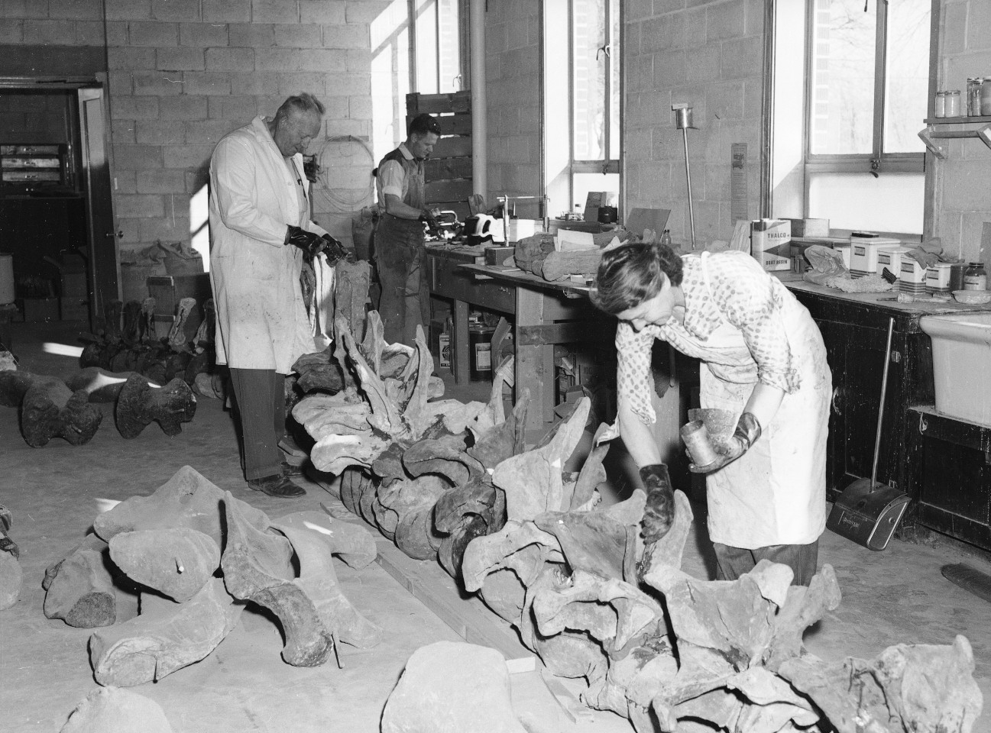
Untermanns
Ernest Untermann,
Museum Director.
— and —
Billie Untermann,
Staff Scientist.

Slide 30
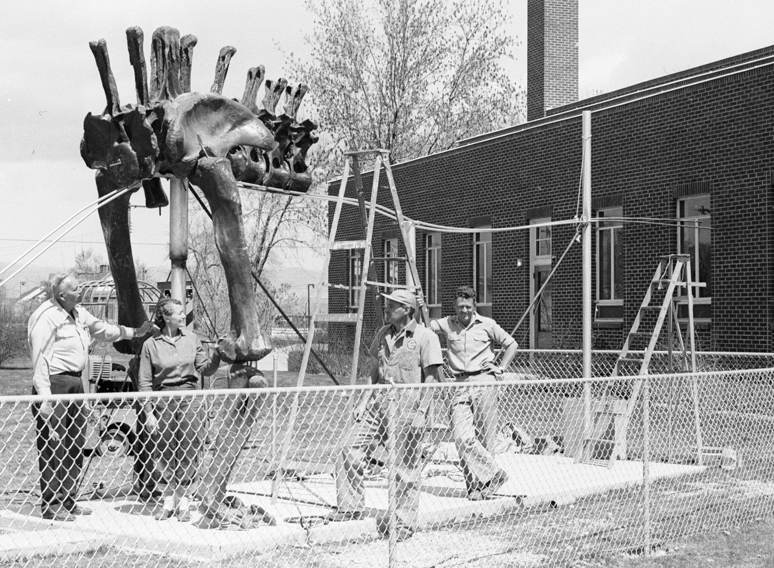
Assembling
the
concrete
cast
Ernest
Billie

Slide 31
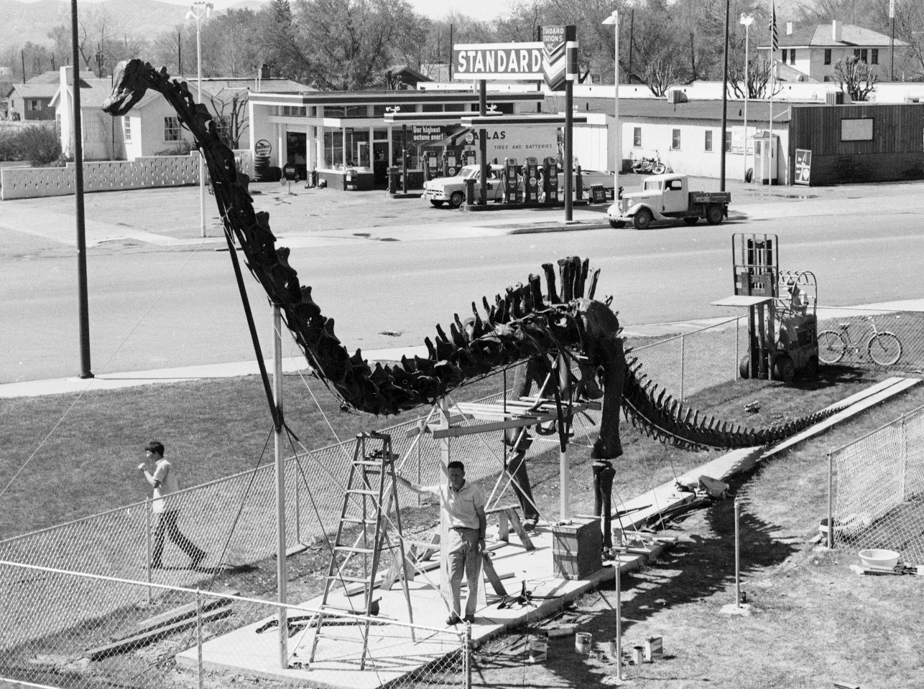
Assembling
the
concrete
cast

Slide 32
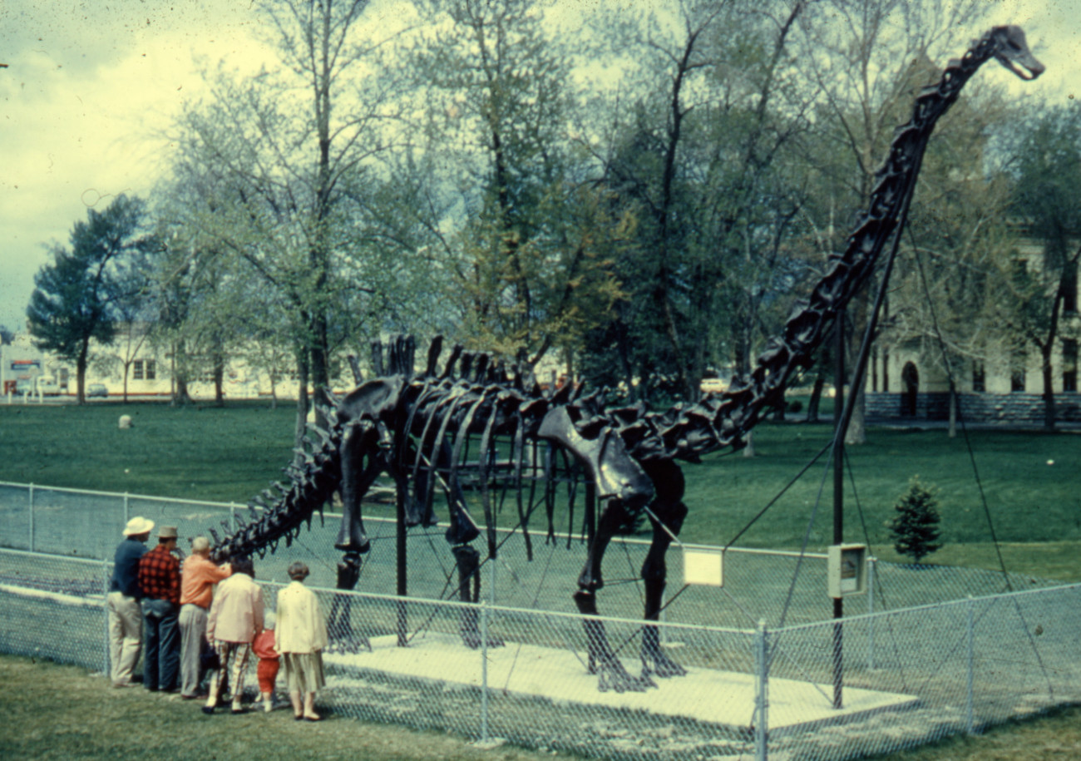
Cultural icon of Utah 1957–89

Slide 33
A cultural icon of Utah
G. Ernest Untermann,
Vernal Express
19 December 1957.

Slide 34
A cultural icon of Utah
Without benefit of seductive curves or a “come hither look”, “Dippy” the 76 foot long skeleton of the dinosaur Diplodocus, standing out on the lawn on the Utah Field House of Natural History, dazzles and delights the tourists, known to the trade as “dudes”.
G. Ernest Untermann,
Vernal Express
19 December 1957.

Slide 35
A cultural icon of Utah
Without benefit of seductive curves or a “come hither look”, “Dippy” the 76 foot long skeleton of the dinosaur Diplodocus, standing out on the lawn on the Utah Field House of Natural History, dazzles and delights the tourists, known to the trade as “dudes”.
As a motorist pulls up to the curb, father hardly has time to set the brake, before the entire family erupts from the car and dashes across the lawn to charge Dippy amid gleeful squeals.
G. Ernest Untermann,
Vernal Express
19 December 1957.

Slide 36
A cultural icon of Utah
Without benefit of seductive curves or a “come hither look”, “Dippy” the 76 foot long skeleton of the dinosaur Diplodocus, standing out on the lawn on the Utah Field House of Natural History, dazzles and delights the tourists, known to the trade as “dudes”.
As a motorist pulls up to the curb, father hardly has time to set the brake, before the entire family erupts from the car and dashes across the lawn to charge Dippy amid gleeful squeals.
Dippy is the most photographed object on U.S. Highway No. 40, between Salt Lake City and Denver. Although he was “born” only six months ago he had already been photographed thousands of times and has been the subject of as many as seven different camera fans at one time.
G. Ernest Untermann,
Vernal Express
19 December 1957.

Slide 37
A cultural icon of Utah
Without benefit of seductive curves or a “come hither look”, “Doppy” the 76 foot long skeleton of the dinosaur Diplodocus, standing out on the lawn on the Utah Field House of Natural History, dazzles and delights the tourists, known to the trade as “dudes”.
As a motorist pulls up to the curb, father hardly has time to set the brake, before the entire family erupts from the car and dashes across the lawn to charge Dippy amid gleeful squeals.
Dippy is the most photographed object on U.S. Highway No. 40, between Salt Lake City and Denver. Although he was “born” only six months ago he had already been photographed thousands of times and has been the subject of as many as seven different camera fans at one time.
G. Ernest Untermann,
Vernal Express
19 December 1957.

Slide 38
1960s: what next for the molds?
Inquiries from various countries

Slide 39
1960s: what next for the molds?
Inquiries from various countries

Slide 40
1960s: what next for the molds?
Inquiries from various countries

Slide 41
Shipped to Rocky Mount, NC.

Slide 42
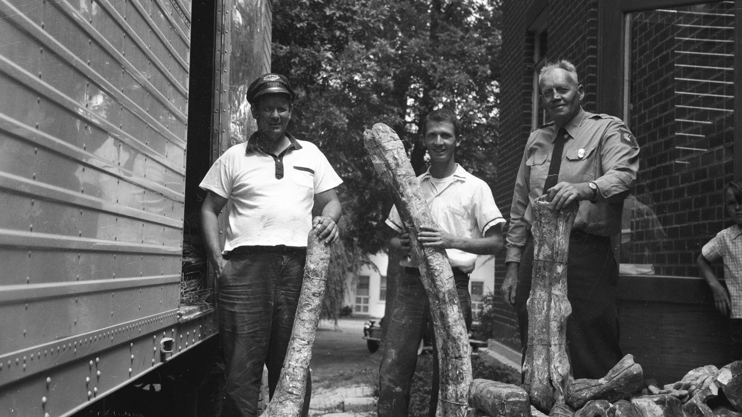
Shipped to Rocky Mount, NC.

Slide 43
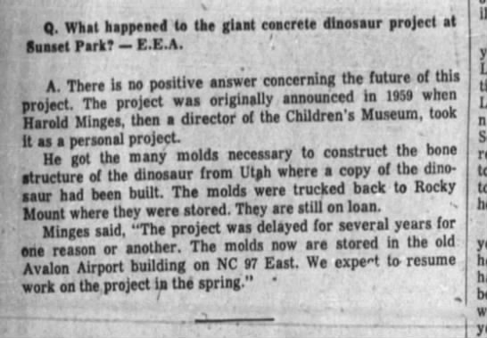
What next for the molds?

Slide 44
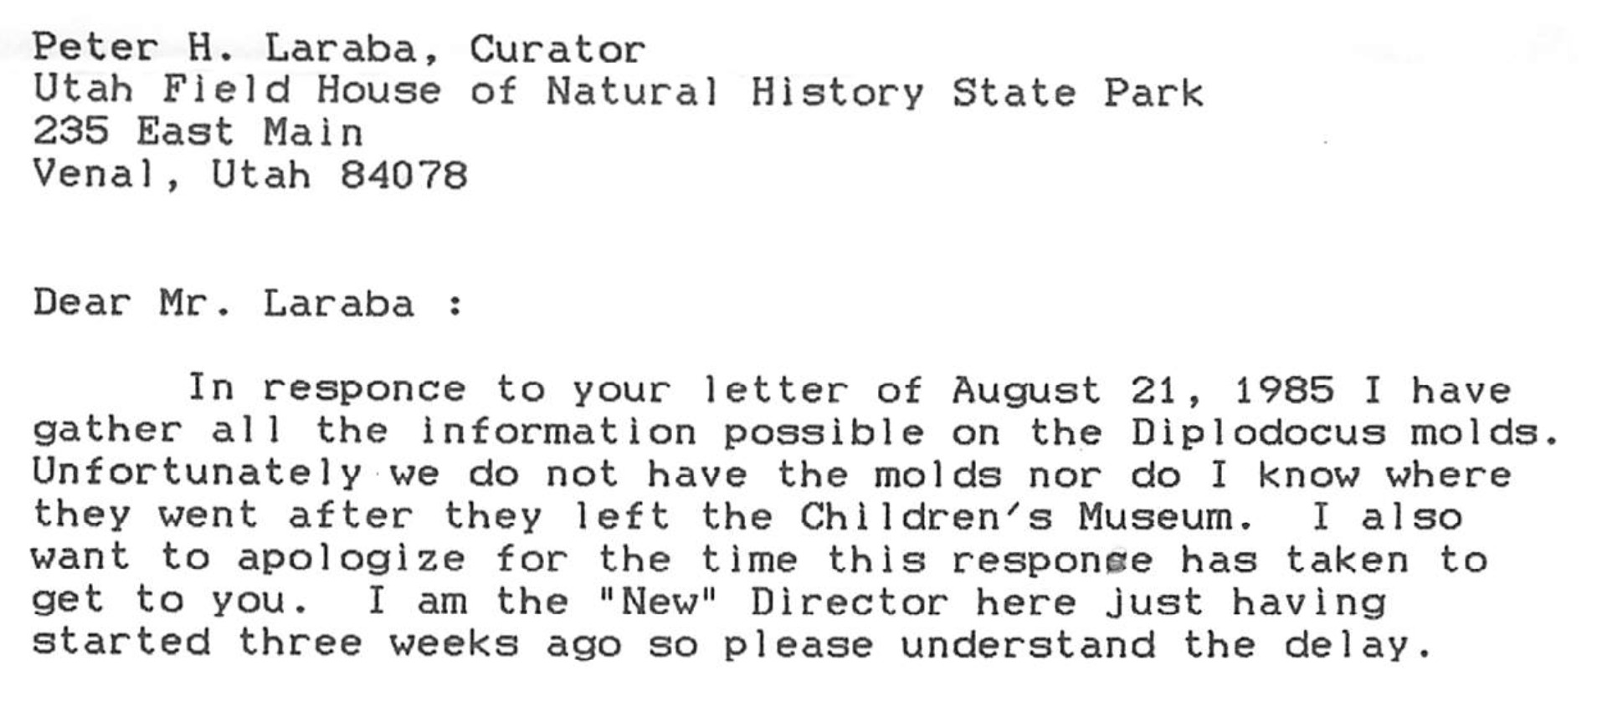
An ignominious fate for the molds

Slide 45
1989: concrete cast crumbling
The Vernal climate ranges from
–40˚F to 100˚F (–40˚C to 38˚C).
By the late 1980s it was coming apart.

Slide 46
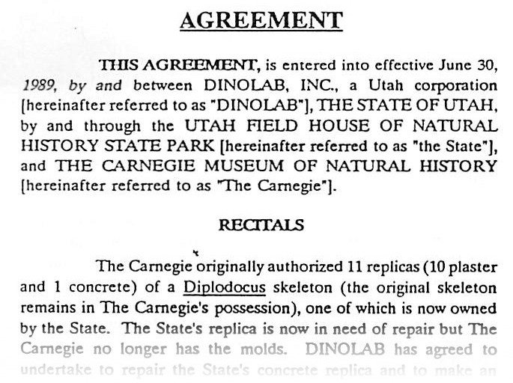
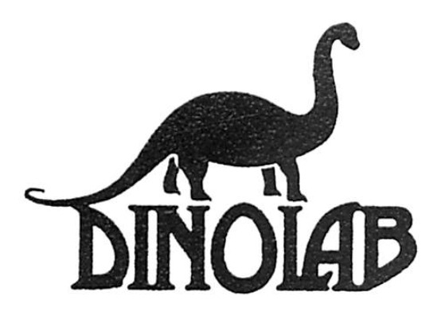
Episode VI: The Return of the Diplodocus
In 1989, new molds
were made from
the concrete cast.

Slide 47
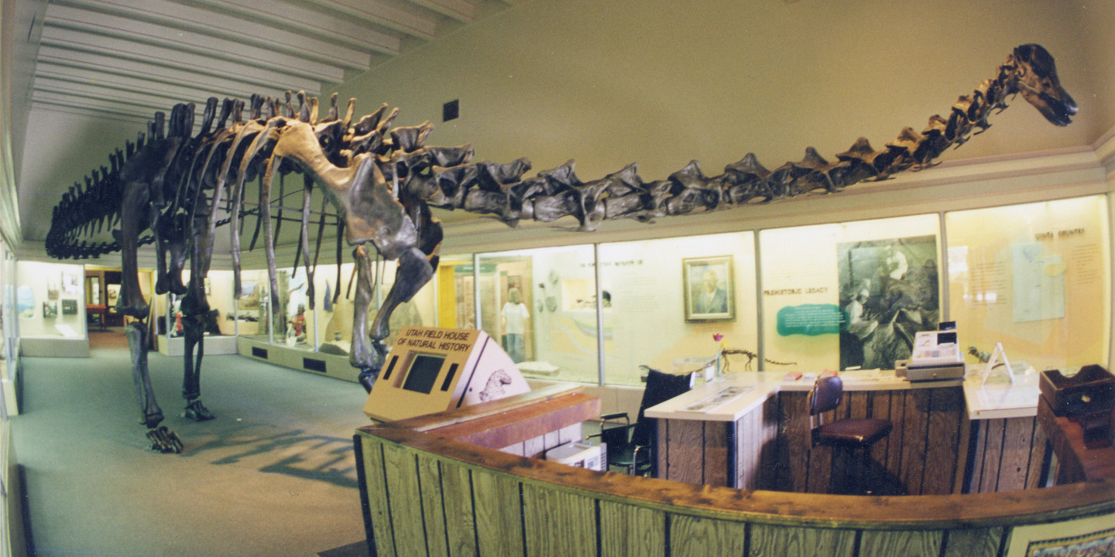
1994: Lightweight cast at the old Field House, Vernal

Slide 48
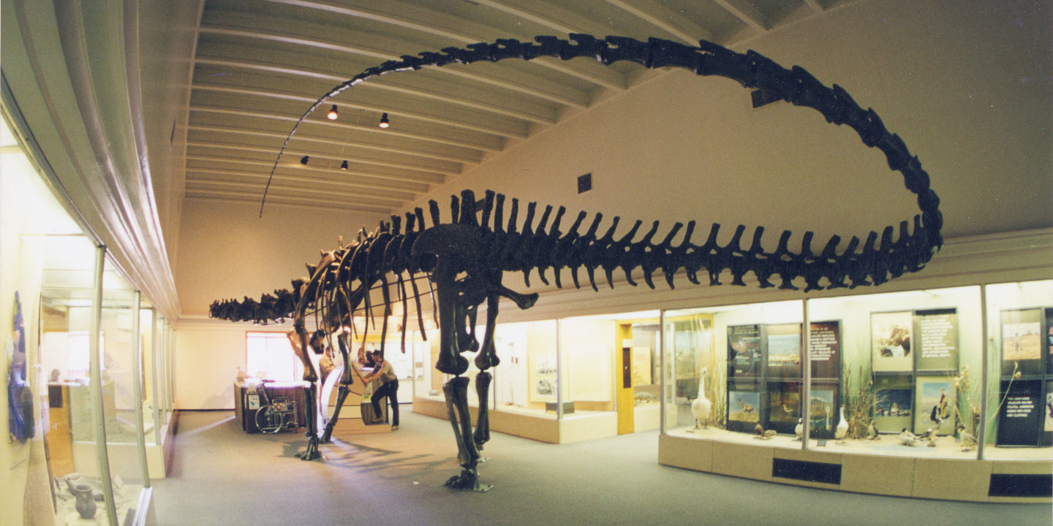
1994: Lightweight cast at the old Field House, Vernal

Slide 49
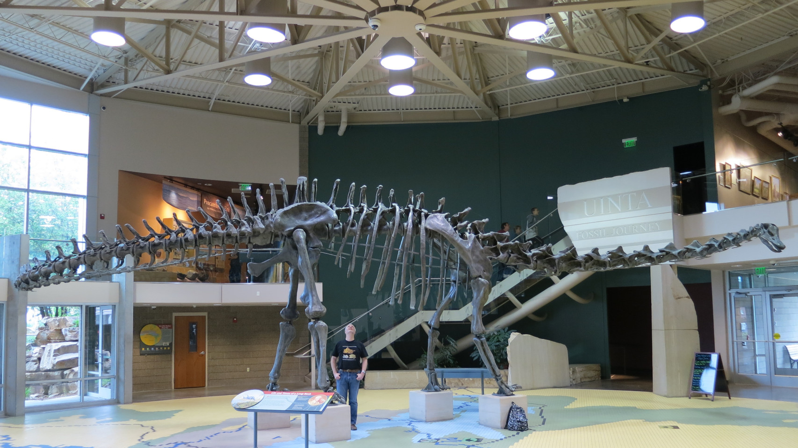
2004: Lightweight cast moved to the new Field House

Slide 50
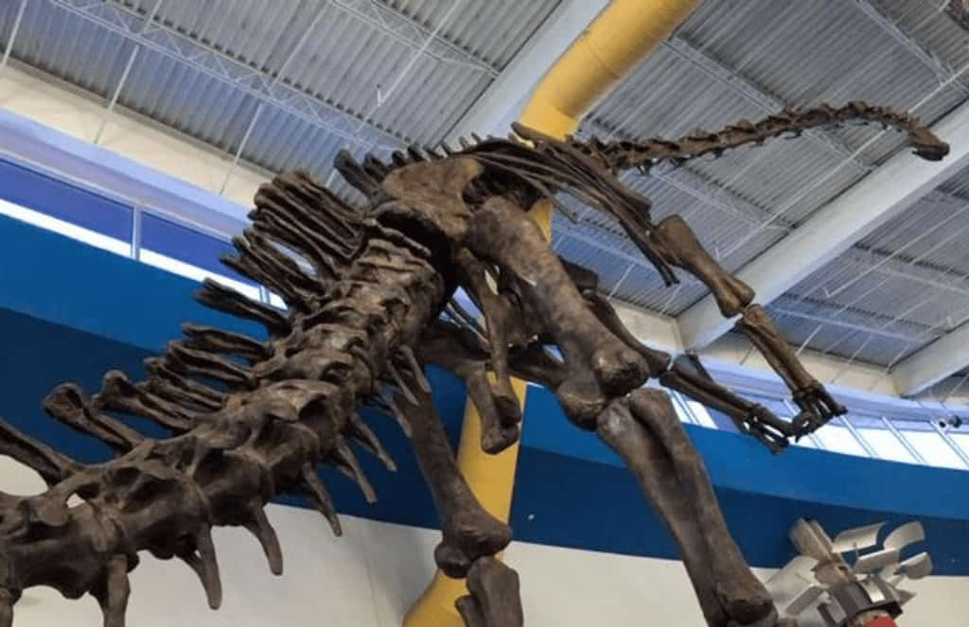
Other second-generation casts
These now inhabit
Japan (five copies)
Canada,
and several locations
in Florida.

Slide 51
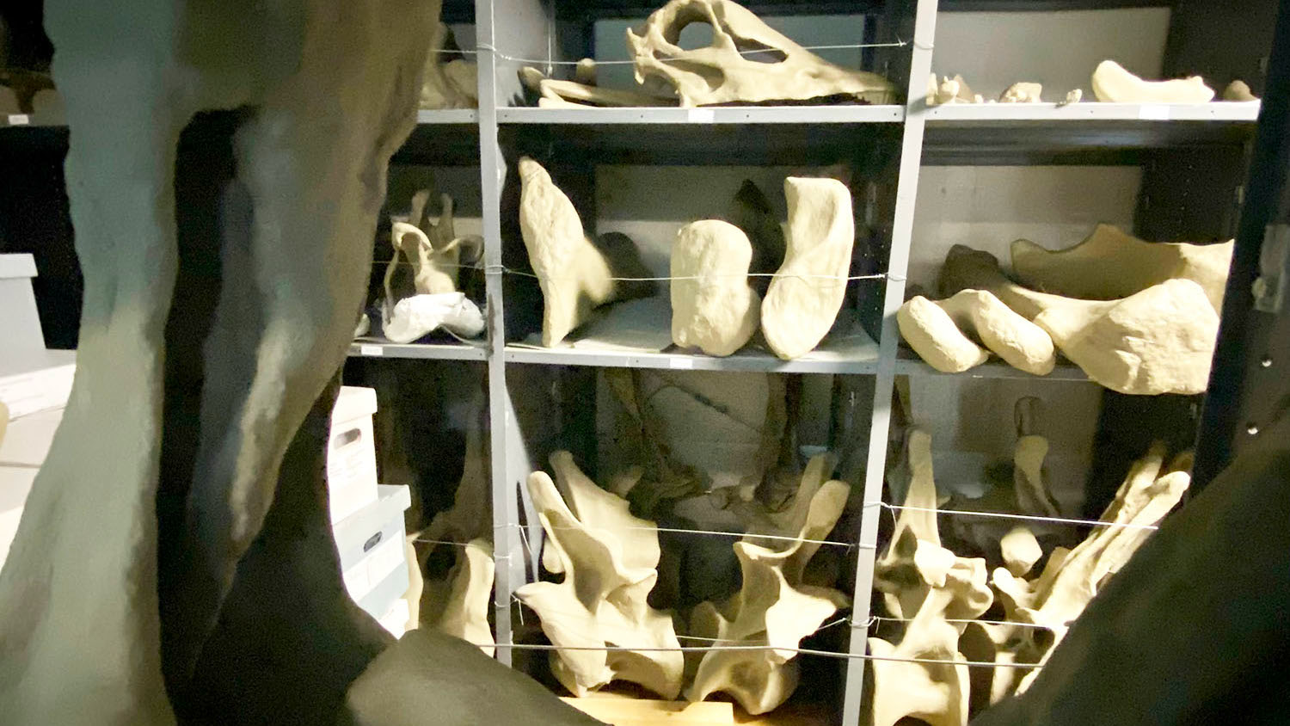
What happened to the concrete cast?
Ten years in collections
at the Prehistoric Museum
in Price, Utah.

Slide 52
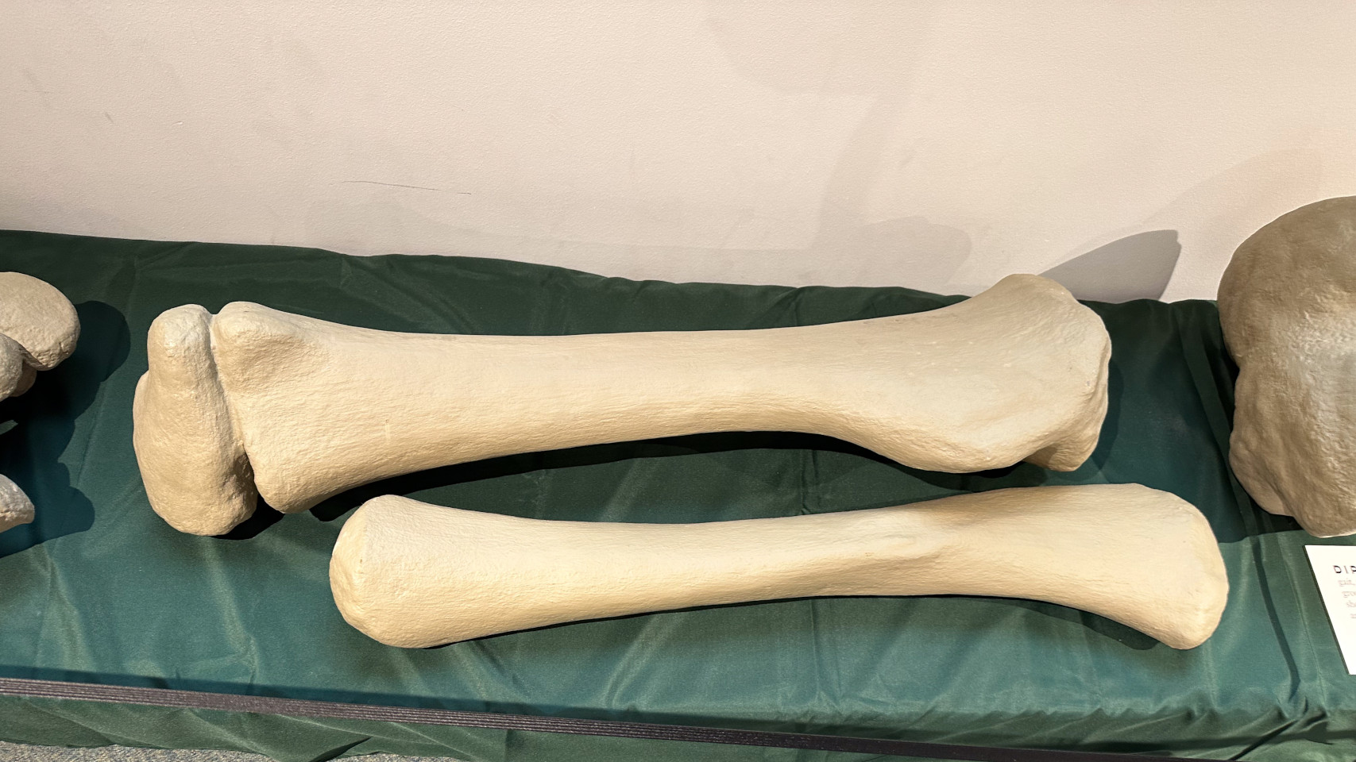
What happened to the concrete cast?
Currently on exhibition at the Prehistoric Museum in Price, Utah

Slide 53
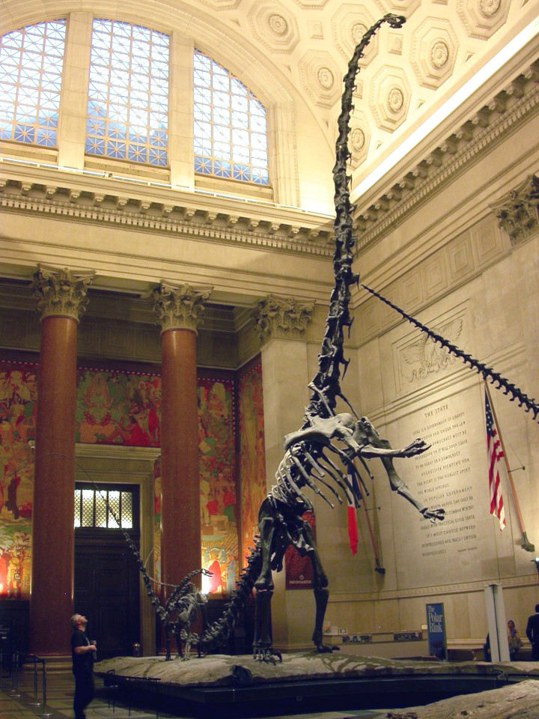
… and finally …
Elements cast from these molds are used
in other mounts

Slide 54
The AMNH’s rearing Barosaurus
Skull, anterior neck, some ribs,
distal tail, chevrons, various limb bones …
… were cast from molds
that were taken from a concrete cast
that was made from the molds
that were taken from the original
Carnegie Diplodocus.

Slide 55
For much, much, much more information …
Taylor, Michael P., Amy C. Henrici, Linsly J. Church, Ilja Nieuwland and Matthew C. Lamanna. In prep. The history and composition of the Carnegie Diplodocus. Manuscript and illustrations at https://github.com/MikeTaylor/palaeo-carnegie
Taylor, Michael P., Steven D. Sroka and Kenneth Carpenter. 2023. The Concrete Diplodocus of Vernal — a Cultural Icon of Utah. Geology of the Intermountain West 10:65–91. doi:10.31711/giw.v10.pp65-91
The skeletal reconstruction of Barosaurus lentus in the American Museum of Natural History. In prep. Taylor, Michael P., Peter May, Lowell Dingus, Eugene S. Gaffney, Mark A. Norell and John S. McIntosh†. Manuscript and illustrations at https://github.com/MikeTaylor/palaeo-baromount

Slide 56
The Untold Story of
the Carnegie Diplodocus
Mike Taylor^{1,*}, Matt Lamanna², Ilja Nieuwland³, Amy Henrici², Linsly Church², Steve Sroka⁴ and Ken Carpenter⁵
1. University of Bristol, Bristol, UK
2. Carnegie Museum of Natural History, Pittsburgh, PA, USA
3. Royal Netherlands Academy of Arts and Sciences, Netherlands
4. Utah Field House of Natural History, Vernal, Utah, USA
5. University of Colorado Museum, Boulder, Colorado, USA

Slide 57
The Untold Story of
the Carnegie Diplodocus
Mike Taylor^{1,*}, Matt Lamanna², Ilja Nieuwland³, Amy Henrici², Linsly Church², Steve Sroka⁴ and Ken Carpenter⁵
1. University of Bristol, Bristol, UK
2. Carnegie Museum of Natural History, Pittsburgh, PA, USA
3. Royal Netherlands Academy of Arts and Sciences, Netherlands
4. Utah Field House of Natural History, Vernal, Utah, USA
5. University of Colorado Museum, Boulder, Colorado, USA

Slide 59
Total length of the mounted skeleton
Source Length (feet) Length (m) Comments
Hatcher (1901) 68 feet 20.7 m Tip of snout to caudal 37

Slide 60
Total length of the mounted skeleton
Source Length (feet) Length (m) Comments
Hatcher (1901) 68 feet 20.7 m Tip of snout to caudal 37
Holland (1904a) 78–80 feet 21.3–24.4 m London mount, predicted
Holland (1904b) 84–85 feet 25.6–25.9 m London mount
Holland (1904b) 78–80 feet 21.3–24.4 m London mount
Holland (1905) 84 feet 25.6 m London mount
Holland (1907) 78.5 feet 23.94 m Berlin mount.
m

Slide 61
Total length of the mounted skeleton
Source Length (feet) Length (m) Comments
Hatcher (1901) 68 feet 20.7 m Tip of snout to caudal 37
Holland (1904a) 78–80 feet 21.3–24.4 m London mount, predicted
Holland (1904b) 84–85 feet 25.6–25.9 m London mount
Holland (1904b) 78–80 feet 21.3–24.4 m London mount
Holland (1905) 84 feet 25.6 m London mount
Holland (1907) 78.5 feet 23.94 m Berlin mount.
Untermann (1959) 76 feet 23.2 m Vernal mount
David Letasi (p.c.) 75 feet 22.9 m Lehi elements, laid out
Vincent Reneleau (p.c.) 77 feet 23.5 m Distance along floor

Slide 62
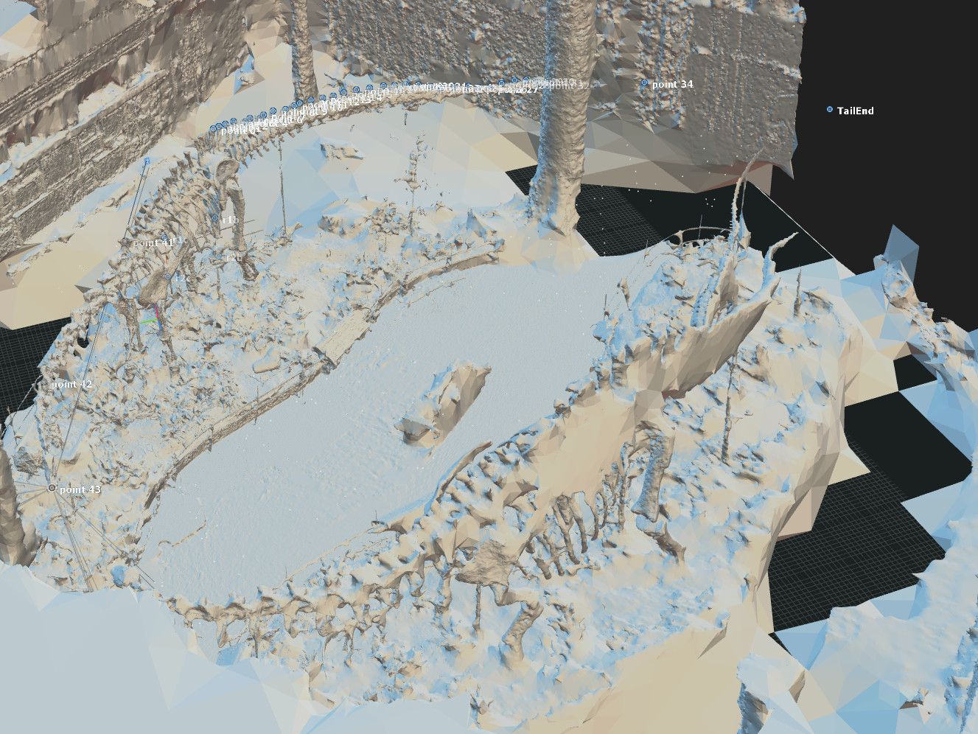
Total length of the mounted skeleton
Source Length (feet) Length (m) Comments
Hatcher (1901) 68 feet 20.7 m Tip of snout to caudal 37
Holland (1904a) 78–80 feet 21.3–24.4 m London mount, predicted
Holland (1904b) 84–85 feet 25.6–25.9 m London mount
Holland (1904b) 78–80 feet 21.3–24.4 m London mount
Holland (1905) 84 feet 25.6 m London mount
Holland (1907) 78.5 feet 23.94 m * Berlin mount.
Untermann (1959) 76 feet 23.2 m Vernal mount
David Letasi (p.c.) 75 feet 22.9 m Lehi elements, laid out
Vincent Reneleau (p.c.) 77 feet 23.5 m Distance along floor
Falkingham Photogram. 85.5 feet 26.05 m Current Carnegie mount

Slide 63
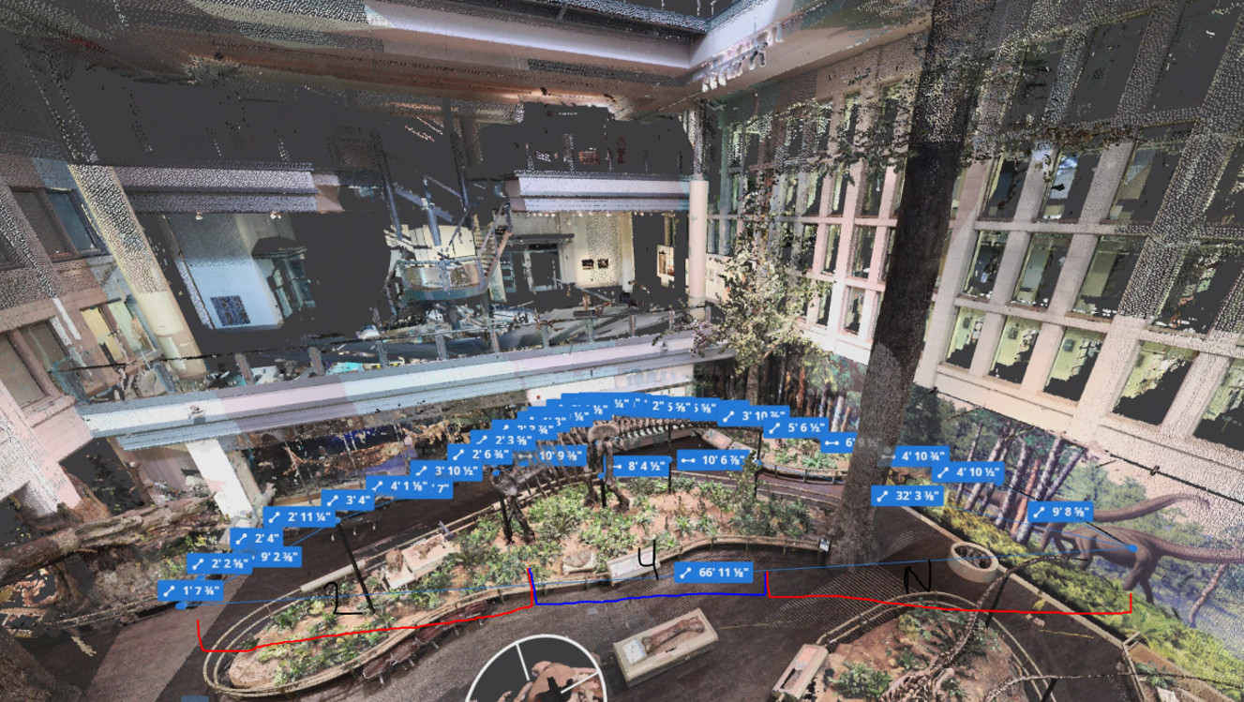
Total length of the mounted skeleton
Source Length (feet) Length (m) Comments
Hatcher (1901) 68 feet 20.7 m Tip of snout to caudal 37
Holland (1904a) 78–80 feet 21.3–24.4 m London mount, predicted
Holland (1904b) 84–85 feet 25.6–25.9 m London mount
Holland (1904b) 78–80 feet 21.3–24.4 m London mount
Holland (1905) 84 feet 25.6 m London mount
Holland (1907) 78.5 feet 23.94 m Berlin mount.
Untermann (1959) 76 feet 23.2 m Vernal mount
David Letasi (p.c.) 75 feet 22.9 m Lehi elements, laid out
Vincent Reneleau (p.c.) 77 feet 23.5 m Distance along floor
Falkingham Photogram. 85.5 feet 26.05 m Current Carnegie mount
Eye-Bot LIDAR 85 feet, 9 in 26.13 m Current Carnegie mount

Slide 64
Total length of the mounted skeleton
Source Length (feet) Length (m) Comments
Hatcher (1901) 68 feet 20.7 m Tip of snout to caudal 37
Holland (1904a) 78–80 feet 21.3–24.4 m London mount, predicted
Holland (1904b) 84–85 feet 25.6–25.9 m London mount
Holland (1904b) 78–80 feet 21.3–24.4 m London mount
Holland (1905) 84 feet 25.6 m London mount
Holland (1907) 78.5 feet 23.94 m Berlin mount.
Untermann (1959) 76 feet 23.2 m Vernal mount
David Letasi (p.c.) 75 feet 22.9 m Lehi elements, laid out
Vincent Reneleau (p.c.) 77 feet 23.5 m Distance along floor
Falkingham Photogram. 85.5 feet 26.05 m Current Carnegie mount
Eye-Bot LIDAR 85 feet, 9 in 26.13 m Current Carnegie mount
Consensus: old mount about 23 m, new mount 26 m.

