Slide 1
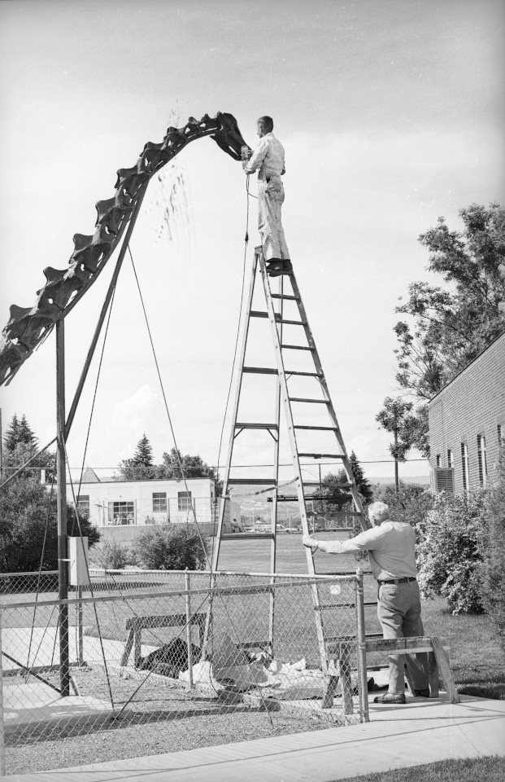
The Untold Story of
the Carnegie Diplodocus
Mike Taylor^{1,*}, Matt Lamanna², Ilja Nieuwland³, Amy Henrici², Linsly Church², Steve Sroka⁴ and Ken Carpenter⁵
1. University of Bristol, Bristol, UK
2. Carnegie Museum of Natural History, Pittsburgh, PA, USA
3. Royal Netherlands Academy of Arts and Sciences, Netherlands
4. Utah Field House of Natural History, Vernal, Utah, USA
5. University of Colorado Museum, Boulder, Colorado, USA

Slide 2
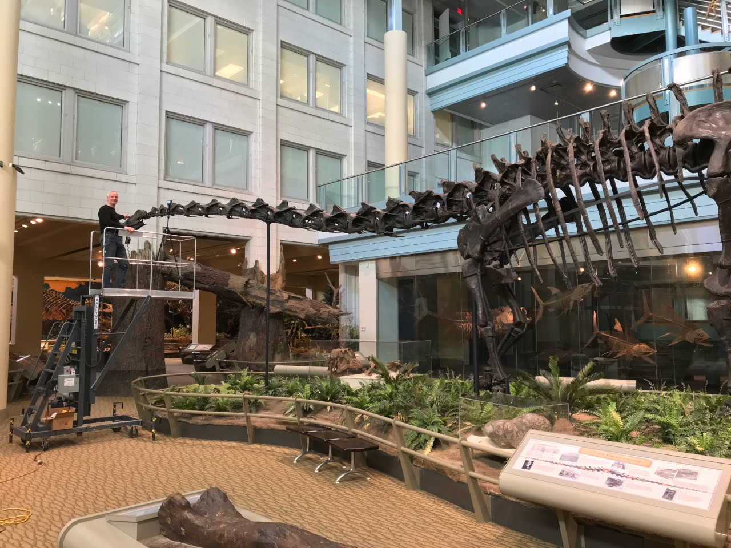
The sauropod
dinosaur
Diplodocus
Best known
from the
Carnegie
specimen
“CM 84”

Slide 3
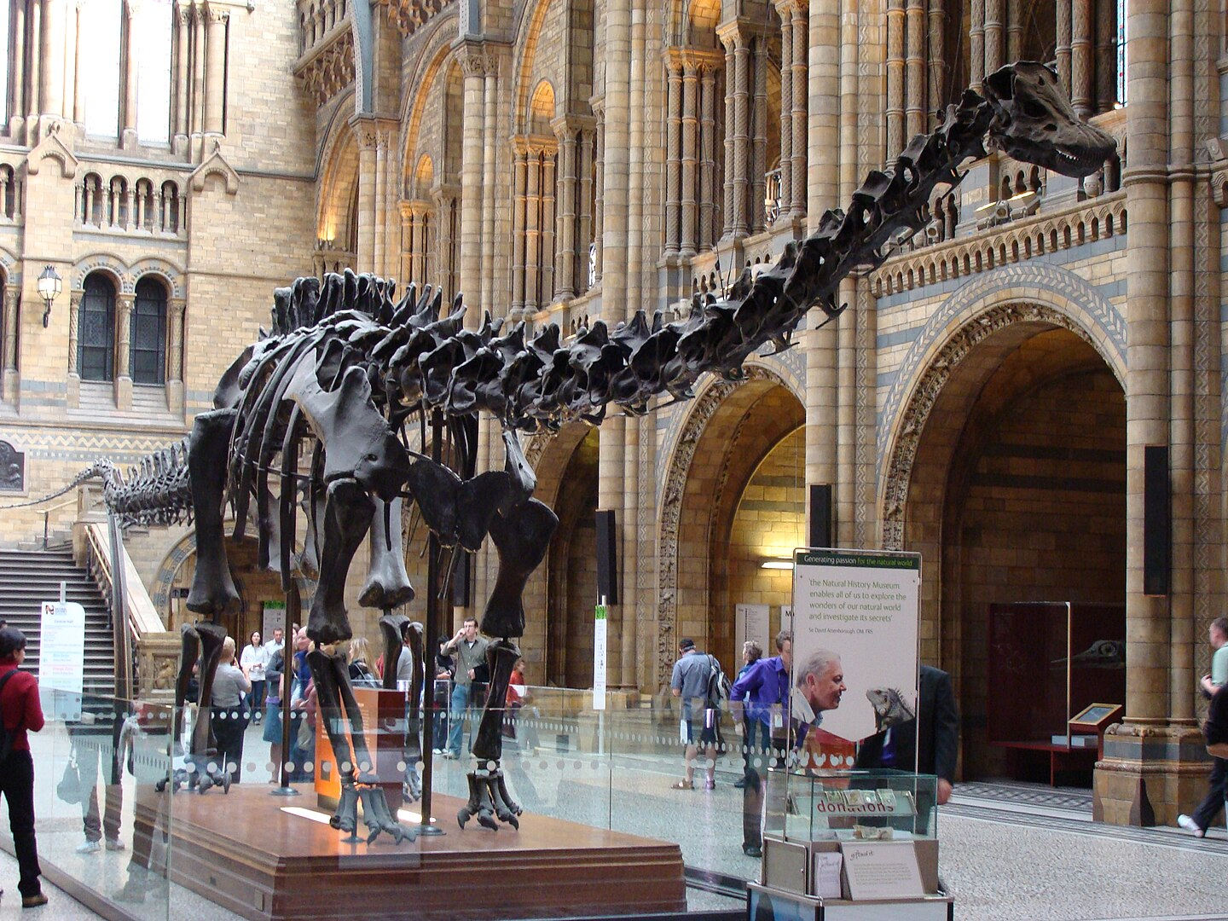
… And its
many casts
Photograph by
Fernando Losada Rodríguez
CC BY-SA 4.0

Slide 4
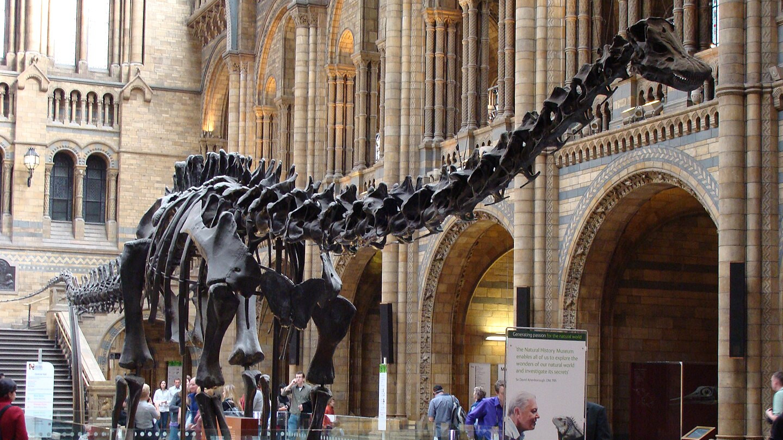
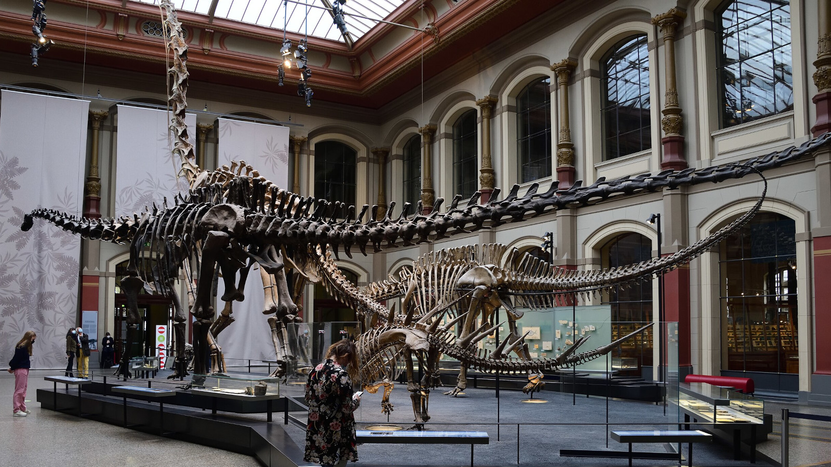
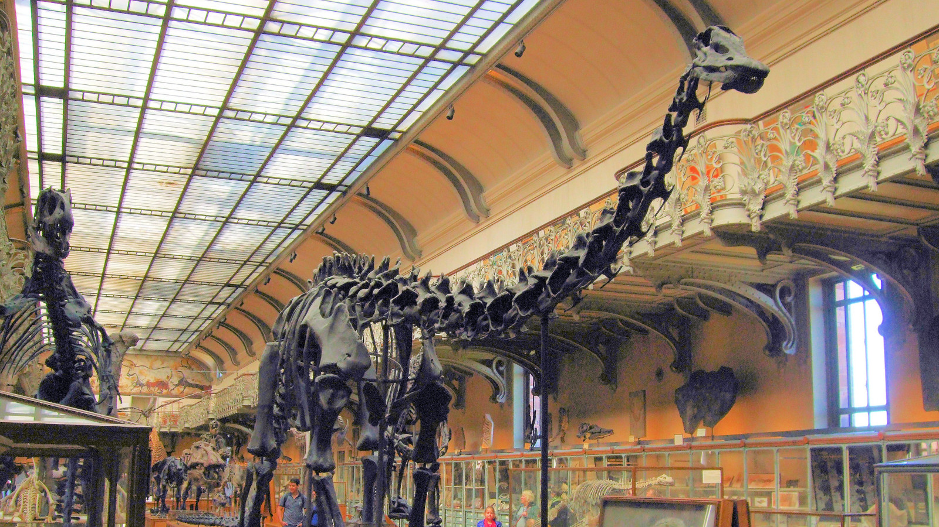
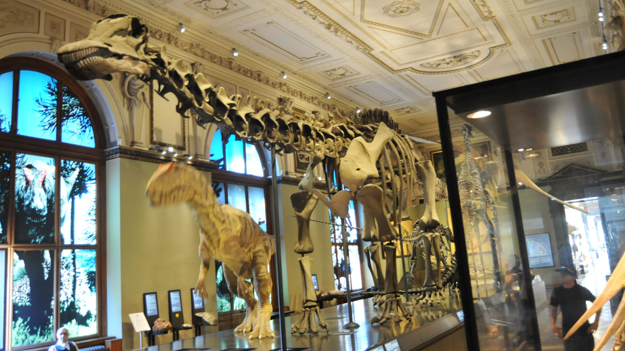
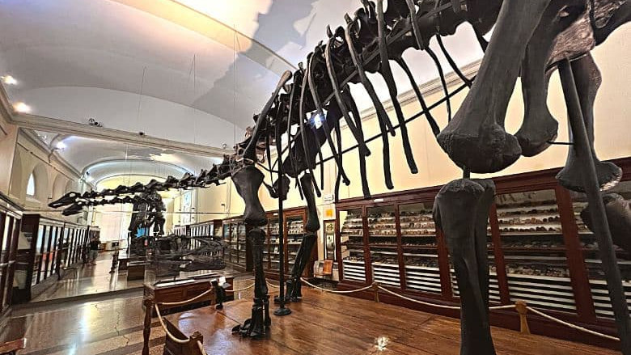
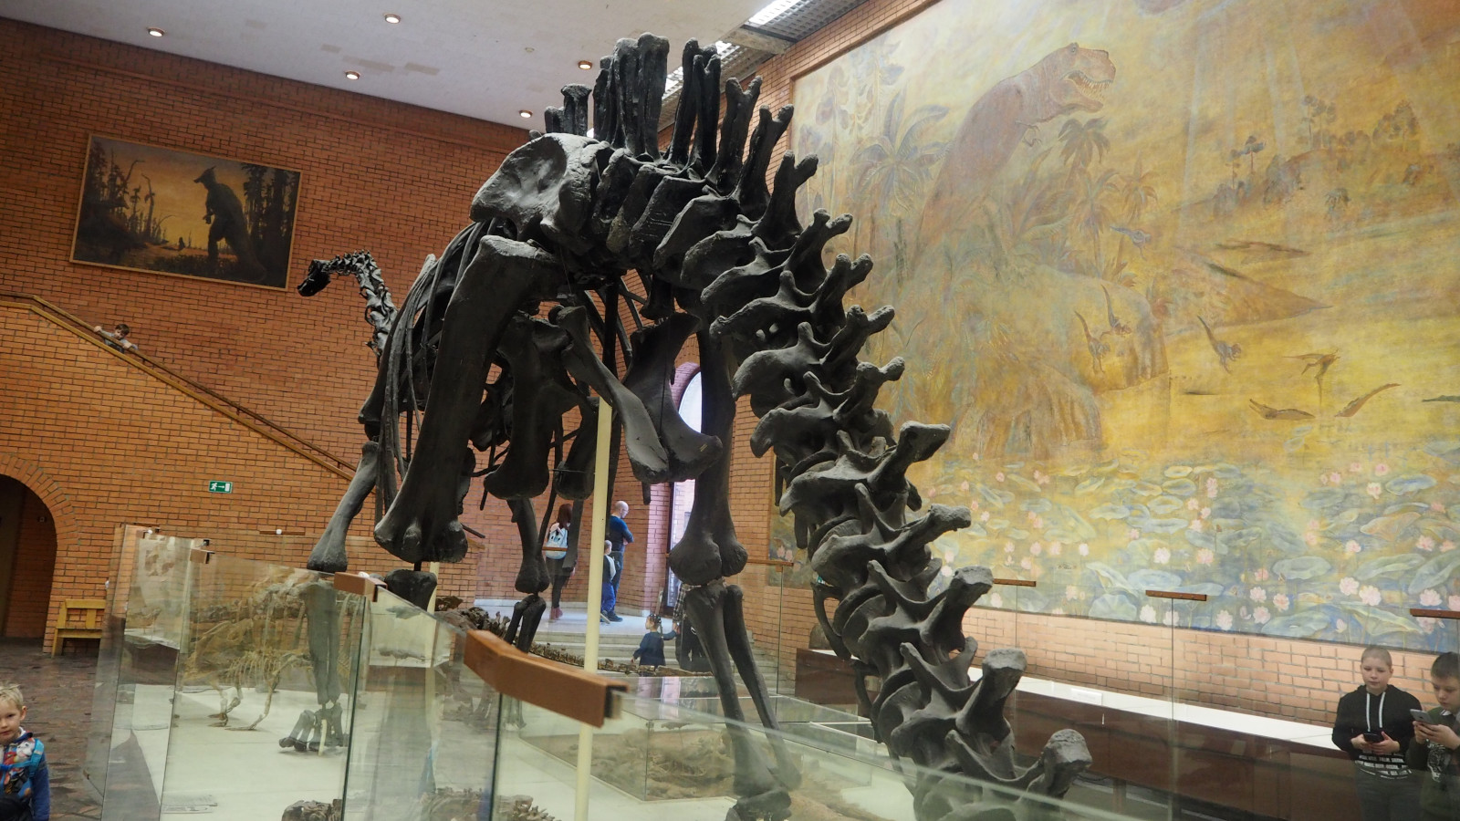
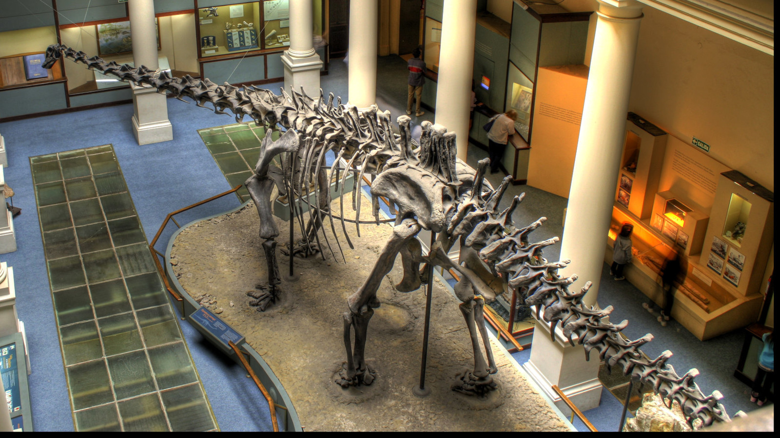
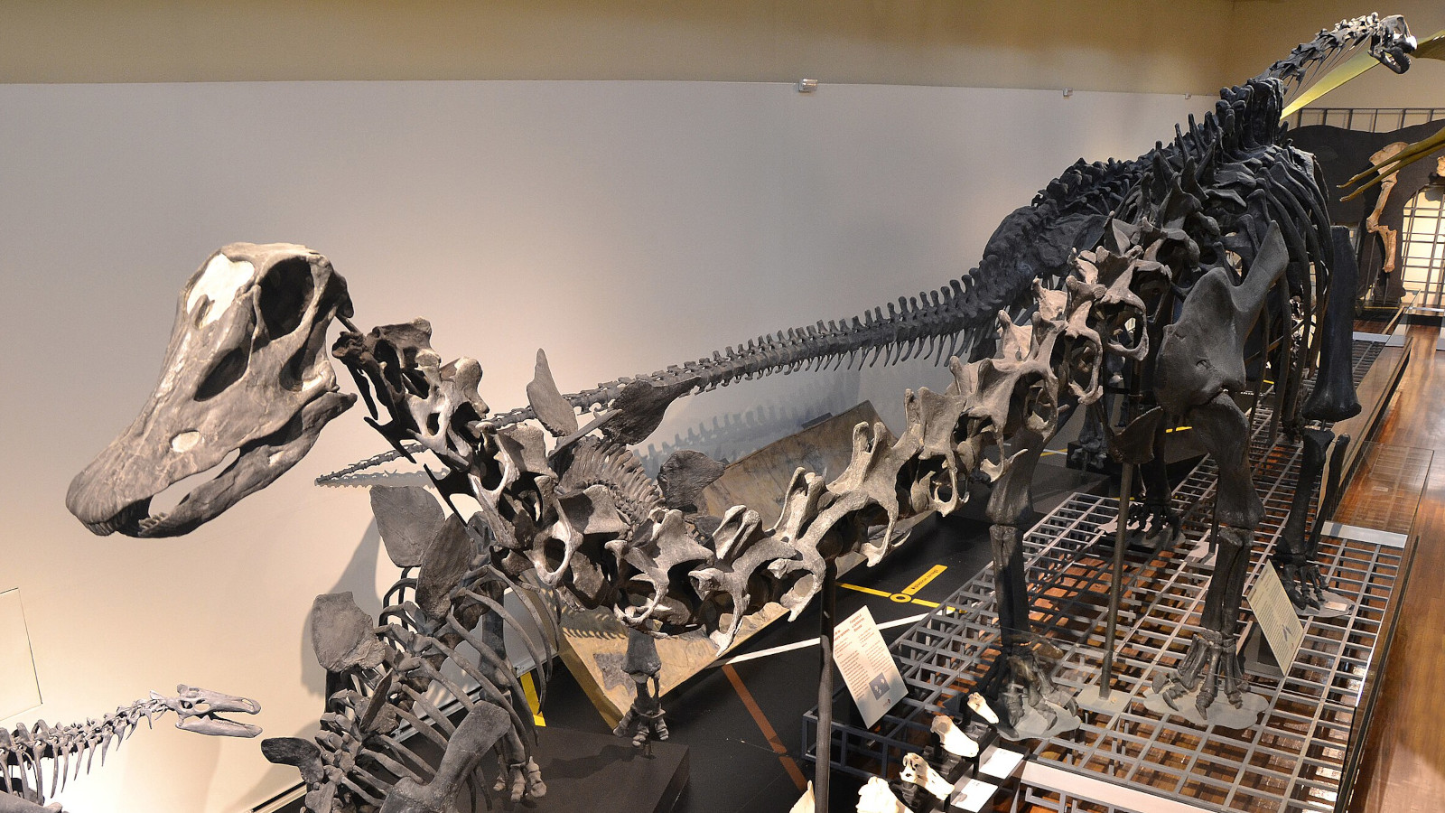
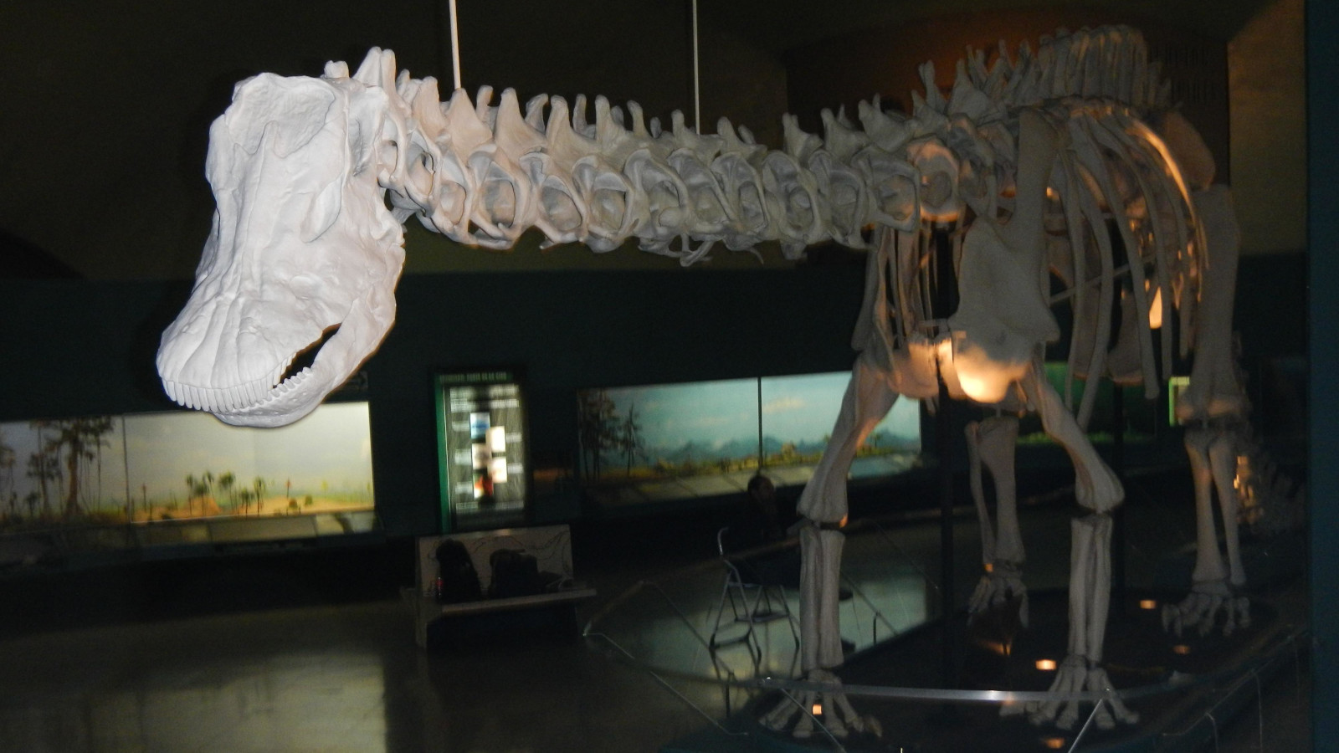
Photograph by
Fernando Losada Rodríguez
CC BY-SA 4.0

Slide 5
Casts were sent around the world in the early 1900s.
Natural History Museum | London | England | 12 May 1905
Museum für Naturkunde Berlin | Berlin | Germany | 13 May 1908
Muséum National d’Histoire Naturelle | Paris | France | 15 June 1908
Kaiserliches und königliches naturhistorisches Hof-Museum | Vienna | Austria | 24 September 1909
Giovanni Capellini Museum for Paleontology and Geology | Bologna | Italy | 27 October 1909
The Imperial Museum | St. Petersburg | Russia | Early July 1910
Museo de La Plata | La Plata | Argentina | 1912
Museo Nacional de Ciencias Naturales | Madrid | Spain | 2 December 1913
Museo de Paleontología (UNAM) | Mexico City | Mexico | 1930
Staatssammlung für Paläontologie und Geologie | Munich | Germany | 1934 (never mounted)

Slide 6
Photograph by
Fernando Losada Rodríguez
CC BY-SA 4.0

Slide 7
“Dippy”
Photograph by
Fernando Losada Rodríguez
CC BY-SA 4.0

Slide 8
“Dippy” 🤮
Photograph by
Fernando Losada Rodríguez
CC BY-SA 4.0

Slide 9
How I accidentally became an expert on this specimen

Slide 10
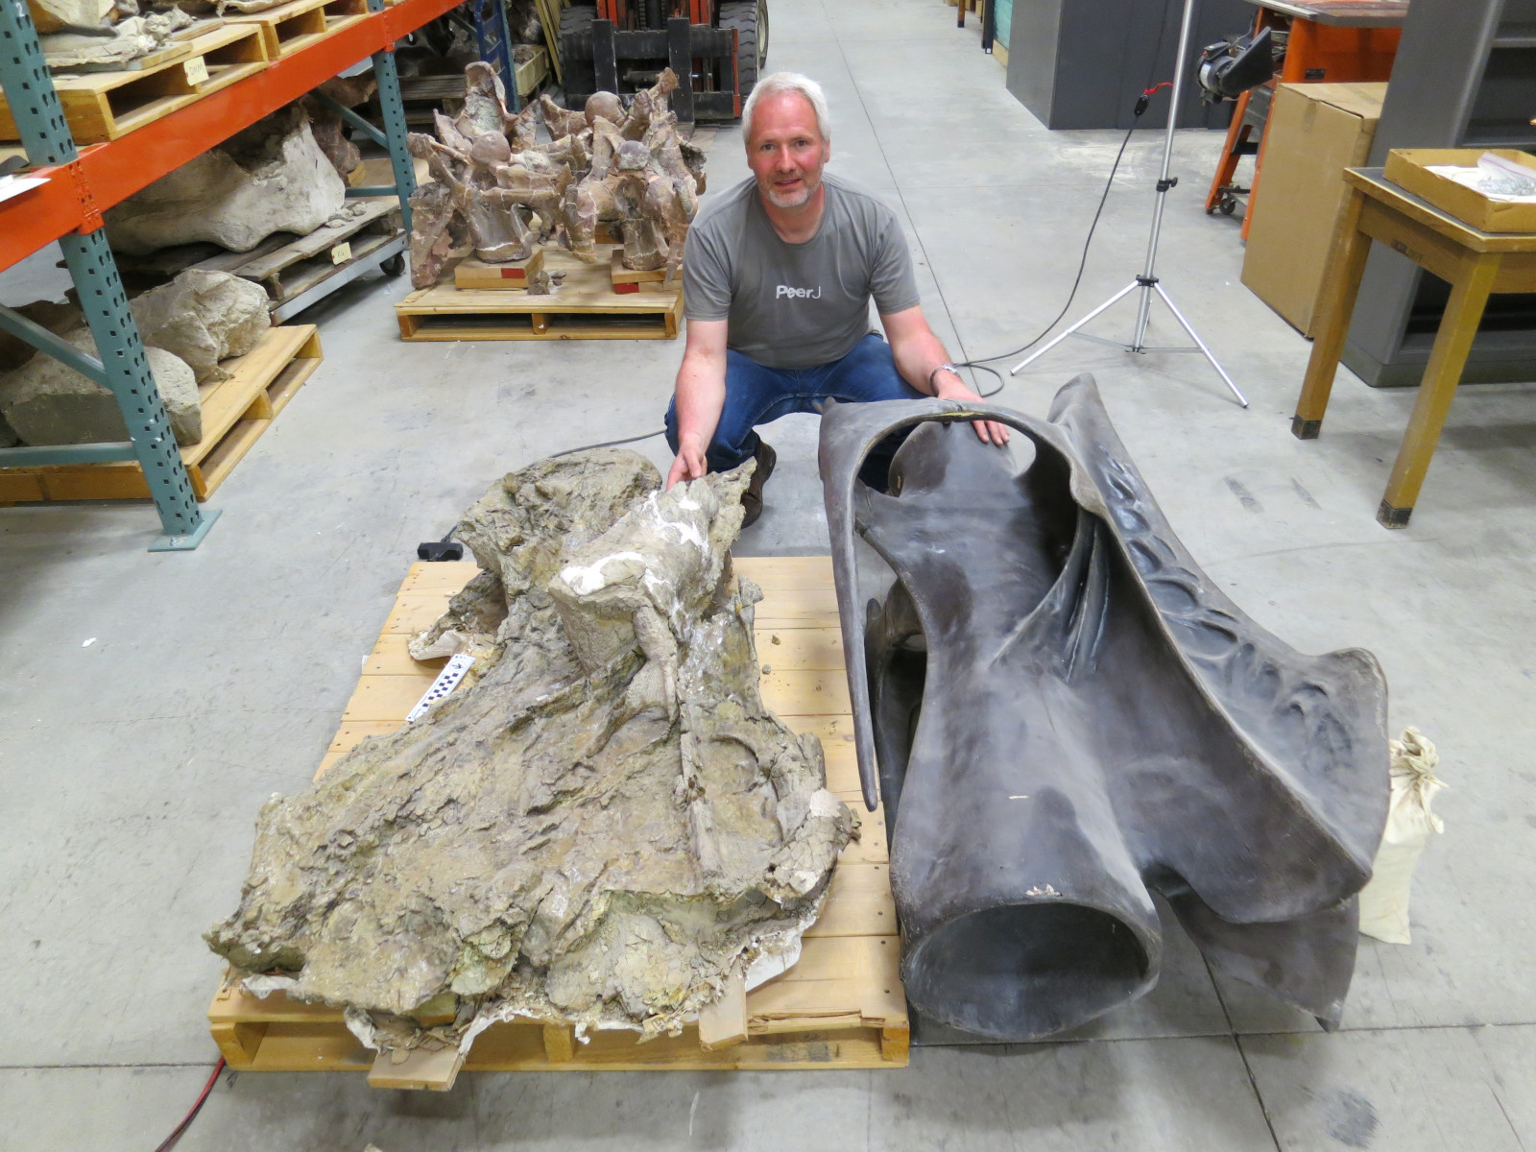
How I accidentally became an expert on this specimen
May 2016: Sauropocalypse.
Brigham Young University
Museum of Paleontology

Slide 11
How I accidentally became an expert on this specimen
May 2016: Sauropocalypse.
Brigham Young University
Museum of Paleontology
Matt Wedel and I think
BYU 9024 is Barosaurus.

Slide 12
How I accidentally became an expert on this specimen
May 2016: Sauropocalypse. Matt and I think BYU 9024 is Barosaurus.
August 2016: "How big did Barosaurus get?" talk at SVPCA in Liverpool.

Slide 13

How I accidentally became an expert on this specimen
May 2016: Sauropocalypse. Matt and I think BYU 9024 is Barosaurus.
August 2016: "How big did Barosaurus get?" talk at SVPCA in Liverpool.
February 2022: "Giant specimens of Barosaurus from Utah and Colorado"

Slide 14
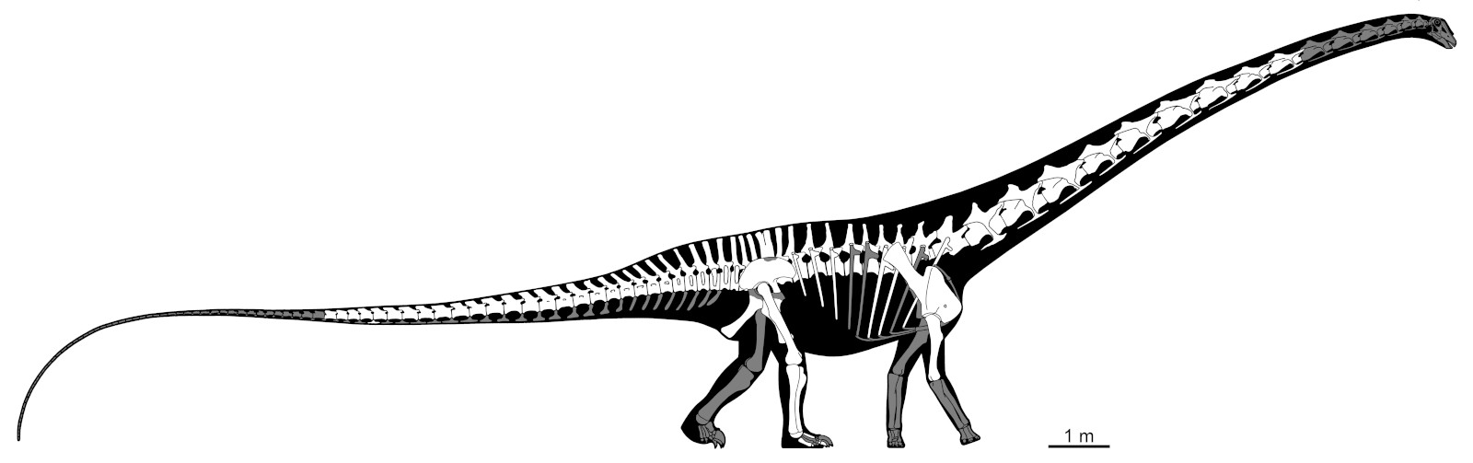
How I accidentally became an expert on this specimen
May 2016: Sauropocalypse. Matt and I think BYU 9024 is Barosaurus.
August 2016: "How big did Barosaurus get?" talk at SVPCA in Liverpool.
February 2022: "Giant specimens of Barosaurus from Utah and Colorado"
March 2022: write background on the AMNH 6341 Barosaurus.

Slide 15
How I accidentally became an expert on this specimen
May 2016: Sauropocalypse. Matt and I think BYU 9024 is Barosaurus.
August 2016: "How big did Barosaurus get?" talk at SVPCA in Liverpool.
February 2022: "Giant specimens of Barosaurus from Utah and Colorado"
March 2022: write background on the AMNH 6341 Barosaurus.
March 2022: "Barosaurus lentus in the American Museum of Natural History".

Slide 16
How I accidentally became an expert on this specimen
May 2016: Sauropocalypse. Matt and I think BYU 9024 is Barosaurus.
August 2016: "How big did Barosaurus get?" talk at SVPCA in Liverpool.
February 2022: "Giant specimens of Barosaurus from Utah and Colorado"
March 2022: write background on the AMNH 6341 Barosaurus.
March 2022: "Barosaurus lentus in the American Museum of Natural History".
March 2022: write background on sources of elements for the mount

Slide 17
How I accidentally became an expert on this specimen
May 2016: Sauropocalypse. Matt and I think BYU 9024 is Barosaurus.
August 2016: "How big did Barosaurus get?" talk at SVPCA in Liverpool.
February 2022: "Giant specimens of Barosaurus from Utah and Colorado"
March 2022: write background on the AMNH 6341 Barosaurus.
March 2022: "Barosaurus lentus in the American Museum of Natural History".
March 2022: write background on sources of elements for the mount
April 2022: "The Concrete Diplodocus of Vernal".

Slide 18
How I accidentally became an expert on this specimen
May 2016: Sauropocalypse. Matt and I think BYU 9024 is Barosaurus.
August 2016: "How big did Barosaurus get?" talk at SVPCA in Liverpool.
February 2022: "Giant specimens of Barosaurus from Utah and Colorado"
March 2022: write background on the AMNH 6341 Barosaurus.
March 2022: "Barosaurus lentus in the American Museum of Natural History".
March 2022: write background on sources of elements for the mount
April 2022: "The Concrete Diplodocus of Vernal".
April 2022: write background on sources of bones in Carnegie Diplodocus.

Slide 19
How I accidentally became an expert on this specimen
May 2016: Sauropocalypse. Matt and I think BYU 9024 is Barosaurus.
August 2016: "How big did Barosaurus get?" talk at SVPCA in Liverpool.
February 2022: "Giant specimens of Barosaurus from Utah and Colorado"
March 2022: write background on the AMNH 6341 Barosaurus.
March 2022: "Barosaurus lentus in the American Museum of Natural History".
March 2022: write background on sources of elements for the mount
April 2022: "The Concrete Diplodocus of Vernal".
April 2022: write background on sources of bones in Carnegie Diplodocus.
April 2022: "The history and composition of the Carnegie Diplodocus".

Slide 20
How I accidentally became an expert on this specimen
May 2016: Sauropocalypse. Matt and I think BYU 9024 is Barosaurus.
August 2016: "How big did Barosaurus get?" talk at SVPCA in Liverpool.
February 2022: "Giant specimens of Barosaurus from Utah and Colorado"
March 2022: write background on the AMNH 6341 Barosaurus.
March 2022: "Barosaurus lentus in the American Museum of Natural History".
March 2022: write background on sources of elements for the mount
April 2022: "The Concrete Diplodocus of Vernal".
April 2022: write background on sources of bones in Carnegie Diplodocus.
April 2022: "The history and composition of the Carnegie Diplodocus".
August 2022: write sections about changes made to the various casts.

Slide 21
How I accidentally became an expert on this specimen
May 2016: Sauropocalypse. Matt and I think BYU 9024 is Barosaurus.
August 2016: "How big did Barosaurus get?" talk at SVPCA in Liverpool.
February 2022: "Giant specimens of Barosaurus from Utah and Colorado"
March 2022: write background on the AMNH 6341 Barosaurus.
March 2022: "Barosaurus lentus in the American Museum of Natural History".
March 2022: write background on sources of elements for the mount
April 2022: "The Concrete Diplodocus of Vernal".
April 2022: write background on sources of bones in Carnegie Diplodocus.
April 2022: "The history and composition of the Carnegie Diplodocus".
August 2022: write sections about changes made to the various casts.
July 2024: "The history of the cast skeletons of the Carnegie Diplodocus".

Slide 22
How I accidentally became an expert on this specimen
February 2022: "Giant specimens of Barosaurus from Utah and Colorado"
March 2022: "Barosaurus lentus in the American Museum of Natural History".
April 2022: "The Concrete Diplodocus of Vernal".
April 2022: "The history and composition of the Carnegie Diplodocus".
July 2024: "The history of the cast skeletons of the Carnegie Diplodocus".

Slide 23
How I accidentally became an expert on this specimen
February 2022: "Giant specimens of Barosaurus from Utah and Colorado"
March 2022: "Barosaurus lentus in the American Museum of Natural History".
April 2022: "The Concrete Diplodocus of Vernal".
April 2022: "The history and composition of the Carnegie Diplodocus".
July 2024: "The history of the cast skeletons of the Carnegie Diplodocus".
Published!

Slide 24
How I accidentally became an expert on this specimen
February 2022: "Giant specimens of Barosaurus from Utah and Colorado"
March 2022: "Barosaurus lentus in the American Museum of Natural History".
April 2022: "The Concrete Diplodocus of Vernal".
April 2022: "The history and composition of the Carnegie Diplodocus".
July 2024: "The history of the cast skeletons of the Carnegie Diplodocus".
Published!
Published!

Slide 25
How I accidentally became an expert on this specimen
February 2022: "Giant specimens of Barosaurus from Utah and Colorado"
March 2022: "Barosaurus lentus in the American Museum of Natural History".
April 2022: "The Concrete Diplodocus of Vernal".
April 2022: "The history and composition of the Carnegie Diplodocus".
July 2024: "The history of the cast skeletons of the Carnegie Diplodocus".
95%
Published!
Published!

Slide 26
How I accidentally became an expert on this specimen
February 2022: "Giant specimens of Barosaurus from Utah and Colorado"
March 2022: "Barosaurus lentus in the American Museum of Natural History".
April 2022: "The Concrete Diplodocus of Vernal".
April 2022: "The history and composition of the Carnegie Diplodocus".
July 2024: "The history of the cast skeletons of the Carnegie Diplodocus".
95%
Published!
Published!
75%

Slide 27
How I accidentally became an expert on this specimen
February 2022: "Giant specimens of Barosaurus from Utah and Colorado"
March 2022: "Barosaurus lentus in the American Museum of Natural History".
April 2022: "The Concrete Diplodocus of Vernal".
April 2022: "The history and composition of the Carnegie Diplodocus".
July 2024: "The history of the cast skeletons of the Carnegie Diplodocus".
65%
95%
Published!
Published!
75%

Slide 28
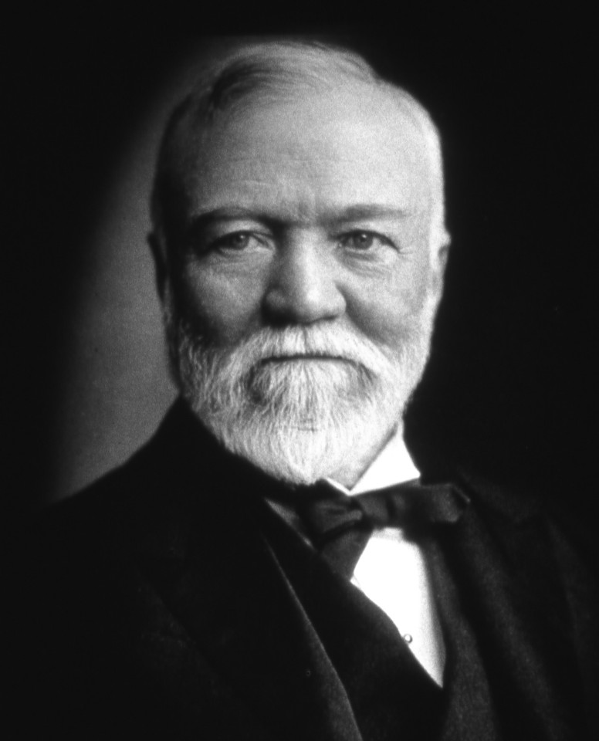
Meet Andrew Carnegie
Steel magnate in late 1800s.
One of the richest people in the world.

Slide 29
Meet Andrew Carnegie
Steel magnate in late 1800s.
One of the richest people in the world.
Became concerned about his legacy.
In early 1900s, gave away 90% of wealth.

Slide 30
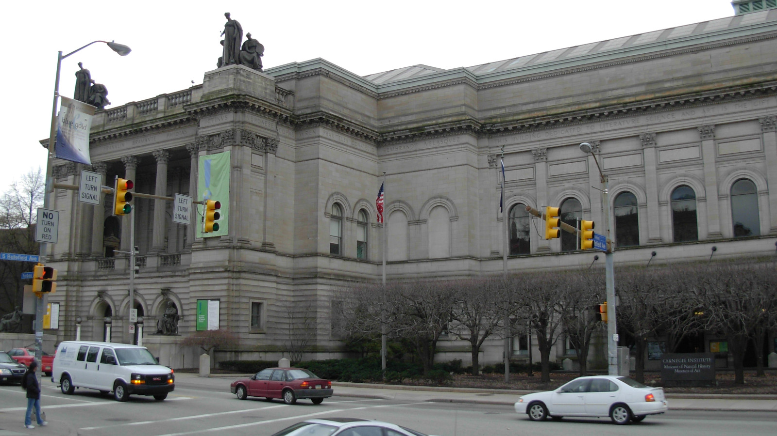
The Carnegie Museum of Natural History
Pittsburgh, Pennsylvania

Slide 31
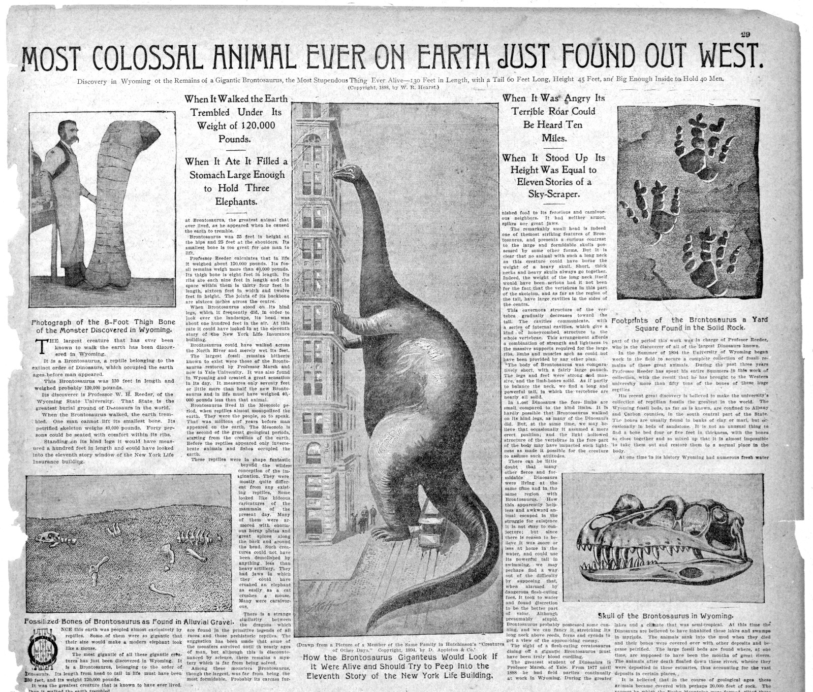
Anonymous 1898b
New York Journal
and Advertiser
11 December 1898

Slide 32
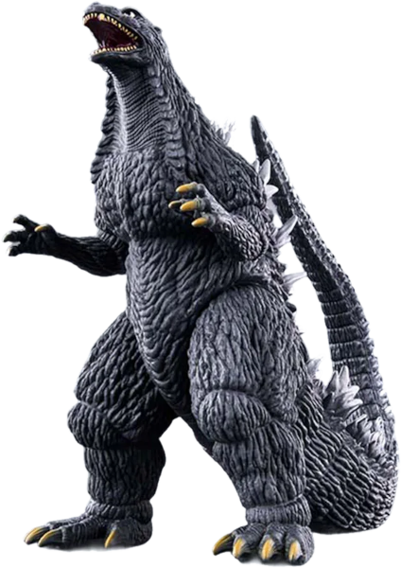
Anonymous 1898b
New York Journal
and Advertiser
11 December 1898

Slide 33
Anonymous 1898b
New York Journal
and Advertiser
11 December 1898

Slide 34
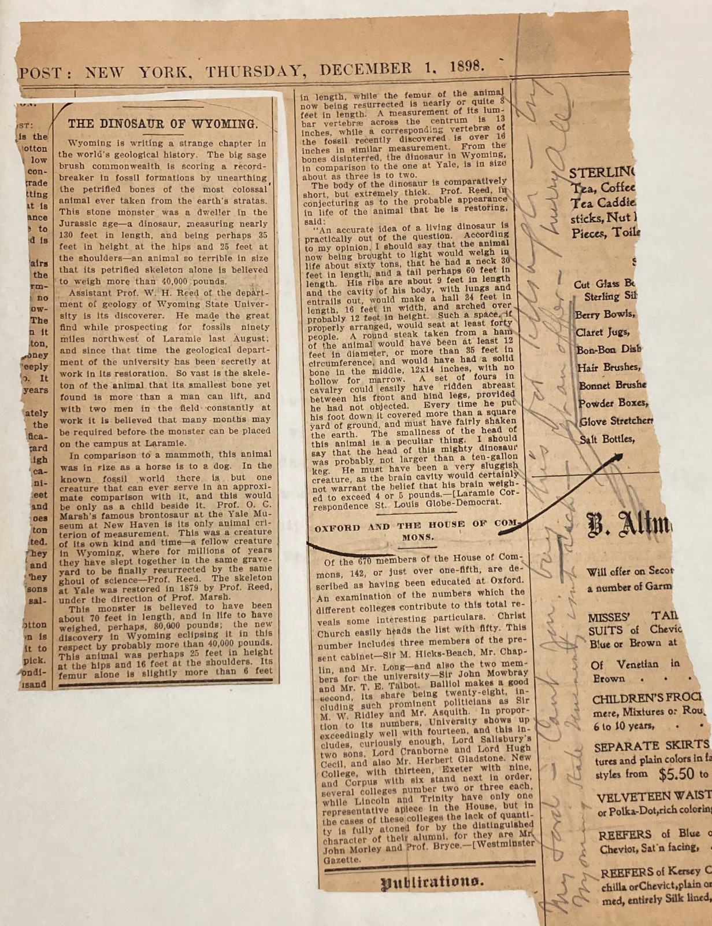
Anonymous 1898a
New York Post
1 December 1898.

Slide 35
Anonymous 1898a
New York Post
1 December 1898.

Slide 36
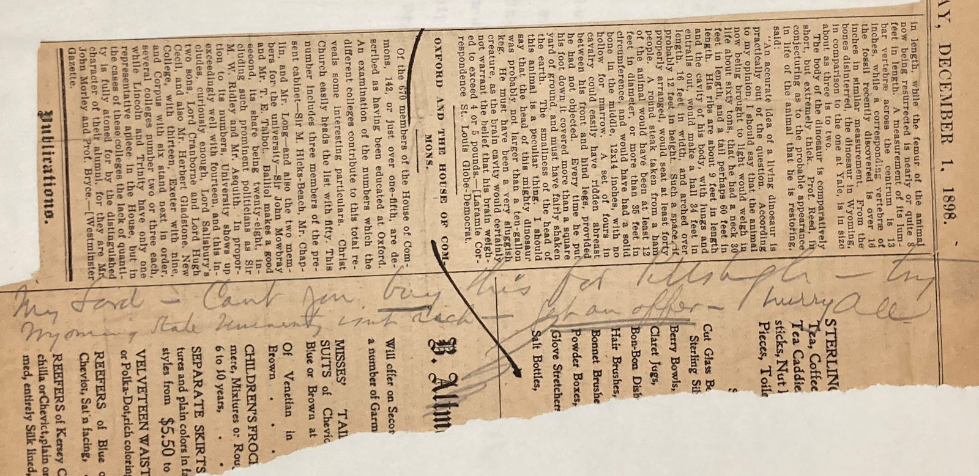
Anonymous 1898a

Slide 37
Anonymous 1898a
My Lord — Cant you buy this for Pittsburgh — try
Wyoming State University isnt rich — get an offer— hurry AC

Slide 38
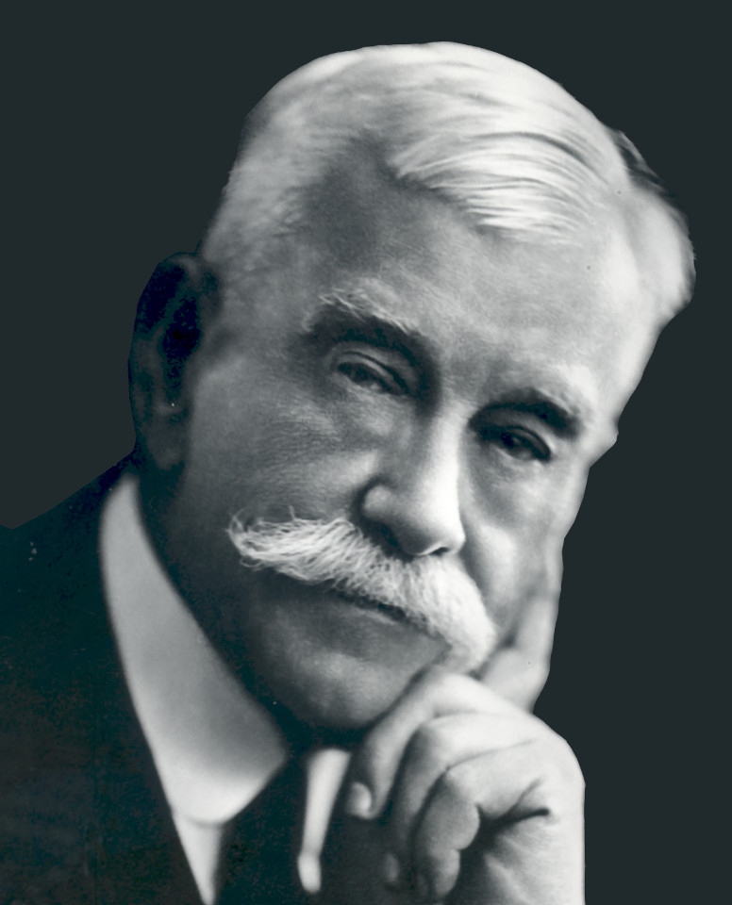
Meet William J. Holland
Director of the Carnegie Museum.

Slide 39
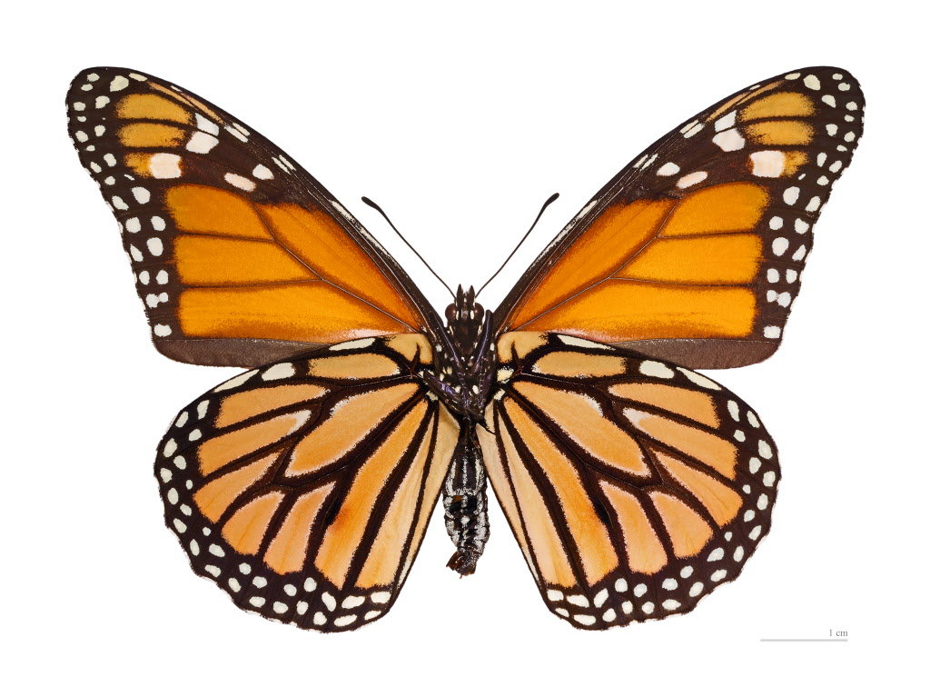
Meet William J. Holland
Director of the Carnegie Museum.
Lepidopterist.

Slide 40
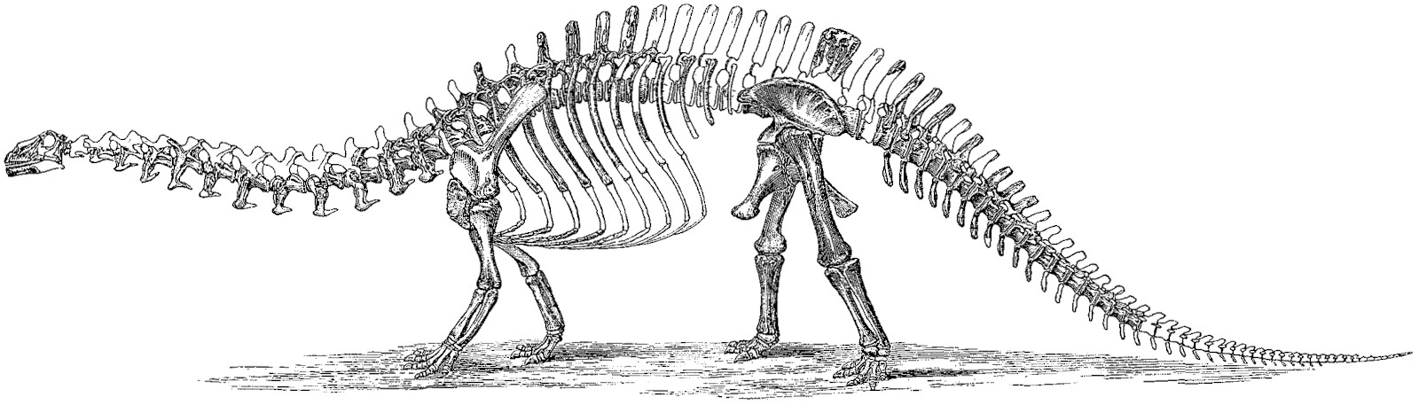
The incredible shrinking dinosaur

Slide 41
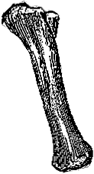
The incredible shrinking dinosaur

Slide 42
The incredible shrinking dinosaur

Slide 43
The incredible shrinking dinosaur

Slide 44
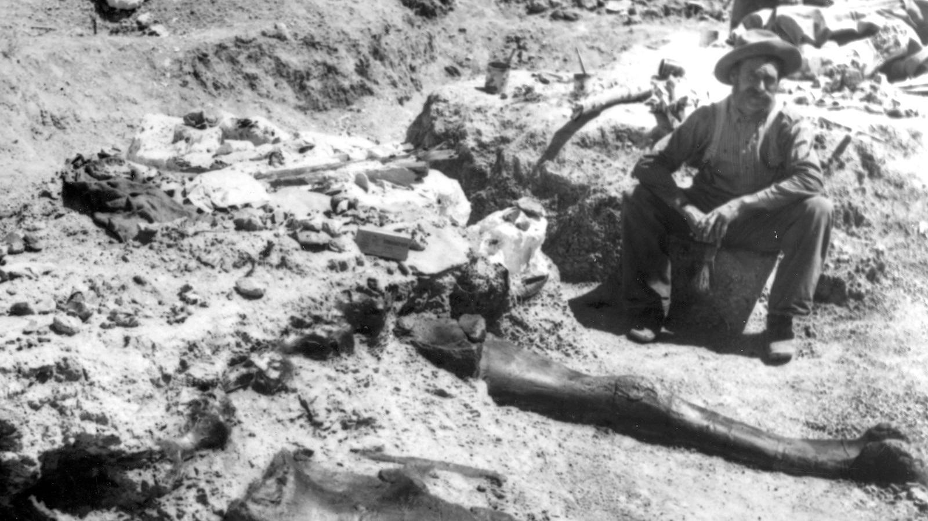
Meet William H. Reed
Discoverer of “The most colossal
Animal ever on earth.

Slide 45
Meet William H. Reed
Discoverer of “The most colossal
Animal ever on earth.
Hired by Holland to find a better
sauropod.

Slide 46
Meet William H. Reed
Discoverer of “The most colossal
Animal ever on earth.
Hired by Holland to find a better
sauropod.
Here with the right femur of
The Carnegie Diplodocus.
Found on 2nd or 3rd July 1899

Slide 47
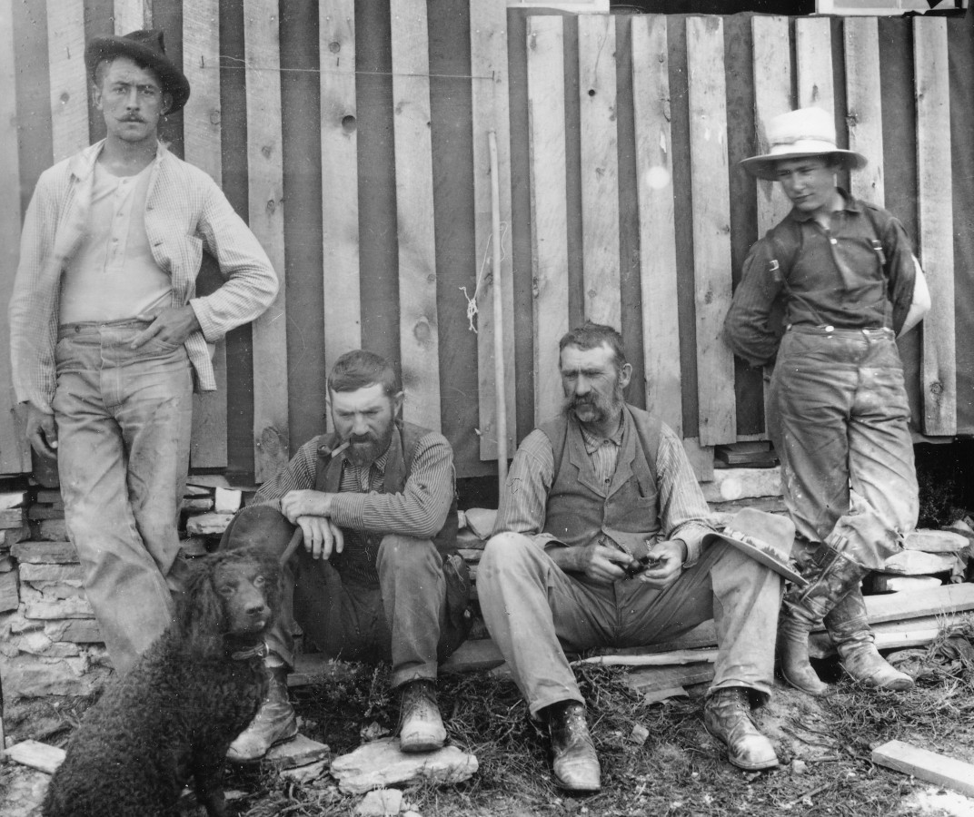
The field crew
Paul Miller
Jacob L. Wortman
William H. Reed
William Reed, Jr.
Not pictured:
Arthur S. Coggeshall.

Slide 48
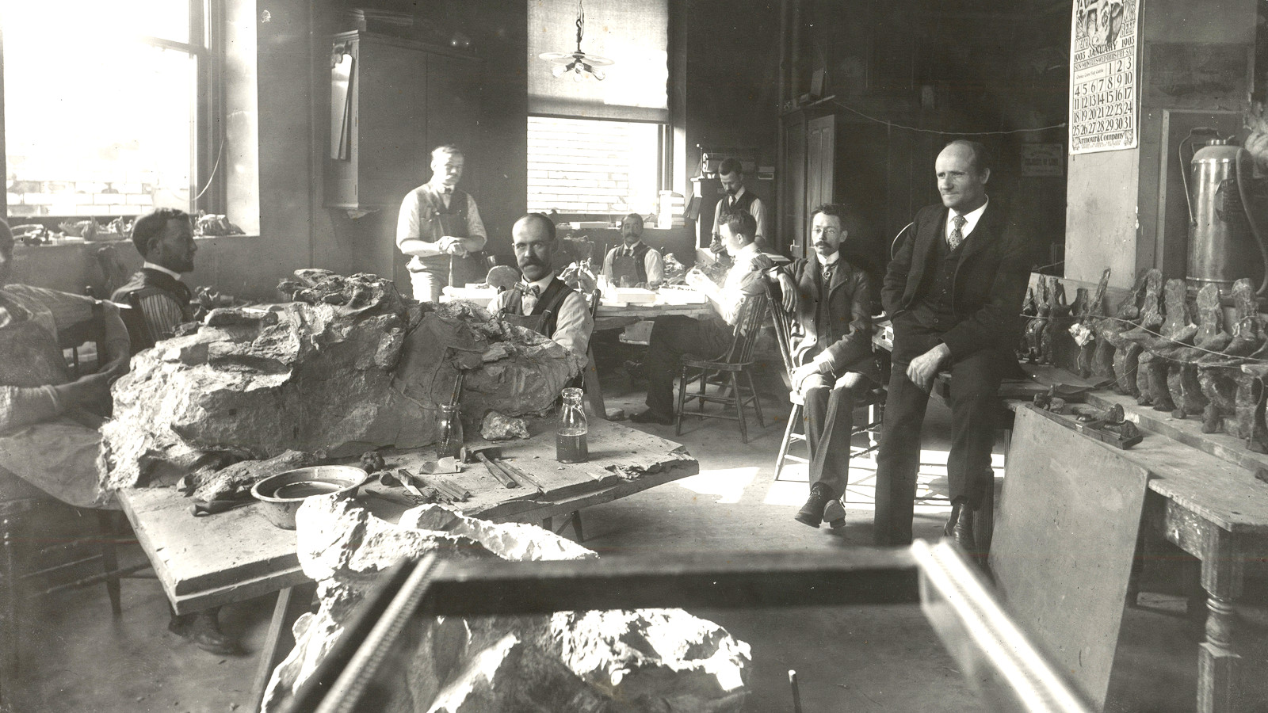
The prep lab (a few years later)
Olaf Peterson
Louis S. Coggeshall
Charles W. Gilmore
Earl Douglass
Arthur S. Coggeshall
Asher W. VanKirk
Sydney Prentice
John Bell Hatcher

Slide 49
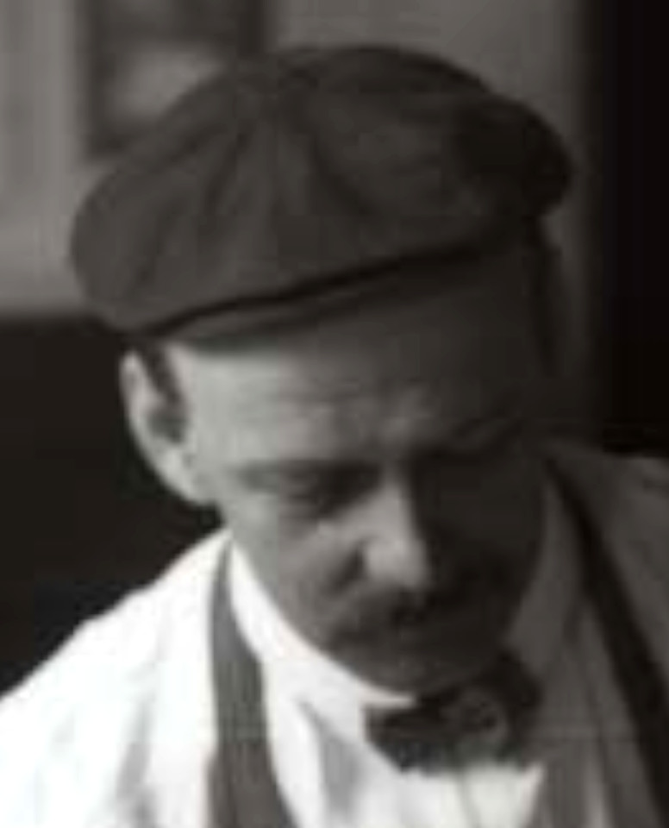
Meet Arthur S. Coggeshall
Lead preparator of the fossils.

Slide 50
Meet Arthur S. Coggeshall
Lead preparator of the fossils.
(Bad photo because he was working class.)

Slide 51
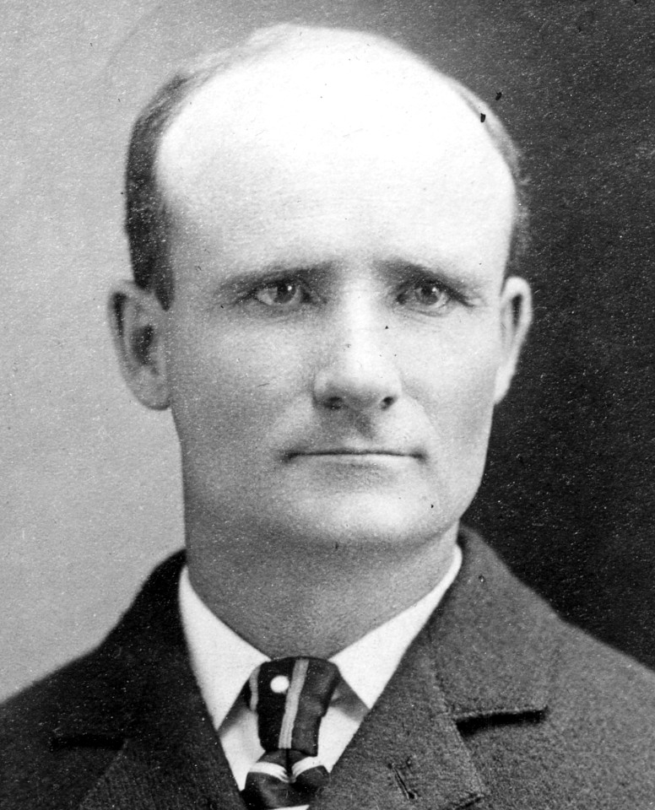
Meet John B. Hatcher
Writer of the monographic description:
Hatcher, John B. 1901. Diplodocus (Marsh):
its osteology, taxonomy and probable habits,
with a restoration of the skeleton.
Memoirs of the Carnegie Museum 1:1–63
and plates I–XIII.

Slide 52
Meet John B. Hatcher
Writer of the monographic description:
Hatcher, John B. 1901. Diplodocus (Marsh):
its osteology, taxonomy and probable habits,
with a restoration of the skeleton.
Memoirs of the Carnegie Museum 1:1–63
and plates I–XIII.
We still cite this all the time.
Want to live forever?
Do good descriptive work.

Slide 53
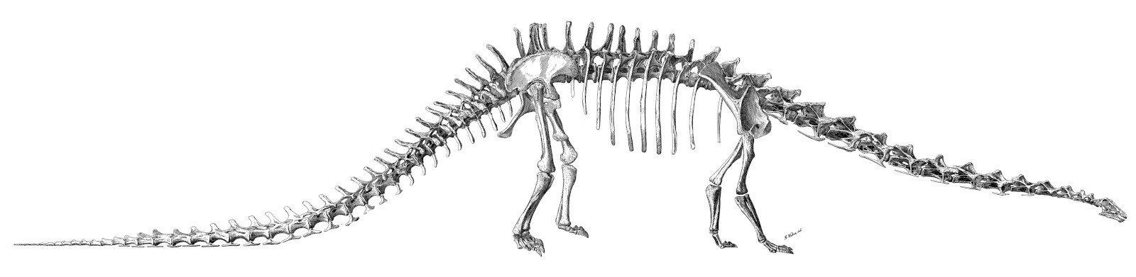
Meet Diplodocus carnegii
Hatcher 1901: plate XII
(Artwork by the much overlooked R. Weber.)

Slide 54
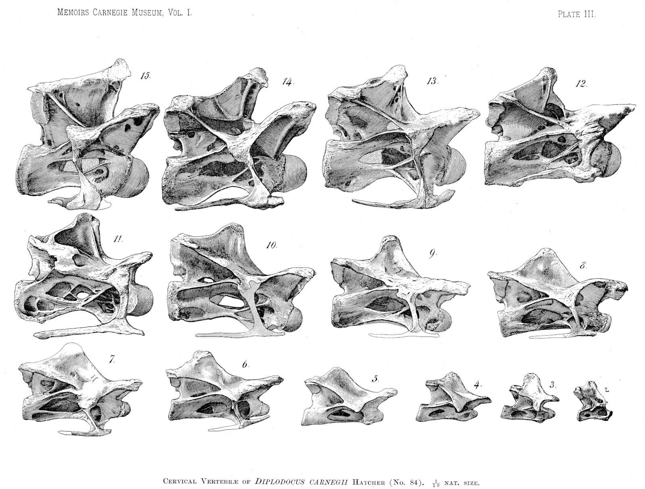
Meet
Diplodocus
carnegii
Hatcher 1901: plate III

Slide 55
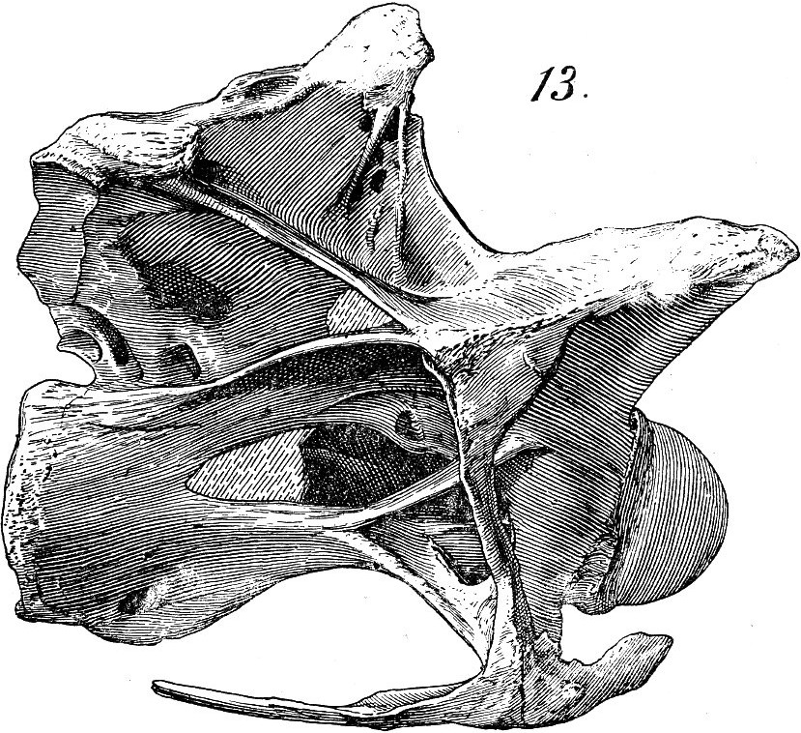
Meet
Diplodocus
carnegii
Hatcher 1901: plate III

Slide 56
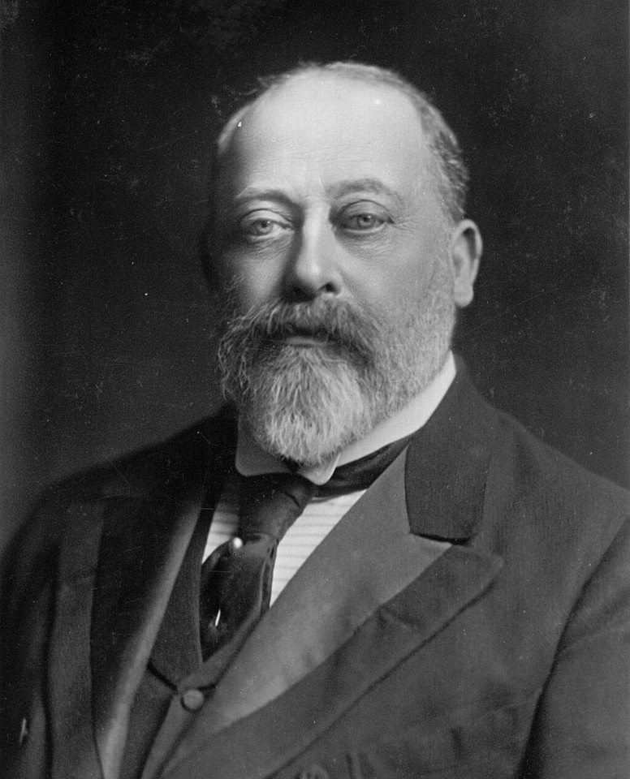
Meet King Edward VII
Known as “Bertie”
Eldest son of Queen Victoria
Heir to throne for 60 years
King from 1901–1910.

Slide 57
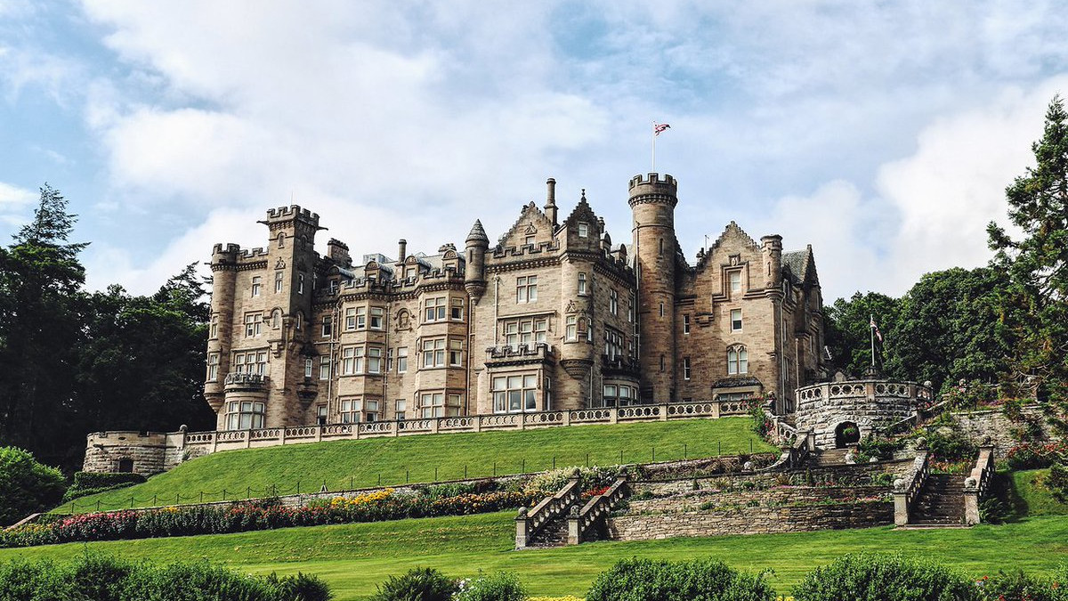
King Edward VII visited Carnegie at Skibo Castle
A surprise visit in October 1902.

Slide 58
… where the King saw Hatcher’s Diplodocus plate

Slide 59
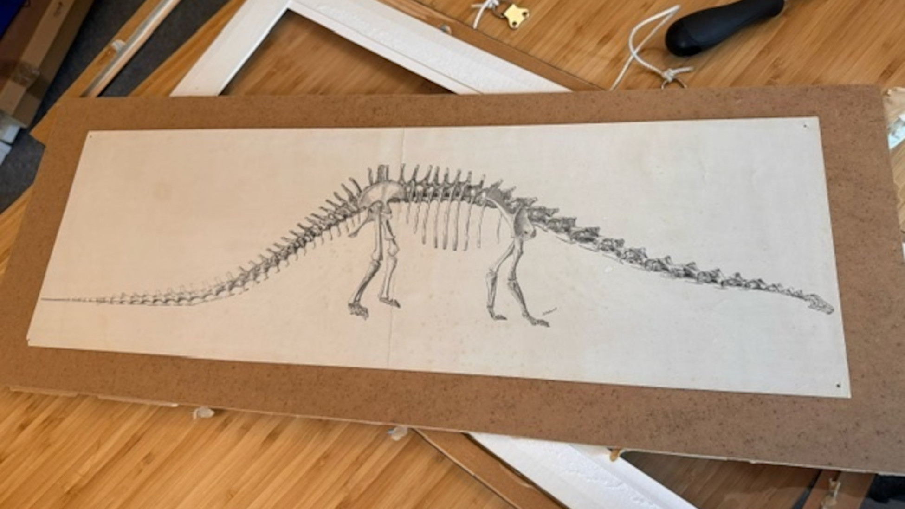
… where the King saw Hatcher’s Diplodocus plate
Now in the collection at the Carnegie Birthplace Museum.

Slide 60
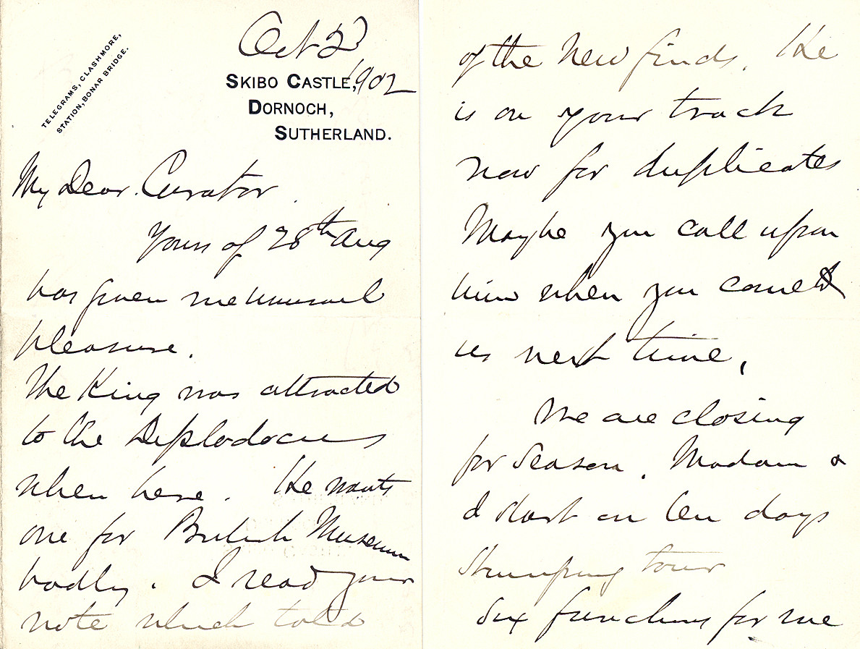
“I want one”
“The King was attracted to the Diplodocus when here. He wants one for British Museum badly. I read your note which told of the new finds. He is on your track now for duplicate.”
Carnegie to Holland,
2 October 1902.

Slide 61
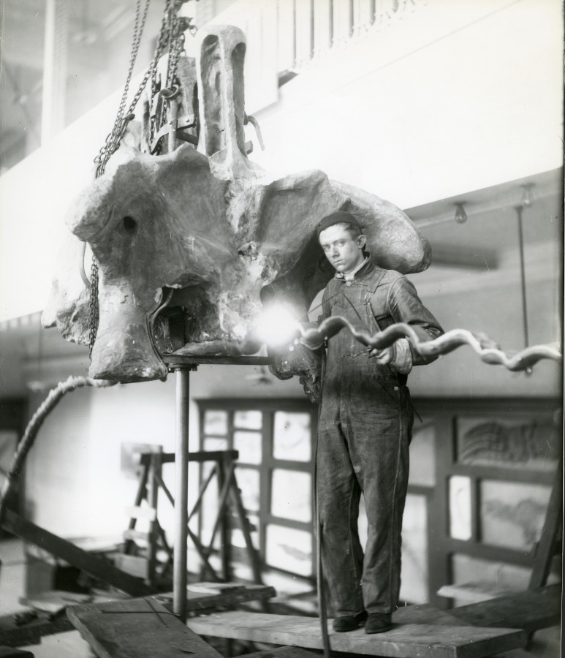
Meet Serafino Agostini
Italian sculptor.
Led the moulding and casting process.

Slide 62
Meet Serafino Agostini
Italian sculptor.
Led the moulding and casting process.
Previously worked on church statuary.

Slide 63
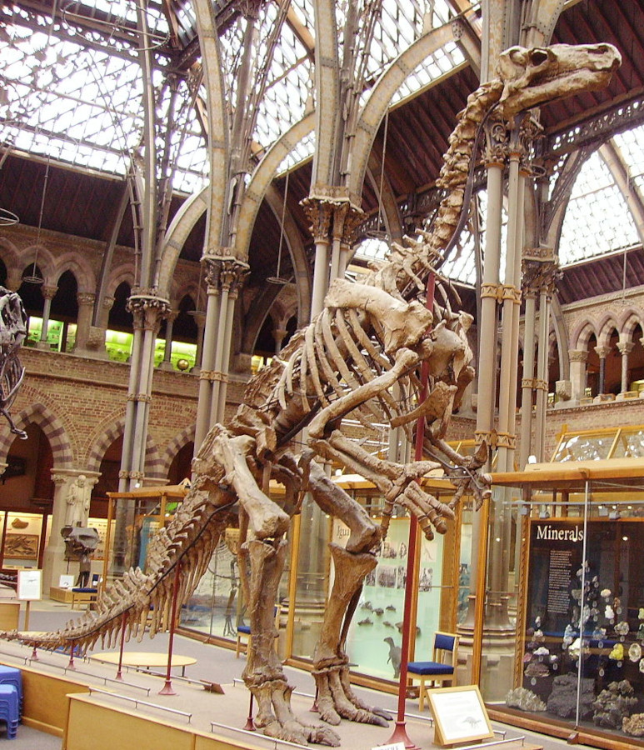
Meet Serafino Agostini
Italian sculptor.
Led the moulding and casting process.
Only previously done with
Belgian Iguanodon.
Secretive.

Slide 64
Meet Serafino Agostini
Italian sculptor.
Led the moulding and casting process.
“To produce the plaster dinosaurs, a cast had to be made of each bone. The entire bone could not be copied at one time but, protected by a thin coating of wax, must be marked off by wax ridges into small sections, sometimes as many as twenty to one bone. [...] The plaster could not be cast directly on the bone because of its brittleness.”
— Seneff (1947:118)

Slide 65
Meet Serafino Agostini
Italian sculptor.
Led the moulding and casting process.
“the condition of our bones […] is such that we cannot without endangering the specimens in some cases pour plaster about them to make piece molds. […] It will become necessary for us to carefully model in sculptor’s clay a number of at least the vertebrae, and then from the models make molds, from which an indefinite number of reproductions can in future be made.”
— Holland (1903) letter to Carnegie.

Slide 66
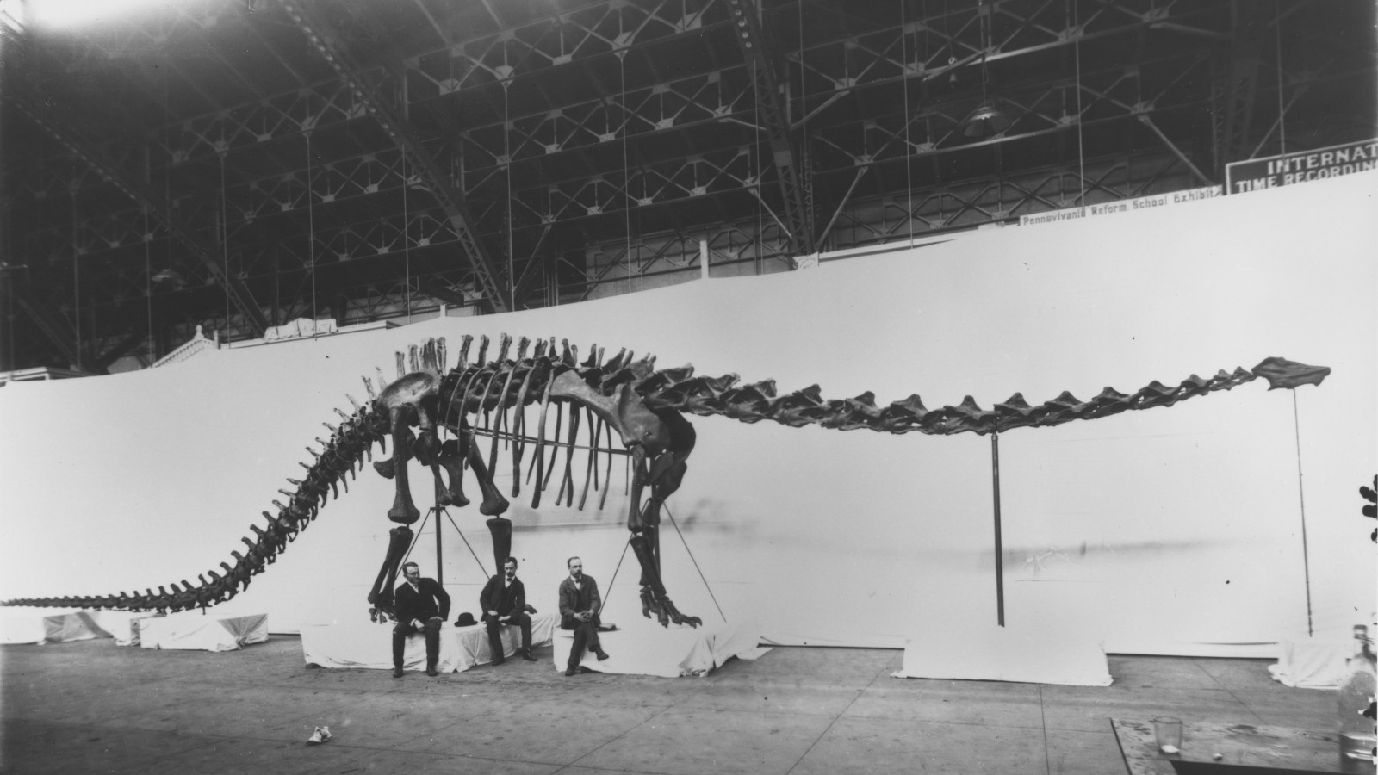
Trial mount of the cast elements
Assembled in June 1904 at Pittsburgh Exposition Society
Shown to invited guests on 29 June
Shown to the public on 30 June
Disassembled on 2 July

Slide 67
Trial mount of the cast elements
Briefly, the world’s first mounted sauropod skeleton.
(The AMNH Brontosaurus was unveiled on 16 February 1905)

Slide 68
Trial mount of the cast elements
The very next day, Hatcher died of typhoid fever.

Slide 69
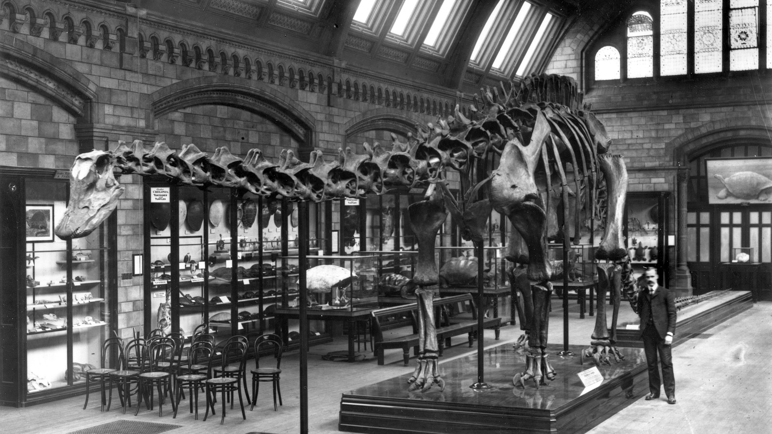
Mounted in London, April 1905

Slide 70
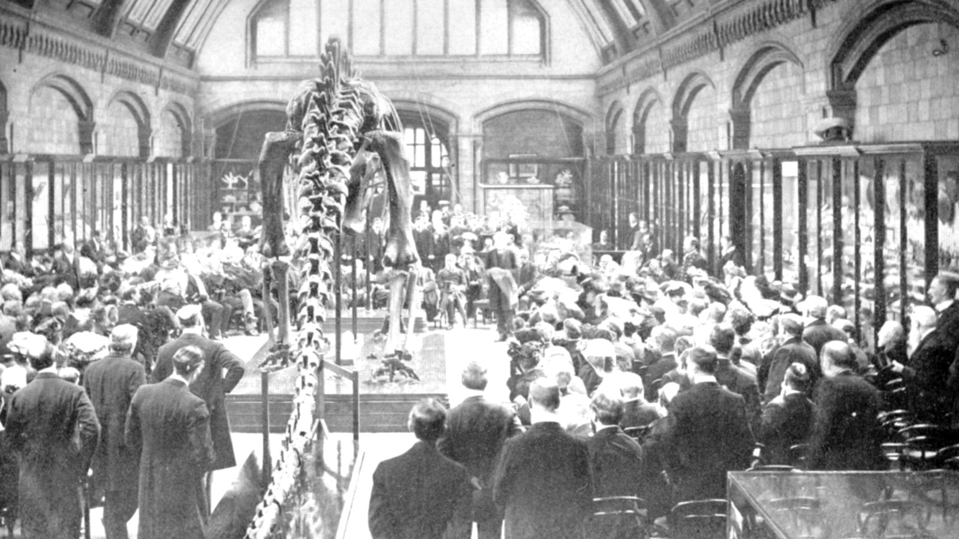
Unveiled on 12 April 1905

Slide 71
Unveiled on 12 April 1905
(The King didn’t turn up.)

Slide 72
Meanwhile, back at the ranch ...

Slide 73
“The work of mounting the original specimen, owing to the great weight of the bones and their extreme brittleness, is a far more difficult task than the work of mounting the replica which is now in the British Museum”
Carnegie Museum annual report, 1906.
(Of course, plaster is lighter than original fossils.)

Slide 74
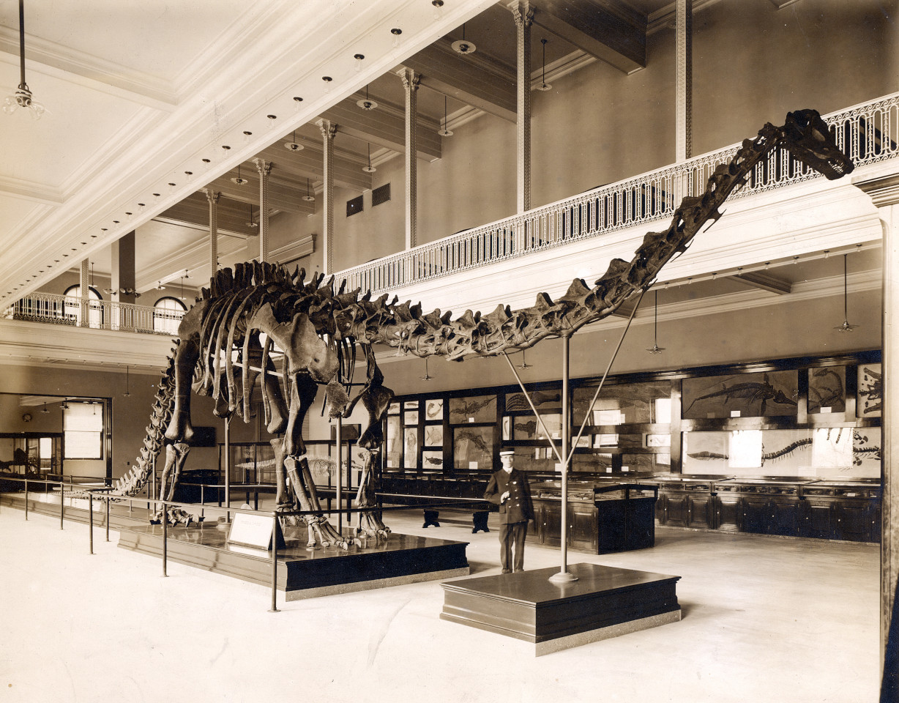
The original
skeleton was
mounted in
1907

Slide 75
The composition of the mounted “skeleton” was complex
Bones
CM 84: neck, torso, ribs, sacrum, 12 proximal caudals, left scapulocoracoid, sternal plates, right ilium, pubes, ischia, left femur

Slide 76
The composition of the mounted “skeleton” was complex
Bones
CM 84: neck, torso, ribs, sacrum, 12 proximal caudals, left scapulocoracoid, sternal plates, right ilium, pubes, ischia, left femur
CM 94: right scapulocoracoid, lower right hindlimb and much of the tail

Slide 77
The composition of the mounted “skeleton” was complex
Bones
CM 84: neck, torso, ribs, sacrum, 12 proximal caudals, left scapulocoracoid, sternal plates, right ilium, pubes, ischia, left femur
CM 94: right scapulocoracoid, lower right hindlimb and much of the tail
CM 307: the rest of the tail

Slide 78
The composition of the mounted “skeleton” was complex
Bones
CM 84: neck, torso, ribs, sacrum, 12 proximal caudals, left scapulocoracoid, sternal plates, right ilium, pubes, ischia, left femur
CM 94: right scapulocoracoid, lower right hindlimb and much of the tail
CM 307: the rest of the tail
CM 33985: lower left hindlimb

Slide 79
The composition of the mounted “skeleton” was complex
Bones
CM 84: neck, torso, ribs, sacrum, 12 proximal caudals, left scapulocoracoid, sternal plates, right ilium, pubes, ischia, left femur
CM 94: right scapulocoracoid, lower right hindlimb and much of the tail
CM 307: the rest of the tail
CM 33985: lower left hindlimb
CM 21775: left forelimb

Slide 80
The composition of the mounted “skeleton” was complex
Bones
CM 84: neck, torso, ribs, sacrum, 12 proximal caudals, left scapulocoracoid, sternal plates, right ilium, pubes, ischia, left femur
CM 94: right scapulocoracoid, lower right hindlimb and much of the tail
CM 307: the rest of the tail
CM 33985: lower left hindlimb
CM 21775: left forelimb
Sculptures
CM 662: sculpted right forelimb
AMNH 965: sculpted forefeet
CM 662: sculpted braincase
USNM 2673: sculpted remainder of skull
Pure sculpture: axis, left ilium, femur and tibia

Slide 81
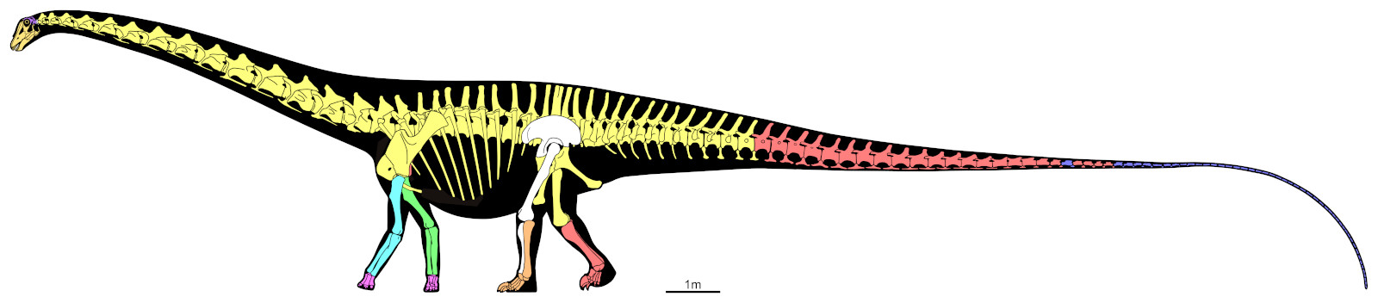
The composition of the mounted “skeleton” was complex
CM 84: neck, torso, ribs, sacrum, 12 proximal caudals, left scapulocoracoid, sternal plates, right ilium, pubes, ischia, left femur
CM 94: right scapulocoracoid, lower right hindlimb and much of the tail
CM 307: the rest of the tail
CM 33985: lower left hindlimb
CM 21775: left forelimb
Sculptures
CM 662: sculpted right forelimb
AMNH 965: sculpted forefeet
CM 662: sculpted braincase
USNM 2673: sculpted remainder of skull
Based on skeletal reconstruction by Scott Hartman
Used by permission

Slide 82
The composition of the mounted “skeleton” was complex
Bones
CM 84: neck, torso, ribs, sacrum, 12 proximal caudals, left scapulocoracoid, sternal plates, right ilium, pubes, ischia, left femur
CM 94: right scapulocoracoid, lower right hindlimb and much of the tail
CM 307: the rest of the tail
CM 33985: lower left hindlimb
CM 21775: left forelimb
Sculptures
CM 662: sculpted right forelimb
AMNH 965: sculpted forefeet
CM 662: sculpted braincase
USNM 2673: sculpted remainder of skull
Pure sculpture: axis, left ilium, femur and tibia

Slide 83
The composition of the mounted “skeleton” was complex
Bones
CM 84: neck, torso, ribs, sacrum, 12 proximal caudals, left scapulocoracoid, sternal plates, right ilium, pubes, ischia, left femur
CM 94: right scapulocoracoid, lower right hindlimb and much of the tail
CM 307: the rest of the tail
CM 33985: lower left hindlimb
CM 21775: left forelimb
Sculptures
CM 662: sculpted right forelimb
AMNH 965: sculpted forefeet
CM 662: sculpted braincase
USNM 2673: sculpted remainder of skull
Pure sculpture: axis, left ilium, femur and tibia
Something
wrong here

Slide 84
The composition of the mounted “skeleton” was complex
Bones
CM 84: neck, torso, ribs, sacrum, 12 proximal caudals, left scapulocoracoid, sternal plates, right ilium, pubes, ischia, left femur
CM 94: right scapulocoracoid, lower right hindlimb and much of the tail
CM 307: the rest of the tail
CM 33985: lower left hindlimb
CM 21775: left forelimb
Sculptures
CM 662: sculpted right forelimb
AMNH 965: sculpted forefeet
CM 662: sculpted braincase
USNM 2673: sculpted remainder of skull
Pure sculpture: axis, left ilium, femur and tibia
Missing: clavicles, interclavicle, sternal ribs, gastralia

Slide 85
Missing: clavicles, interclavicle, sternal ribs, gastralia

Slide 86
Missing: clavicles, interclavicle, sternal ribs, gastralia

Slide 87
Missing: clavicles, interclavicle, sternal ribs, gastralia

Slide 88
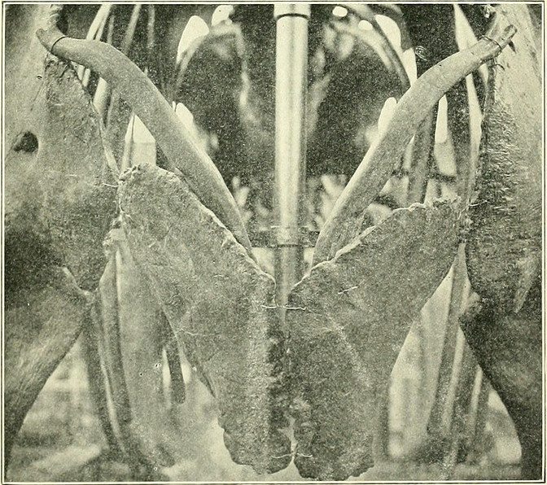

Slide 90
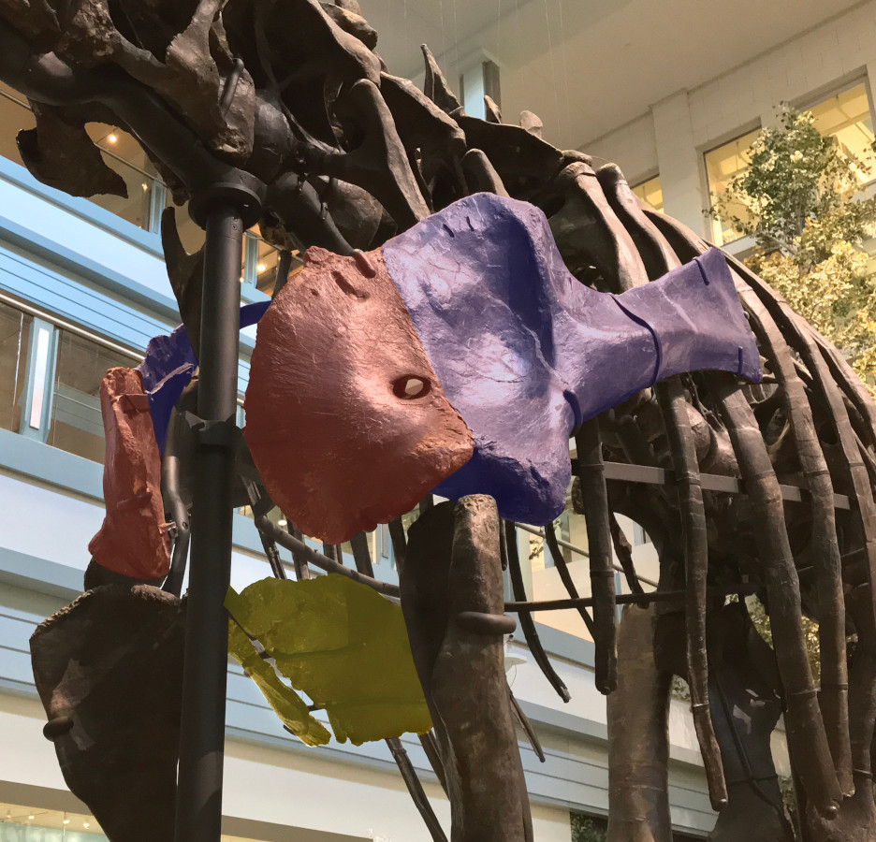

Slide 92
?
?

Slide 93
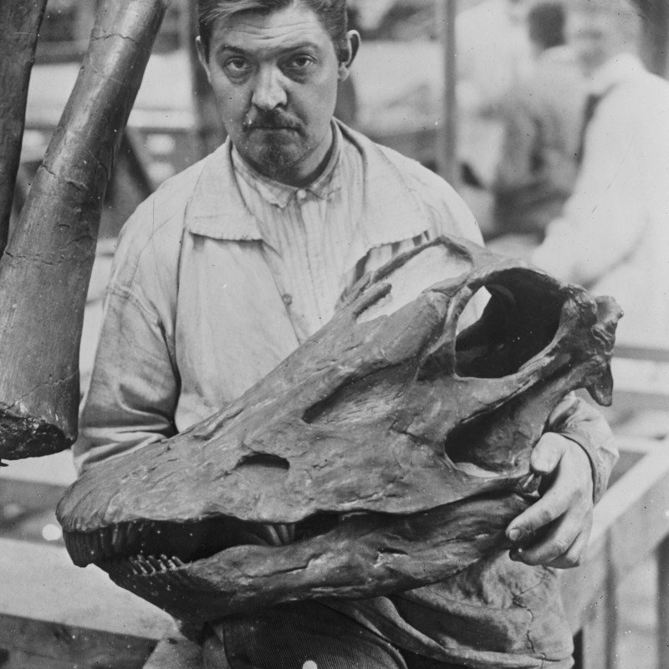
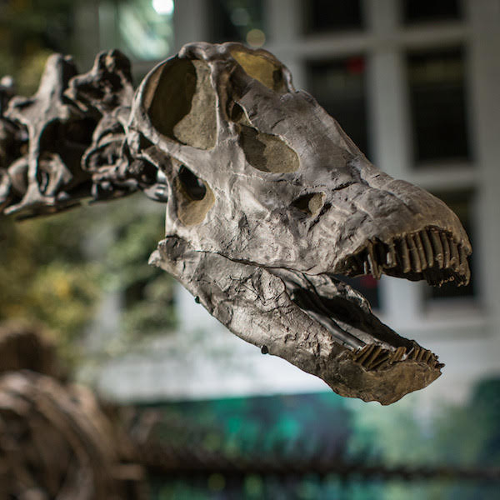
Skull replacement (between 1912 and 1947)
CM 662 braincase +
USNM 2673 remainder of skull
→
CM 11161 skull

Slide 94
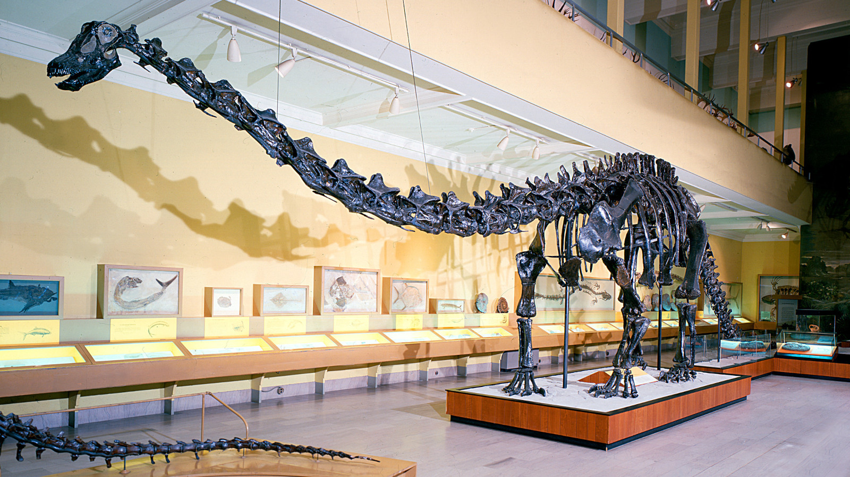
Suspension of neck
(some time before 1999)

Slide 95
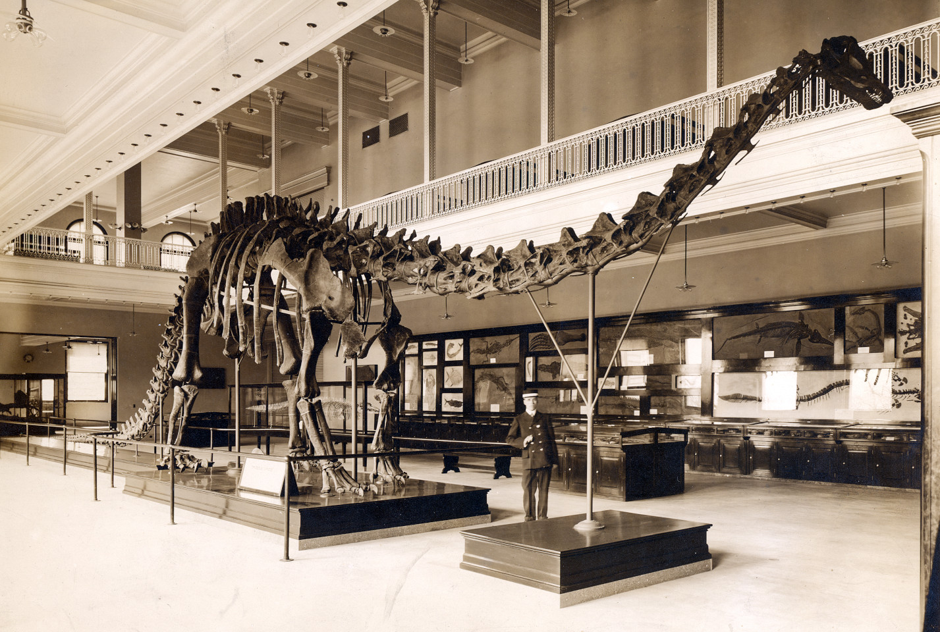
Forelimb problems

Slide 96
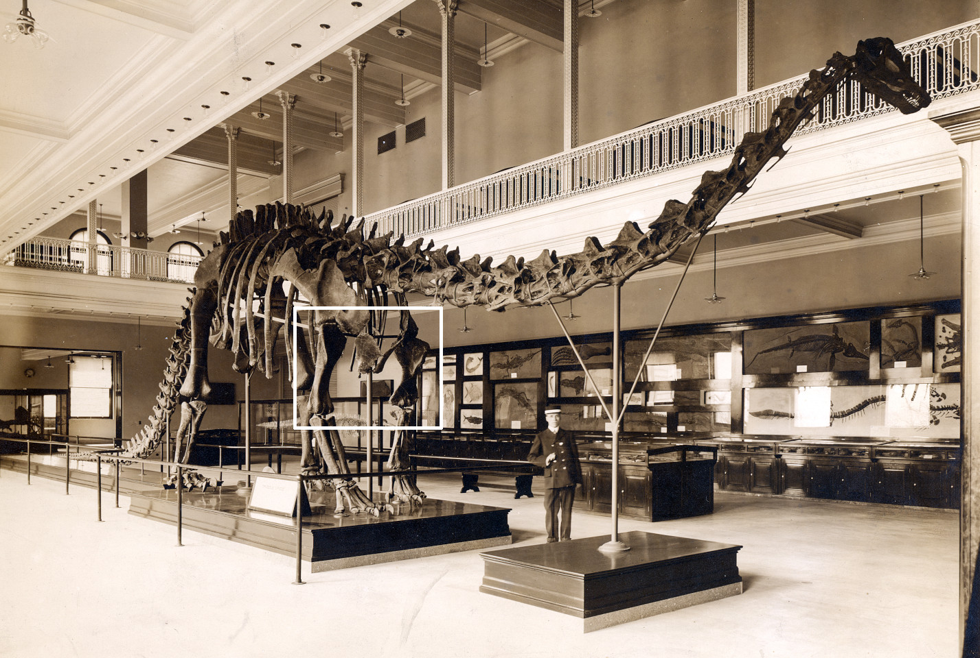
Forelimb problems

Slide 97

Forelimb problems

Slide 98

Diplodocus sp. AMNH 5855
left humerus, anterior view (reversed)
(Mook 1917:figure 2A)

Slide 99

Camarasaurus supremus AMNH 5761/H.2
left humerus, anterior view
(Osborn and Mook 1921:figure 84B)

Slide 100

Forelimb replacement from DMNS 1494?
Denver Museum of Nature and Science

Slide 101
Forelimb replacement from DMNS 1494?
Denver Museum of Nature and Science
But its forelimbs were
casts from the original
Carnegie mount!

Slide 102

Forelimb replacement
2007
BYU 681 scaled sculptures

Slide 103
Forefoot problems

Slide 104
Forefoot problems

Slide 105

Forefoot epic part 1.
Original Paris mount
AMNH 965 camarasaurid

Slide 106

Forefoot epic part 2.
2007 re-pose at HMN
AMNH 965 camarasaurid

Slide 107

Forefoot epic part 3.
1999 forefoot update
CM 662 “Diplodocus” hayi
(= Galeamopus hayi)

Slide 108

Forefoot epic part 4.
2007 remount
WDC-FS001A
Referred to D. carnegii
but probably not Diplodocus.
(From Wyoming Dinosaur Center.)

Slide 109

During remounting at Phil Fraley Productions studio, 2007

Slide 110

The remounted skeleton, photo in 2020

Slide 111

Total length of the mounted skeleton
Source Length (feet) Length (m) Comments
Hatcher (1901) 68 feet 20.7 m Tip of snout to caudal 37

Slide 112

Total length of the mounted skeleton
Source Length (feet) Length (m) Comments
Hatcher (1901) 68 feet 20.7 m Tip of snout to caudal 37
Holland (1904a) 78–80 feet 21.3–24.4 m London mount, predicted
Holland (1904b) 84–85 feet 25.6–25.9 m London mount
Holland (1904b) 78–80 feet 21.3–24.4 m London mount
Holland (1905) 84 feet 25.6 m London mount
Holland (1907) 78.5 feet 23.94 m Berlin mount.

Slide 113
Total length of the mounted skeleton
Source Length (feet) Length (m) Comments
Hatcher (1901) 68 feet 20.7 m Tip of snout to caudal 37
Holland (1904a) 78–80 feet 21.3–24.4 m London mount, predicted
Holland (1904b) 84–85 feet 25.6–25.9 m London mount
Holland (1904b) 78–80 feet 21.3–24.4 m London mount
Holland (1905) 84 feet 25.6 m London mount
Holland (1907) 78.5 feet 23.94 m Berlin mount.
Untermann (1959) 76 feet 23.2 m Vernal mount
David Letasi (p.c.) 75 feet 22.9 m Lehi elements, laid out
Vincent Reneleau (p.c.) 77 feet 23.5 m Distance along floor

Slide 114

Total length of the mounted skeleton
Source Length (feet) Length (m) Comments
Hatcher (1901) 68 feet 20.7 m Tip of snout to caudal 37
Holland (1904a) 78–80 feet 21.3–24.4 m London mount, predicted
Holland (1904b) 84–85 feet 25.6–25.9 m London mount
Holland (1904b) 78–80 feet 21.3–24.4 m London mount
Holland (1905) 84 feet 25.6 m London mount
Holland (1907) 78.5 feet 23.94 m * Berlin mount.
Untermann (1959) 76 feet 23.2 m Vernal mount
David Letasi (p.c.) 75 feet 22.9 m Lehi elements, laid out
Vincent Reneleau (p.c.) 77 feet 23.5 m Distance along floor
Falkingham Photogram. 85.5 feet 26.05 m Current Carnegie mount

Slide 115

Total length of the mounted skeleton
Source Length (feet) Length (m) Comments
Hatcher (1901) 68 feet 20.7 m Tip of snout to caudal 37
Holland (1904a) 78–80 feet 21.3–24.4 m London mount, predicted
Holland (1904b) 84–85 feet 25.6–25.9 m London mount
Holland (1904b) 78–80 feet 21.3–24.4 m London mount
Holland (1905) 84 feet 25.6 m London mount
Holland (1907) 78.5 feet 23.94 m Berlin mount.
Untermann (1959) 76 feet 23.2 m Vernal mount
David Letasi (p.c.) 75 feet 22.9 m Lehi elements, laid out
Vincent Reneleau (p.c.) 77 feet 23.5 m Distance along floor
Falkingham Photogram. 85.5 feet 26.05 m Current Carnegie mount
Eye-Bot LIDAR 85 feet, 9 in 26.13 m Current Carnegie mount

Slide 116
Total length of the mounted skeleton
Source Length (feet) Length (m) Comments
Hatcher (1901) 68 feet 20.7 m Tip of snout to caudal 37
Holland (1904a) 78–80 feet 21.3–24.4 m London mount, predicted
Holland (1904b) 84–85 feet 25.6–25.9 m London mount
Holland (1904b) 78–80 feet 21.3–24.4 m London mount
Holland (1905) 84 feet 25.6 m London mount
Holland (1907) 78.5 feet 23.94 m Berlin mount.
Untermann (1959) 76 feet 23.2 m Vernal mount
David Letasi (p.c.) 75 feet 22.9 m Lehi elements, laid out
Vincent Reneleau (p.c.) 77 feet 23.5 m Distance along floor
Falkingham Photogram. 85.5 feet 26.05 m Current Carnegie mount
Eye-Bot LIDAR 85 feet, 9 in 26.13 m Current Carnegie mount
Consensus: old mount about 23 m, new mount 26 m.

Slide 117
Casts were sent around the world in the early 1900s.
Natural History Museum | London | England | 12 May 1905
Museum für Naturkunde Berlin | Berlin | Germany | 13 May 1908
Muséum National d’Histoire Naturelle | Paris | France | 15 June 1908
Kaiserliches und königliches naturhistorisches Hof-Museum | Vienna | Austria | 24 September 1909
Giovanni Capellini Museum for Paleontology and Geology | Bologna | Italy | 27 October 1909
The Imperial Museum | St. Petersburg | Russia | Early July 1910
Museo de La Plata | La Plata | Argentina | 1912
Museo Nacional de Ciencias Naturales | Madrid | Spain | 2 December 1913
Museo de Paleontología (UNAM) | Mexico City | Mexico | 1930
Staatssammlung für Paläontologie und Geologie | Munich | Germany | 1934 (never mounted)

Slide 118
We’ve already seen the London cast (1905)

Slide 119
The Berlin cast (1908)

Slide 120
The Paris cast (1908)

Slide 121
The Vienna cast (1909)

Slide 122
The Bologna cast (1909)

Slide 123
The Russian cast (1910)

Slide 124
The La Plata cast (1912)

Slide 125
The Madrid cast (1913)

Slide 126
Carnegie died in 1919
Broken by the outbreak of WWI.

Slide 127
The Mexico City cast (1930)

Slide 128
Casts were sent around the world in the early 1900s.
Natural History Museum | London | England | 12 May 1905
Museum für Naturkunde Berlin | Berlin | Germany | 13 May 1908
Muséum National d’Histoire Naturelle | Paris | France | 15 June 1908
Kaiserliches und königliches naturhistorisches Hof-Museum | Vienna | Austria | 24 September 1909
Giovanni Capellini Museum for Paleontology and Geology | Bologna | Italy | 27 October 1909
The Imperial Museum | St. Petersburg | Russia | Early July 1910
Museo de La Plata | La Plata | Argentina | 1912
Museo Nacional de Ciencias Naturales | Madrid | Spain | 2 December 1913
Museo de Paleontología (UNAM) | Mexico City | Mexico | 1930
Staatssammlung für Paläontologie und Geologie | Munich | Germany | 1934 (never mounted)

Slide 129
Casts were sent around the world in the early 1900s.
Natural History Museum | London | England | 12 May 1905
Museum für Naturkunde Berlin | Berlin | Germany | 13 May 1908
Muséum National d’Histoire Naturelle | Paris | France | 15 June 1908
Kaiserliches und königliches naturhistorisches Hof-Museum | Vienna | Austria | 24 September 1909
Giovanni Capellini Museum for Paleontology and Geology | Bologna | Italy | 27 October 1909
The Imperial Museum | St. Petersburg | Russia | Early July 1910
Museo de La Plata | La Plata | Argentina | 1912
Museo Nacional de Ciencias Naturales | Madrid | Spain | 2 December 1913
Museo de Paleontología (UNAM) | Mexico City | Mexico | 1930
Staatssammlung für Paläontologie und Geologie | Munich | Germany | 1934 (never mounted)

Slide 130

1934 was
not a great
time in
Germany

Slide 131

Spinosaurus aegyptiacus holotype BSP 1912 VIII 19

Slide 132
Spinosaurus destroyed by allied bombs in April 1944

Slide 133

Diplodocus taken to abandoned convent

Slide 134

Diplodocus taken to abandoned convent

Slide 135

… and the documentation lost

Slide 136


Hippie parties in the 1960s

Slide 137
Casts were sent around the world in the early 1900s.
Natural History Museum | London | England | 12 May 1905
Museum für Naturkunde Berlin | Berlin | Germany | 13 May 1908
Muséum National d’Histoire Naturelle | Paris | France | 15 June 1908
Kaiserliches und königliches naturhistorisches Hof-Museum | Vienna | Austria | 24 September 1909
Giovanni Capellini Museum for Paleontology and Geology | Bologna | Italy | 27 October 1909
The Imperial Museum | St. Petersburg | Russia | Early July 1910
Museo de La Plata | La Plata | Argentina | 1912
Museo Nacional de Ciencias Naturales | Madrid | Spain | 2 December 1913
Museo de Paleontología (UNAM) | Mexico City | Mexico | 1930
Staatssammlung für Paläontologie und Geologie | Munich | Germany | 1934 (never mounted)

Slide 138
Casts were sent around the world in the early 1900s.
Natural History Museum | London | England | 12 May 1905
Museum für Naturkunde Berlin | Berlin | Germany | 13 May 1908
Muséum National d’Histoire Naturelle | Paris | France | 15 June 1908
Kaiserliches und königliches naturhistorisches Hof-Museum | Vienna | Austria | 24 September 1909
Giovanni Capellini Museum for Paleontology and Geology | Bologna | Italy | 27 October 1909
The Imperial Museum | St. Petersburg | Russia | Early July 1910
Museo de La Plata | La Plata | Argentina | 1912
Museo Nacional de Ciencias Naturales | Madrid | Spain | 2 December 1913
Museo de Paleontología (UNAM) | Mexico City | Mexico | 1930
Staatssammlung für Paläontologie und Geologie | Munich | Germany | 1934 (never mounted)
Molds unused since
1930 or even 1910.

Slide 139

Episode IV:
A New Hope
In 1952,
Carnegie curator
LeRoy “Pop” Kay
donated the molds
to the Field House
in Vernal.

Slide 140

Untermanns
Ernest Untermann,
Museum Director.
— and —
Billie Untermann,
Staff Scientist.

Slide 141

Assembling
the
concrete
cast
Ernest
Billie

Slide 142

Assembling
the
concrete
cast

Slide 143

Cultural
icon of
Utah
1957–89

Slide 144

A cultural icon of Utah
G. Ernest Untermann,
Vernal Express
19 December 1957.

Slide 145
A cultural icon of Utah
Without benefit of seductive curves or a “come hither look”, “Dippy” the 76 foot long skeleton of the dinosaur Diplodocus, standing out on the lawn on the Utah Field House of Natural History, dazzles and delights the tourists, known to the trade as “dudes”.
G. Ernest Untermann,
Vernal Express
19 December 1957.

Slide 146
A cultural icon of Utah
Without benefit of seductive curves or a “come hither look”, “Dippy” the 76 foot long skeleton of the dinosaur Diplodocus, standing out on the lawn on the Utah Field House of Natural History, dazzles and delights the tourists, known to the trade as “dudes”.
As a motorist pulls up to the curb, father hardly has time to set the brake, before the entire family erupts from the car and dashes across the lawn to charge Dippy amid gleeful squeals.
G. Ernest Untermann,
Vernal Express
19 December 1957.

Slide 147
A cultural icon of Utah
Without benefit of seductive curves or a “come hither look”, “Dippy” the 76 foot long skeleton of the dinosaur Diplodocus, standing out on the lawn on the Utah Field House of Natural History, dazzles and delights the tourists, known to the trade as “dudes”.
As a motorist pulls up to the curb, father hardly has time to set the brake, before the entire family erupts from the car and dashes across the lawn to charge Dippy amid gleeful squeals.
Dippy is the most photographed object on U.S. Highway No. 40, between Salt Lake City and Denver. Although he was “born” only six months ago he had already been photographed thousands of times and has been the subject of as many as seven different camera fans at one time.
G. Ernest Untermann,
Vernal Express
19 December 1957.

Slide 148
A cultural icon of Utah
Without benefit of seductive curves or a “come hither look”, “Doppy” the 76 foot long skeleton of the dinosaur Diplodocus, standing out on the lawn on the Utah Field House of Natural History, dazzles and delights the tourists, known to the trade as “dudes”.
As a motorist pulls up to the curb, father hardly has time to set the brake, before the entire family erupts from the car and dashes across the lawn to charge Dippy amid gleeful squeals.
Dippy is the most photographed object on U.S. Highway No. 40, between Salt Lake City and Denver. Although he was “born” only six months ago he had already been photographed thousands of times and has been the subject of as many as seven different camera fans at one time.
G. Ernest Untermann,
Vernal Express
19 December 1957.

Slide 149

1960s: where will the molds go next?
Inquiries from various countries

Slide 150

1960s: what next for the molds?
Inquiries from various countries

Slide 151

1960s: what next for the molds?
Inquiries from various countries

Slide 152

Shipped to Rocky Mount, NC.

Slide 153

Shipped to Rocky Mount, NC.

Slide 154

What next for the molds? (1968)

Slide 155

An ignominious fate for the molds?

Slide 156

The molds have been traced
to Houston!

Slide 157

The molds have been traced
to Houston!

Slide 158

The molds have been traced
to Houston!

Slide 159

The molds have been traced
to Houston!

Slide 160
1989: concrete cast crumbling
The Vernal climate ranges from
–40˚F to 100˚F (–40˚C to 38˚C).
By the late 1980s it was coming apart.

Slide 161


Episode VI: The Return of the Diplodocus
In 1989, new molds
were made from
the concrete cast.

Slide 162

1994: Lightweight cast at the old Field House, Vernal

Slide 163

1994: Lightweight cast at the old Field House, Vernal

Slide 164

2004: Lightweight cast moved to the new Field House

Slide 165

Other second-generation casts
These now inhabit
Japan (five copies)
Canada,
and several locations
in Florida.

Slide 166

What happened to the concrete cast?
Ten years in collections
at the Prehistoric Museum
in Price, Utah.

Slide 167

What happened to the concrete cast?
Currently on exhibition at the Prehistoric Museum in Price, Utah

Slide 168
What happened to the concrete cast?
Currently on exhibition at the Prehistoric Museum in Price, Utah
Note poor definition

Slide 169

… and finally …
Elements cast from these molds are used
in other mounts

Slide 170

The AMNH’s rearing Barosaurus
Skull, anterior neck, some ribs,
distal tail, chevrons, various limb bones …

Slide 171
The AMNH’s rearing Barosaurus
Skull, anterior neck, some ribs,
distal tail, chevrons, various limb bones …
… were cast from molds
that were taken from a concrete cast
that was made from the molds
that were taken from sculptures
modelled from vertebrae of
the original Carnegie Diplodocus.

Slide 172
For much, much, much more information …
Taylor, Michael P., Amy C. Henrici, Linsly J. Church, Ilja Nieuwland and Matthew C. Lamanna. 2025. The history and composition of the Carnegie Diplodocus. Annals of the Carnegie Museum 91(1):55–91.
doi: 10.2992/007.091.0104
Taylor, Michael P., Steven D. Sroka and Kenneth Carpenter. 2023. The Concrete Diplodocus of Vernal — a Cultural Icon of Utah. Geology of the Intermountain West 10:65–91. doi:10.31711/giw.v10.pp65-91
The skeletal reconstruction of Barosaurus lentus in the American Museum of Natural History. In prep. Taylor, Michael P., Peter May, Lowell Dingus, Eugene S. Gaffney, Mark A. Norell and John S. McIntosh†. Manuscript and illustrations at https://github.com/MikeTaylor/palaeo-baromount

Slide 173
The Untold Story of
the Carnegie Diplodocus
Mike Taylor^{1,*}, Matt Lamanna², Ilja Nieuwland³, Amy Henrici², Linsly Church², Steve Sroka⁴ and Ken Carpenter⁵
1. University of Bristol, Bristol, UK
2. Carnegie Museum of Natural History, Pittsburgh, PA, USA
3. Royal Netherlands Academy of Arts and Sciences, Netherlands
4. Utah Field House of Natural History, Vernal, Utah, USA
5. University of Colorado Museum, Boulder, Colorado, USA

Slide 174
The Untold Story of
the Carnegie Diplodocus
Mike Taylor^{1,*}, Matt Lamanna², Ilja Nieuwland³, Amy Henrici², Linsly Church², Steve Sroka⁴ and Ken Carpenter⁵
1. University of Bristol, Bristol, UK
2. Carnegie Museum of Natural History, Pittsburgh, PA, USA
3. Royal Netherlands Academy of Arts and Sciences, Netherlands
4. Utah Field House of Natural History, Vernal, Utah, USA
5. University of Colorado Museum, Boulder, Colorado, USA
All these co-authors!

Slide 175
The Untold Story of
the Carnegie Diplodocus
Mike Taylor^{1,*}, Matt Lamanna², Ilja Nieuwland³, Amy Henrici², Linsly Church², Steve Sroka⁴ and Ken Carpenter⁵
1. University of Bristol, Bristol, UK
2. Carnegie Museum of Natural History, Pittsburgh, PA, USA
3. Royal Netherlands Academy of Arts and Sciences, Netherlands
4. Utah Field House of Natural History, Vernal, Utah, USA
5. University of Colorado Museum, Boulder, Colorado, USA

Slide 177


